Slide 1

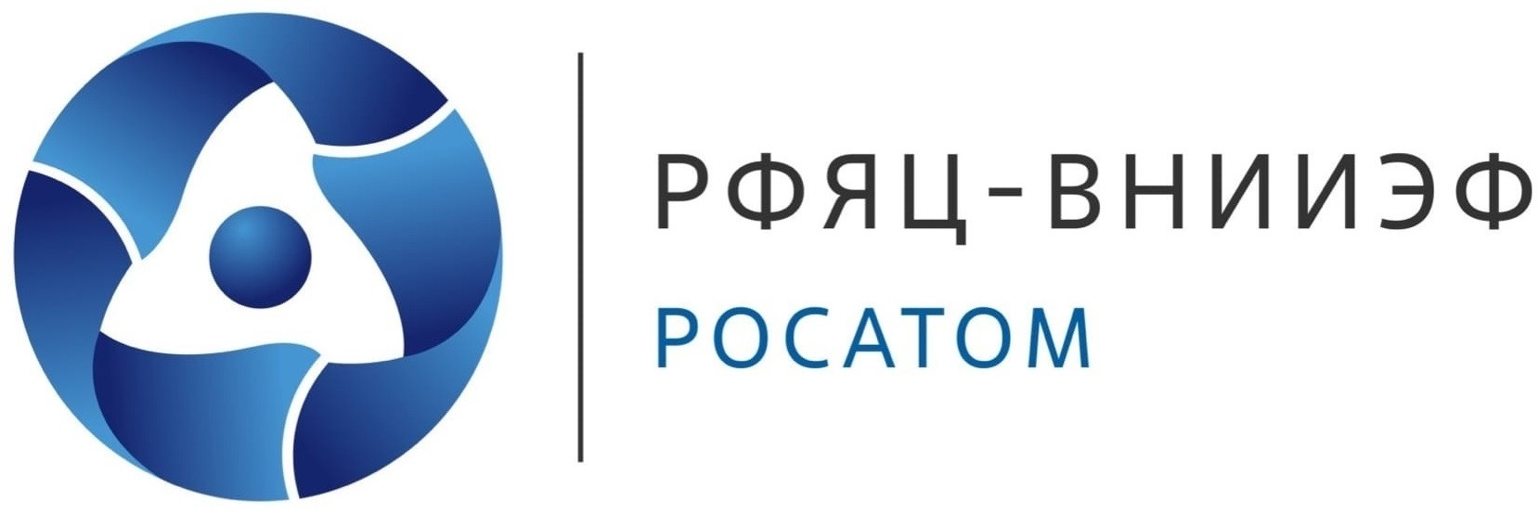


«Practical applications of neutrinos»
V. Efremov, K. Kouzakov, R. Musyaev, A. Studenikin, M. Verkhovtsev , A. Yukhimchuk
RFNC-VNIIEF
National Center for Physics and Mathematics
Lomonosov Moscow State University
Moscow
23.08.2025

Slide 2
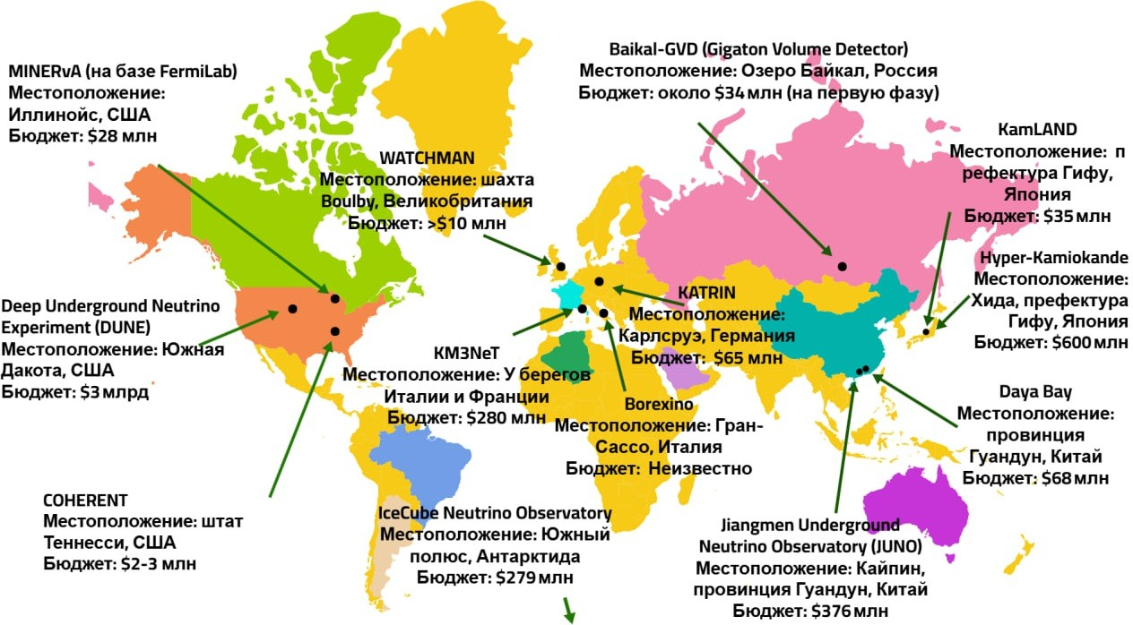
Using neutrinos as a strategic resource of the XXI century
Introduction
Neutrinos are elementary particles that pass through any matter with minimal interaction. Key features of their applied use include: ensuring nuclear safety, developing neutrino communications, and resource exploration and Earth's tomography.
Figure 1. Largest neutrino projects on the world map.
2 / 31

Slide 3
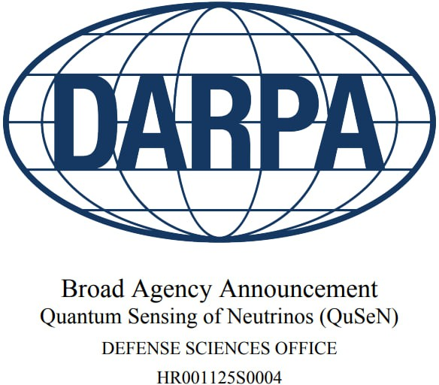
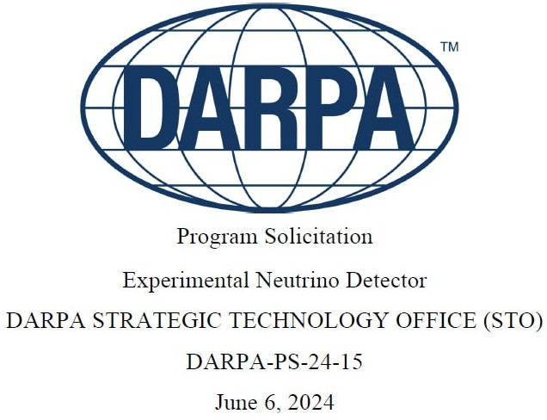
Unprecedented technology race
Introduction
The U.S. Department of Defense's Advanced Research Projects Agency (DARPA) is launching two active programs: Experimental Neutrino Detector and QuSeN (Quantum Sensing of Neutrinos), with durations of 18 and 30 months, respectively.
Sources:
Quantum Sensing of Neutrinos (QuSeN): Broad Agency Announcement / Defense Advanced Research Projects Agency, Defense Sciences Office. — Arlington: DARPA, 2024. — HR001125S0004. — URL: https://www.darpa.mil/work‐with‐us/opportunities.
Experimental Neutrino Detector: Program Solicitation / Defense Advanced Research Projects Agency, Strategic Technology Office. — Arlington: DARPA, 2024. —
DARPA‐PS‐24‐15. — URL:https://www.darpa.mil/work‐with‐us/opportunitie
3 / 31

Slide 4
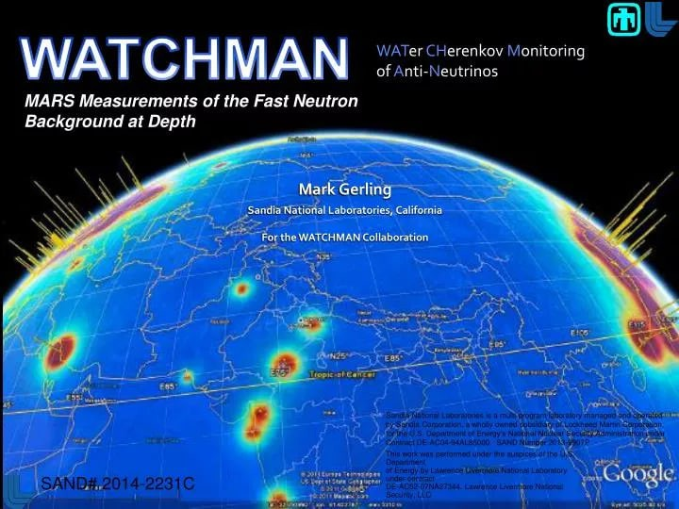
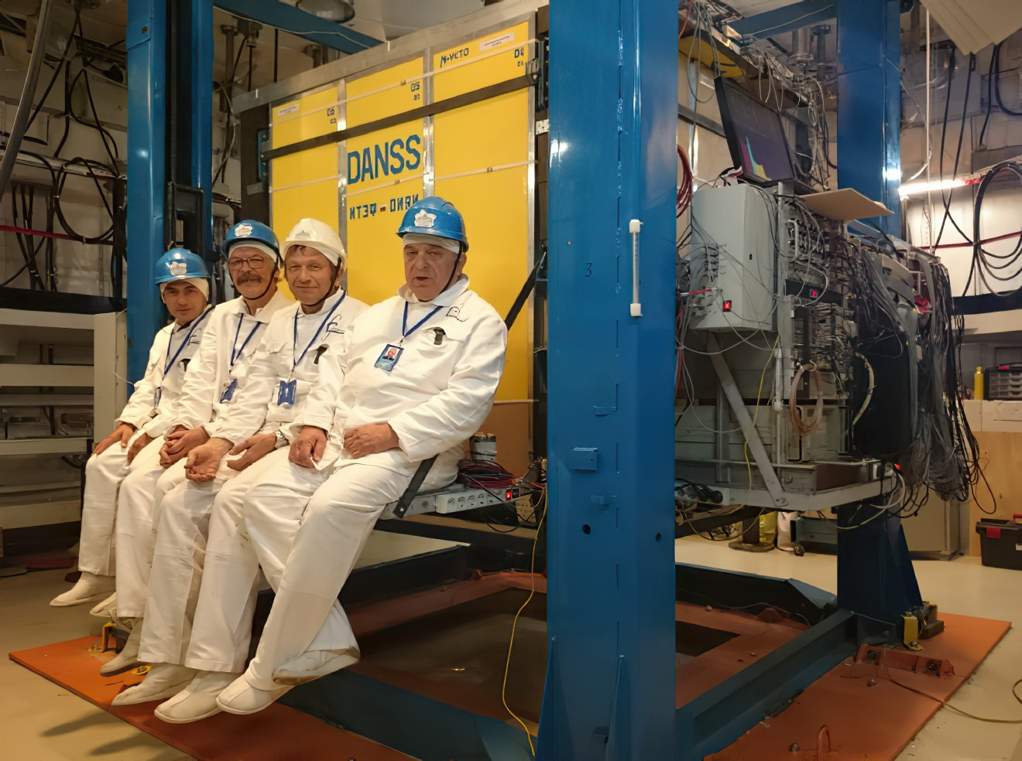
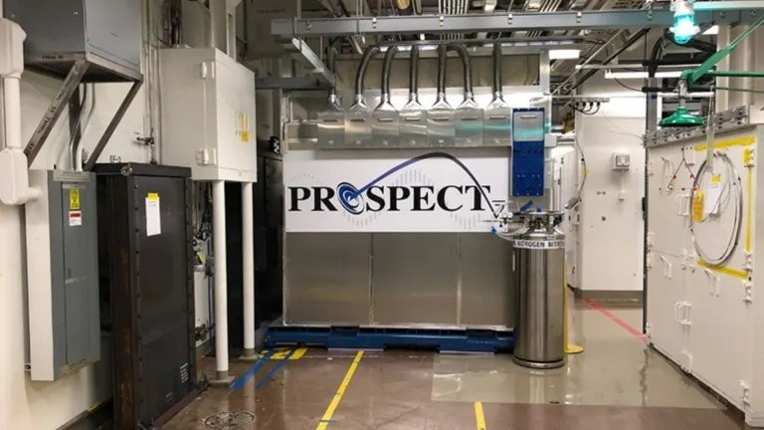

Introduction
Unprecedented technology race
4 / 31

Slide 5
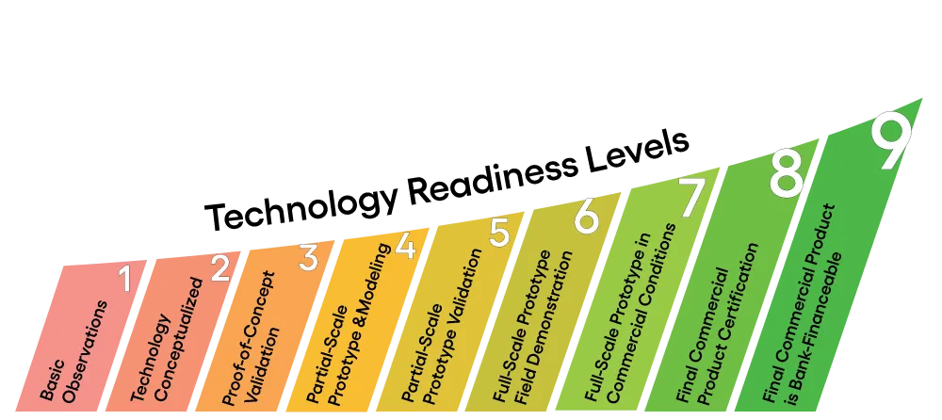
Technology Readiness Level
Introduction
Figure 2. Technology Readiness Level (TRL) — A scale that assesses the maturity of a technology during its conceptualization, development, and application stages.
5 / 31

Slide 6
Key directions for the development of neutrino technologies
Introduction
The most important directions for the development of neutrino technologies are:
- ensuring national security through nuclear activity control;
- development of secure communication and navigation systems;
- achieving energy and resource independence through revolutionary geological exploration methods.
6 / 31

Slide 7
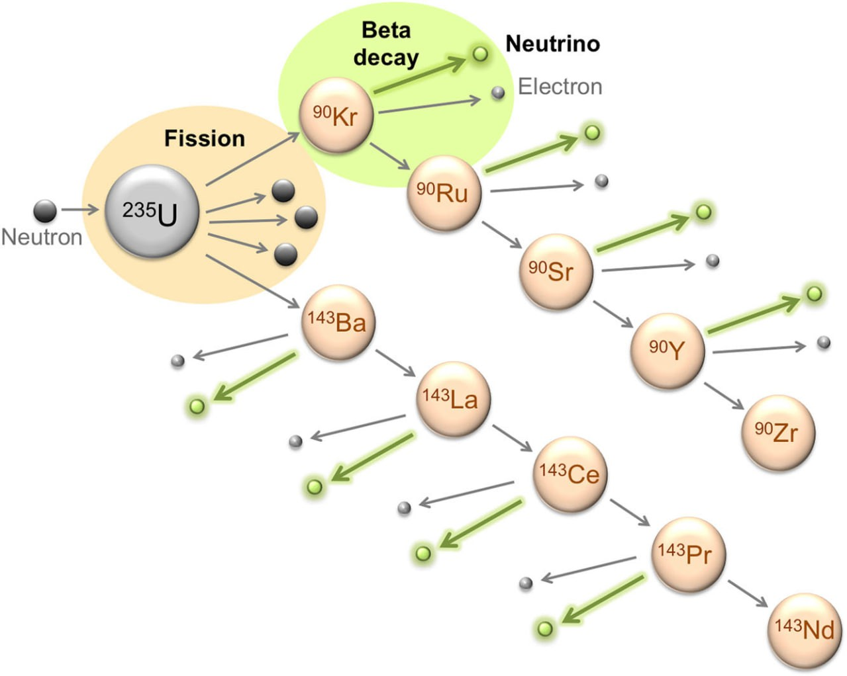
Physical principles of the nuclear activity control method
Ensuring national security
Control of nuclear activities — a new era of transparency
Figure 3. Example of a beta-decay chain of fission fragments leading to the emission of 8 neutrinos.
The physical basis of the method lies in detecting antineutrinos from the beta-decay of fission products. Each fission event of uranium-235 or plutonium-239 is accompanied by the emission of an average of 6 antineutrinos with a characteristic spectrum.
7 / 31

Slide 8
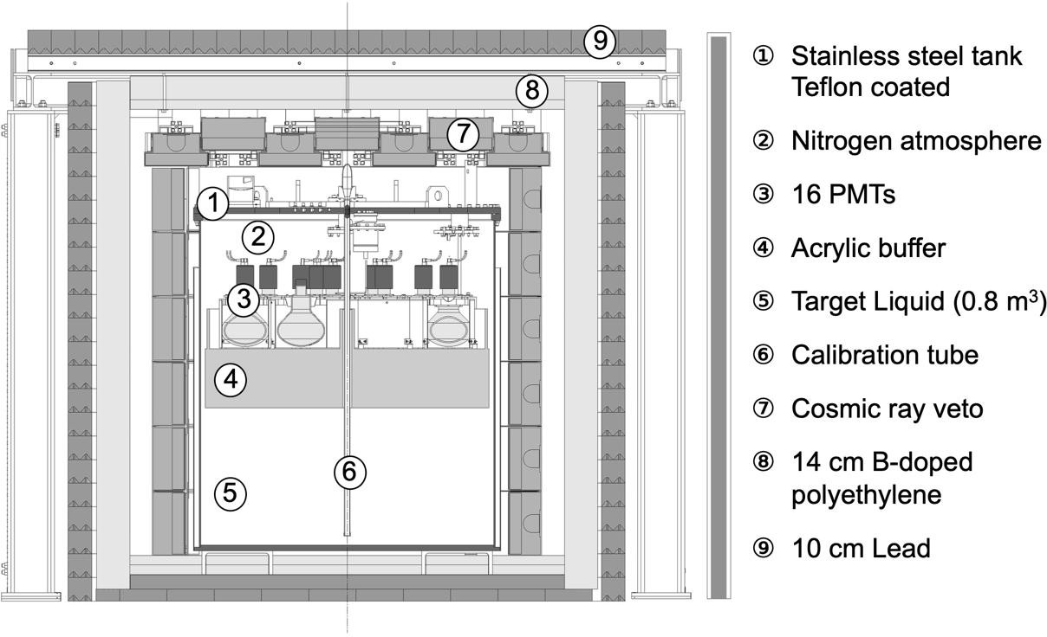
Proof of reactor monitoring feasibility. NUCIFER experiment
Ensuring national security
Control of nuclear activities — a new era of transparency
Figure 4. Cross-section of the NUCIFER detector.
The NUCIFER detector, weighing less than a ton, placed 7 meters from the 70 MW OSIRIS reactor, accumulated over 40,000 events from 2012 to 2015. The relative error in power determination was 1% per week without access to the reactor core.
Source: Boireau G. et al. Online monitoring of the Osiris reactor with the Nucifer neutrino detector // Physical Review D. — 2016. — Vol. 93. — P. 112006. —
DOI: 10.1103/PhysRevD.93.112006. 8 / 31

Slide 9
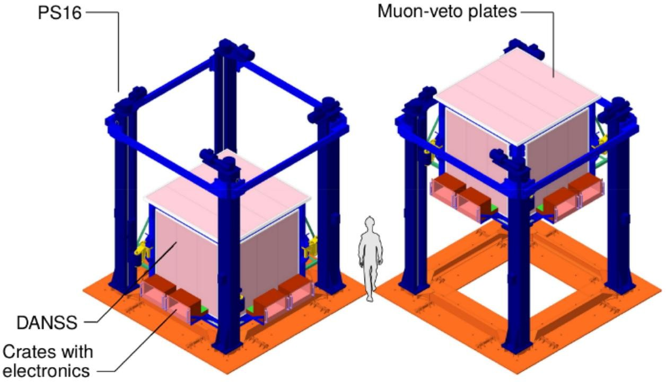
Monitoring of the Kalinin Nuclear Power Plant. DANSS detector
Detector of the reactor AntiNeutrino based on Solid Scintillator
Ensuring national security
Control of nuclear activities — a new era of transparency
7 years of continuous operation
(since 2016)
- 5000 events daily;
- Accuracy: 1% per week;
- Sensitive volume 1 m³, 2500
scintillator strips.
Fuel burnup control:
- Determination of ²³⁵U and ²³⁹Pu;
- Accuracy 2‐3% per week;
- Real-time monitoring.
Figure 5. Diagram of the DANSS detector.
Key achievement
Record accuracy in monitoring the isotopic composition of the reactor core.
Source: Alekseev I. G. et al. The DANSS Experiment: Recent Results and Perspective // Bulletin of the Lebedev Physics Institute. — 2024. — Vol. 51, № 1. — P. 8–15. — DOI:10.3103/S1068335623601796.
9 / 31

Slide 10
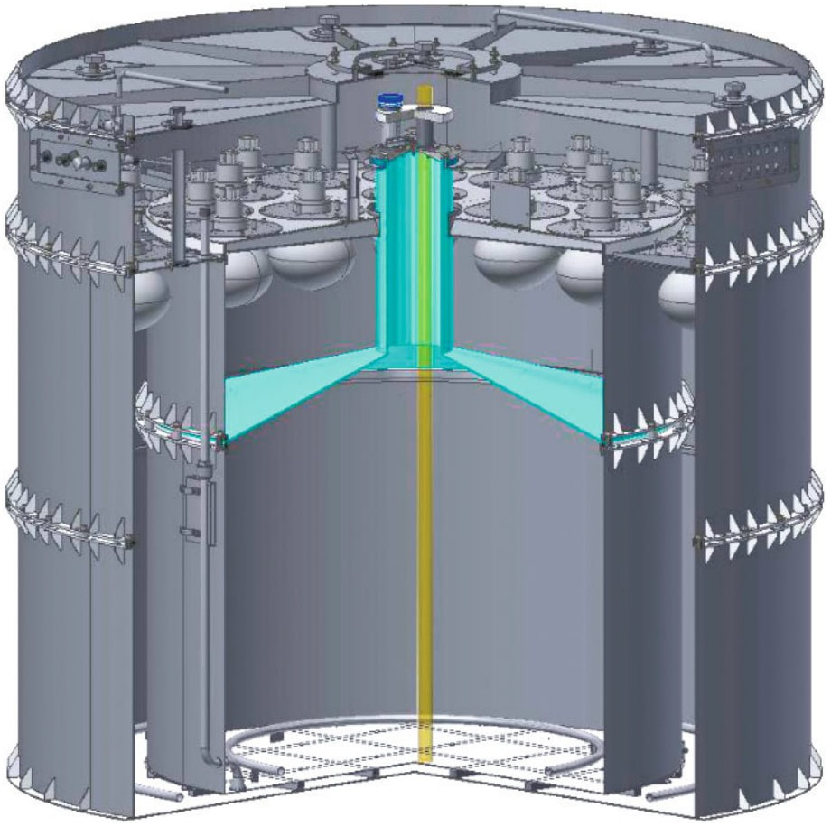
Monitoring of the Kalinin Nuclear Power Plant. iDREAM detector
Industrial Detector of REactor Antineutrinos for Monitoring
Ensuring national security
Control of nuclear activities — a new era of transparency
Technical parameters:
- Distance: 20 m from VVER‐1000;
- Volume: 1,1 m³ liquid scintillator LAB + 0,1% Gd;
- launch: 2021.
Results (2021‐2022):
- 1584 ± 10 events/day;
- 101.7 days of data;
- neutron capture time: 33 µs.
Figure 6. Sketch of the iDREAM detector.
Key achievement
Direct observation of fuel burnup through changes in antineutrino flux.
Source: Abramov A. A. et al. Antineutrino Signal in the iDREAM Detector at Kalinin NPP // Physics of Atomic Nuclei. — 2024. — Vol. 86. — P. 1389–1393. —
DOI:
10.1134/S1063778824010022.
10 / 31

Slide 11
Operation without underground shielding. PROSPECT experiment
Precision Reactor Oscillation and Spectrum Experiment
Ensuring national security
Control of nuclear activities — a new era of transparency
First successful registration of reactor antineutrinos from the HFIR (High Flux Isotope Reactor, Oak Ridge, Tennessee, USA) on the surface
Detector
Statistics
Accuracy
4 tons
154 segments
⁶Li‐doped scintillator
7-9 m from HFIR
700 𝜈¯_{e}/day
1%/week
power monitoring
2.9°
direction (record!)
70 000+ events
96 days
S/B = 1.7:1
Operation without underground shielding
Differentiation of fuel isotopic composition (93% ²³⁵U)
Key achievement
Compact monitoring system without underground shielding for nuclear safety control
Source: Surukuchi P. T. Improved Short-Baseline 235U Antineutrino Oscillation and Energy Spectrum Measurement Using PROSPECT// arXiv. – 2019. – arXiv:1910.04924.
DOI 10.48550/arXiv.1910.04924.
11 / 31

Slide 12
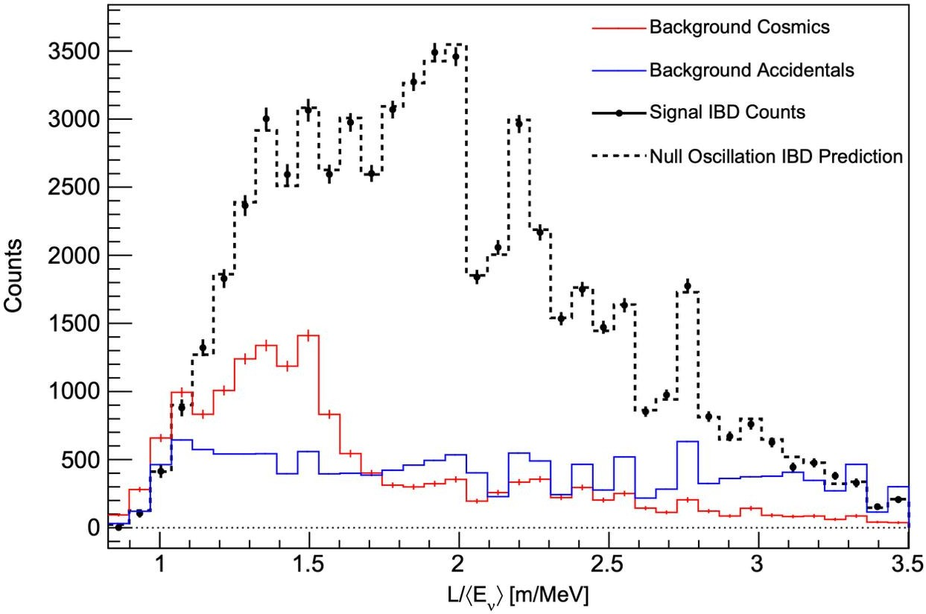
Ensuring national security
Control of nuclear activities — a new era of transparency
Operation without underground shielding. PROSPECT experiment
Precision Reactor Oscillation and Spectrum Experiment
Figure 7. Spectrum of the ratio of distance to average neutrino energy L/⟨E𝜈 ⟩ for inverse beta-decay signals with background subtracted (black dots) and estimated correlated (solid red line) and random (solid blue line) background during HFIR reactor operation periods. The predicted inverse beta-decay signal without oscillations is shown (black dashed line). Error bars represent statistical uncertainties 1𝜎.
12 / 31

Slide 13
Differentiation of isotopic composition. Daya Bay experiment
Ensuring national security
Control of nuclear activities — a new era of transparency
6 commercial reactors (17.4 GW total capacity)
Tracking changes in composition over the fuel cycle:
U‐235: 60% → 40% (burnup)
Pu‐239: 7% → 30% (accumulation)
Differentiation of spectra of different isotopes by the shape of the energy distribution
Technical parameters of the experiment
‐ 8 identical detectors
‐ Detector efficiency: ±0.2%
- Energy calibration: <0.5%
‐ on/off with 5 hours with a probability of over 99%
‐ distance: ∼550 m
‐ 1958 days of observation
‐ 3.5M IBD events
Practical significance:
- Verification of declared fuel composition
- Detection of unauthorized material extraction
- Complements PROSPECT data on pure U-235
Key achievement
Real-time monitoring of fuel evolution
Source: An F. P., Bai W. D., Balantekin A. B. et al. Comprehensive Measurement of the Reactor Antineutrino Spectrum and Flux at Daya Bay // Physical Review Letters. – 2025. Vol. 134. – Art. 201802. – DOI: 10.1103/PhysRevLett.134.201802
13 / 31

Slide 14
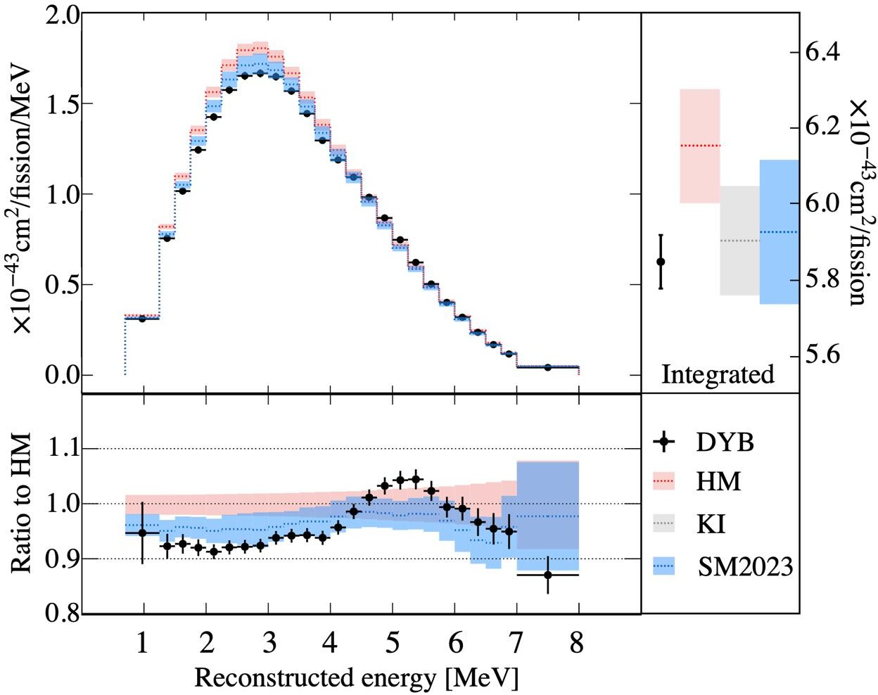
Ensuring national security
Control of nuclear activities — a new era of transparency
Daya Bay experiment
Figure 8. Antineutrino spectrum from commercial reactors (Daya Bay): black dots — experimental data, colored lines — theoretical models (HM, SM2023, KI), lower panel — deviation of data from models. A "bump" in the 5-7 MeV range is visible — the famous reactor anomaly.
14 / 31

Slide 15
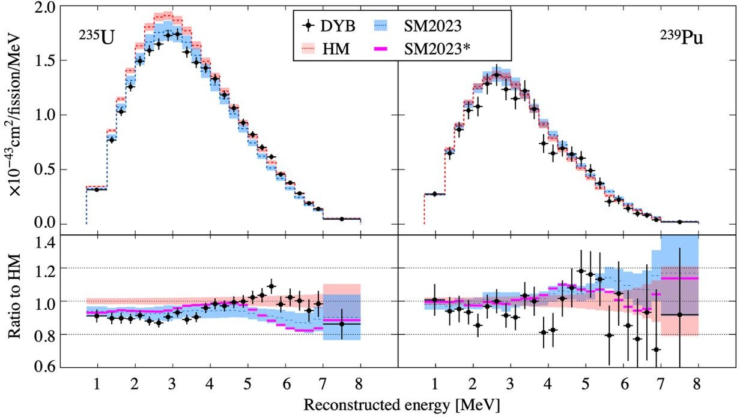
Ensuring national security
Control of nuclear activities — a new era of transparency
Daya Bay experiment
Figure 9. Antineutrino spectra from U-235 (left) and Pu-239 (right): black dots — Daya Bay experimental data, colored lines — theoretical models (HM, SM2023). Lower panels show deviations from the HM model. Differences in the spectra shapes of the two isotopes are visible, enabling fuel composition determination via antineutrino measurements.
15 / 31

Slide 16
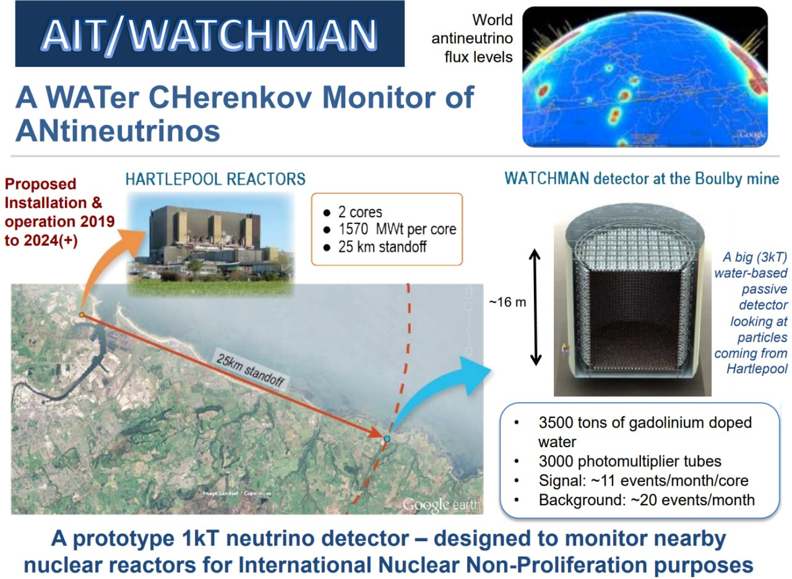
Ensuring national security
Control of nuclear activities — a new era of transparency
Long-range detection. WATCHMAN project
Figure 10. Detector in Boulby for monitoring Hartlepool Nuclear Power Station at a distance of 25 km
Source: Grant C. et al. WATCHMAN: A Remote Reactor Monitor and Advanced Instrumentation Testbed // J. Phys.: Conf. Ser. – 2020. – Vol. 1468, No 1. – Art. 012182. –
DOI: 10.1088/1742‐6596/1468/1/012182. 16 / 31

Slide 17
On the path to detecting submarines?
Ensuring national security
Neutrino technologies for detecting nuclear submarines
Revolutionary method: detection of shut-down reactors
Key innovation: registration of antineutrinos from Ce‐144 and Ru‐106
‐ Ce‐144: T_{1/2} = 285 days
‐ Ru‐106: T_{1/2} = 374 days
‐ dominate 2-3 years after reactor shutdown
Detector requirements:
‐ Fuel extraction: 100 kg
‐ Enrichment control: 10 tons
‐ Distance: 25‐100 m
‐ Detection probability: 90%
‐ False positives: 5%
Unique advantages:
‐ Impossible to shield
‐ No access to the vessel required
‐ Preservation of military secrets
‐ Continuous monitoring
‐ Reactor operation history
Practical application
Critically important for the AUKUS agreement — control of nuclear submarine technology transfer to Australia without compromising military secrecy
Source: Cogswell B. K., Huber P. Cerium Ruthenium Low‐Energy Antineutrino Measurements for Safeguarding Military Naval Reactors // Physical Review Letters. – 2022.– Т. 128, № 24. – С. 241803. – DOI: 10.1103/PhysRevLett.128.241803
17 / 31

Slide 18
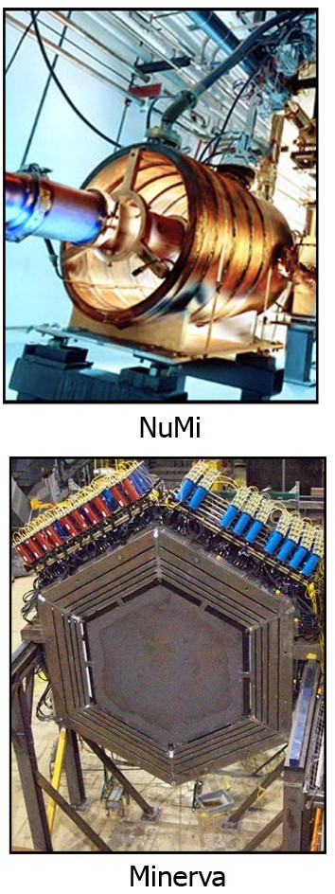
First successful experiment on information transmission via neutrinos at Fermilab
Ensuring national security
Secure neutrino communication channels
Parameters of the experiment (March 2012) Source:
- Main Injector: 120 GeV protons
- Decay pipe: 675 m
- Energy of 𝜈: 1‐10 GeV
MINERvA detector:
- Mass: 5.3 tons
- Distance: 1035 km
- Depth: 105 m
- 32 000 scintillator strips
Results:
- Transmitted: "neutrino" (ASCII)
- Speed: 0.1 bits/second
- Bit error rate: 1%
Historical achievement
First demonstration of information transmission through 240 meters of rock using neutrinos
Figure 11. Photos of NuMI and MINERvA
Source: Stancil D. D. et al. Demonstration of Communication Using Neutrinos // Modern Physics Letters A. – 2012. – Т. 27, № 12. – Art. 1250077. – DOI: 10.1142/S0217732312500770.
18 / 31

Slide 19
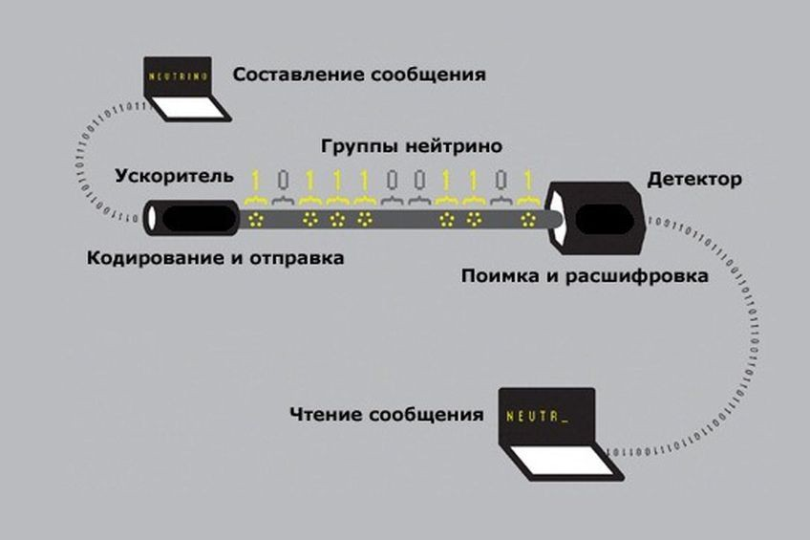
First successful experiment on information transmission via neutrinos at Fermilab
Ensuring national security
Secure neutrino communication channels
Information transmission was carried out using binary encoding: the presence of a neutrino pulse corresponded to a logical one, the absence to zero. In this way, the word "neutrino" was transmitted in ASCII encoding.
The achieved transmission speed was 0.1 bits/second with an error rate of 1%. The experiment results demonstrated the fundamental possibility of using neutrinos for information transmission through media opaque to electromagnetic radiation.
Figure 12. Schematic representation of neutrino-based information transmission technology implementation.
Source: Stancil D. D. et al. Demonstration of Communication Using Neutrinos // Modern Physics Letters A. – 2012. – Т. 27, № 12. – Art. 1250077. – DOI: 10.1142/S0217732312500770.
19 / 31

Slide 20
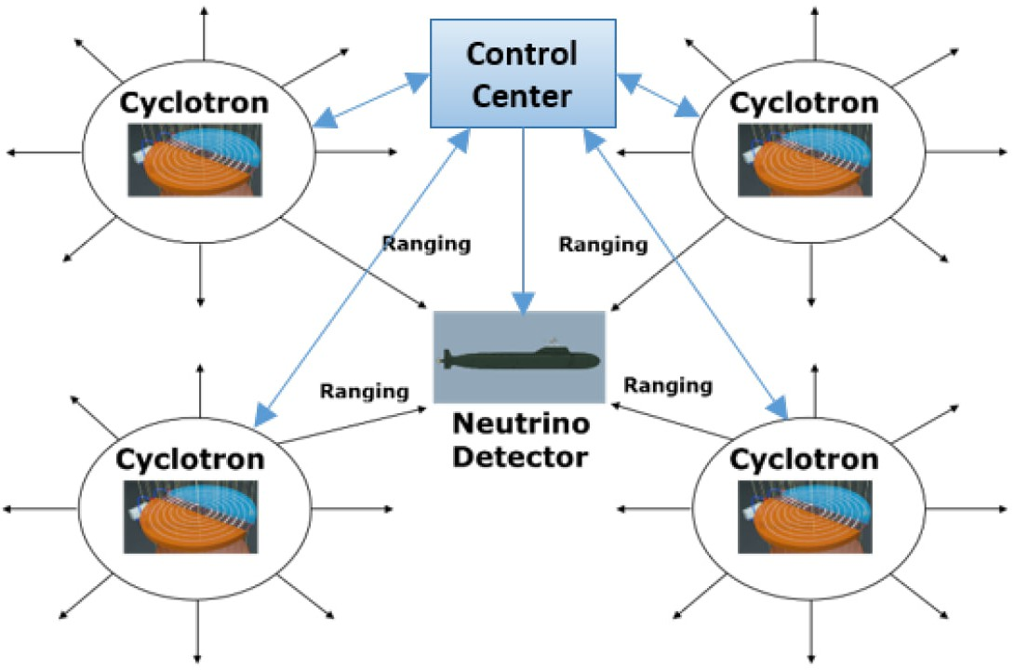
POSITRINO project
Positioning, NavigatION and TIMing with neutrino particles
Ensuring national security
Secure neutrino communication channels
System parameters:
Sources: Cyclotrons/linacs
Energy of 𝜈: 30‐50 MeV
Process: CE𝜈NS (amplification by 1-2 orders)
Pulse: 7 × 10⁻⁶ second
Resolution: 1 km
Detector (500 tons):
CsI[Na] scintillators
Silicon photomultipliers
Time ranging method
Figure 13. Scheme for implementing neutrino navigation.
Critical limitation
Required flux: 3.8 × 10²⁵ 𝜈/year - 2‐3 orders of magnitude higher than current sources
Source: Fidalgo J., et al. POSITRINO: Positioning, Navigation and Timing with Neutrino Particles // Proceedings of the 33rd International Technical Meeting of the Satellite Division of The Institute of Navigation (ION GNSS+ 2020). – 2020. – Р. 2533–2547. – DOI: 10.33012/2020.17701
20 / 31

Slide 21
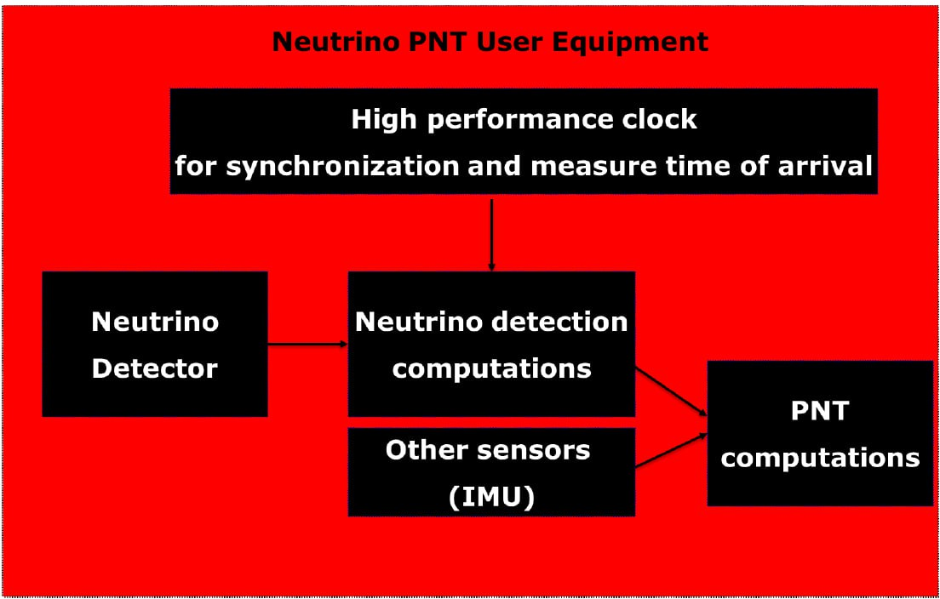
Ensuring national security
Secure neutrino communication channels
POSITRINO project
Positioning, NavigatION and TIMing with neutrino particles
Areas of application:
- Submarine navigation
- Subsurface navigation
- Spacecraft navigation
- Arctic operations
Technological status:
- Conceptual development
- Readiness: TRL 1-2
- Implementation: 10-20 years
- Barrier: Insufficiently powerful 𝜈 sources
Figure 14. Scheme for integrating neutrino navigation with IMU
Principle of hybrid navigation
Rare neutrino events correct the accumulated error of inertial measurements (IMU)
Source: Fidalgo J., et al. POSITRINO: Positioning, Navigation and Timing with Neutrino Particles // Proceedings of the 33rd International Technical Meeting of the Satellite Division of The Institute of Navigation (ION GNSS+ 2020). – 2020. – Р. 2533–2547. – DOI: 10.33012/2020.17701
21 / 31

Slide 22
Geoneutrinos: a window into Earth's internal structure
Direct measurement of the planet's radiogenic heat
Energy and resource independence
Revolution in geological exploration
What are geoneutrinos?
Antineutrinos from the radioactive decay of U-238 and Th-232 in Earth's interior
‐ Energy: up to 3.26 MeV (uranium), up to 2.25 MeV (thorium)
‐ Direct information on Earth's composition and heat generation
‐ Two pioneering experiments: KamLAND (2005) and Borexino (2010)
KamLAND (Japan):
‐ 1 kiloton of liquid scintillator
‐ Depth: 1000 m
‐ First registration: 2005 year
‐ Over 3000 events in 17 years
Borexino (Italy):
‐ 300 tons of ultra-pure scintillator
‐ Record purity: U/Th < 10⁻¹⁶ g/g
‐ Distance from nuclear
power plants: 800 km
‐ Accuracy: 99.997%
Key result
Earth's radiogenic heat: 20±5 TW out of a total flux of 47±2 TW
Source: G. Fiorentini, G. L. Fogli, E. Lisi, F. Mantovani, A. M. Rotunno. Mantle geoneutrinos in KamLAND and Borexino // Physical Review D. – 2012. – Vol. 86, No 3. – Art. 033004. – DOI: 10.1103/PhysRevD.86.033004
22 / 31

Slide 23
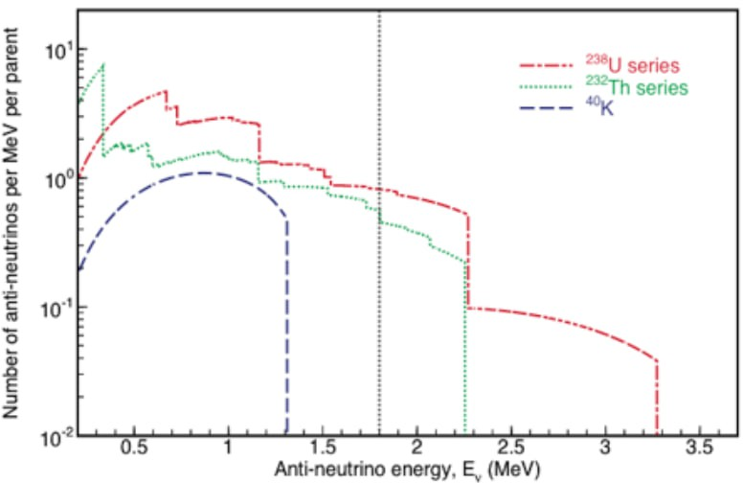
KamLAND. Pioneer in geoneutrino registration
Kamioka Liquid Scintillator Antineutrino Detector
Energy and resource independence
Revolution in geological exploration
Achievements over 17 years:
- First registration (2005)
- Over 3000 geoneutrino events
- Spectroscopy (2022)
- Ratio Th/U = 3.9±0.9
Key discoveries:
- Map of U/Th in the mantle
- Limit on georeactor:
<3.7 TW (90% Cl)
- Confirmation of the chondritic
model
Figure 15. Energy spectrum of geoneutrinos.
First results (749 days):
4.5‐54.2 events (90% CI)
Significance for geophysics
First direct measurement of the composition of Earth's deep layers using particle physics methods
Source: G. Fiorentini, G. L. Fogli, E. Lisi, F. Mantovani, A. M. Rotunno. Mantle geoneutrinos in KamLAND and Borexino // Physical Review D. – 2012. – Vol. 86, No 3. –
Art. 033004. – DOI: 10.1103/PhysRevD.86.033004
23 / 31

Slide 24
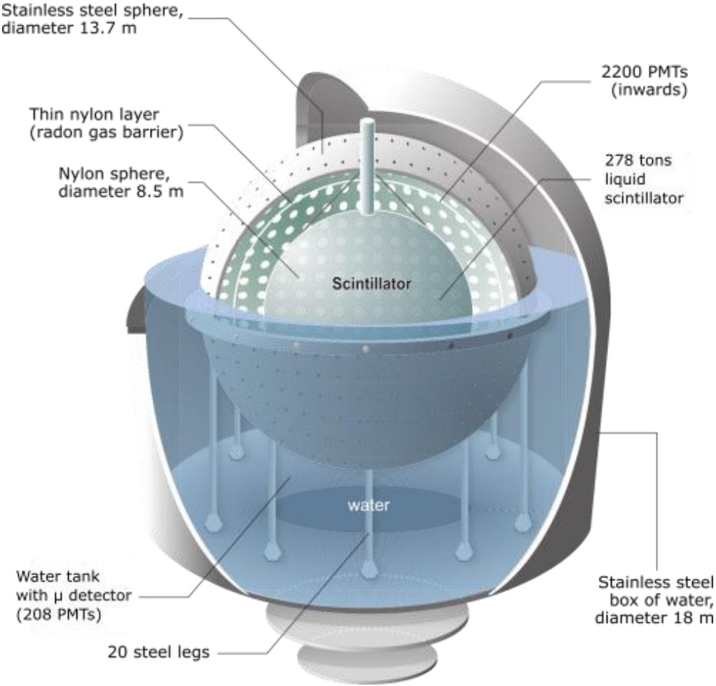
Precision measurements of geoneutrinos. Borexino
Energy and resource independence
Revolution in geological exploration
Advantages of the setup:
- Record purity of the detector
- U/Th < 10⁻¹⁶ g/g
- Distance from nuclear power plants (800 km)
- Stable geological platform
Results (3262 days):
- Total signal: 47.0^{+8.4}_{-7.7} terrestrial
neutrino units (TNU)
- Mantle signal: 21.2 TNU
- Accuracy: 99.0%
- Radiogenic heat:
24.6^{+11.1} TW
−10.4
Figure 16. Diagram of the Borexino detector in Gran Sasso, Italy
Breakthrough in geophysics
First extraction of the mantle geoneutrino signal with high reliability
Source: G. Fiorentini, G. L. Fogli, E. Lisi, F. Mantovani, A. M. Rotunno. Mantle geoneutrinos in KamLAND and Borexino // Physical Review D. – 2012. – Vol. 86, No 3. – Art. 033004. – DOI: 10.1103/PhysRevD.86.033004
24 / 31

Slide 25
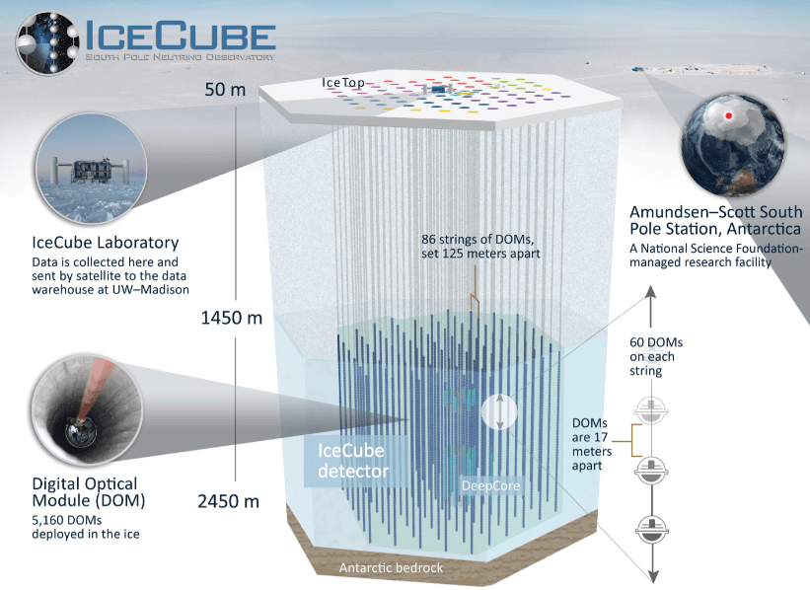
Measurement of Earth's internal structure. IceCube experiment
Energy and resource independence
Neutrino tomography of the Earth
Results (10 years of data):
- Earth's mass: (5.97±0.03)×10²⁴ kg
- Core mass: (1.94±0.05)×10²⁴ kg
- Precision 1% compared to seismic data;
-Energy of 𝜈: 1‐100 TeV.
Confirmation of PREM (Preliminary Reference Earth Model):
- Core density: 13 g/cm³
- Mantle density: 4‐5 g/cm³
- Outer core radius: 3480 km
- Resolution: 200 km
Historical achievement: first tomography of the entire planet using particle physics methods
Figure 17. IceCube detector in Antarctica.
‐ 1 km³ antarctic ice
‐ 5160 optical modules
‐ Depth: 1450‐2450 m
‐ 86 vertical strings
Physical principle
At E > 100 TeV, neutrinos are noticeably absorbed by matter → measurement of density by flux attenuation
Source: Aartsen M. G. et al. Neutrino Interferometry for High‐Precision Tests of Lorentz Symmetry with IceCube // Nature Physics. – 2018. – Vol. 14, No 9. – Pp. 961–966. – DOI: 10.1038/s41567‐018‐0172‐2
25 / 31

Slide 26
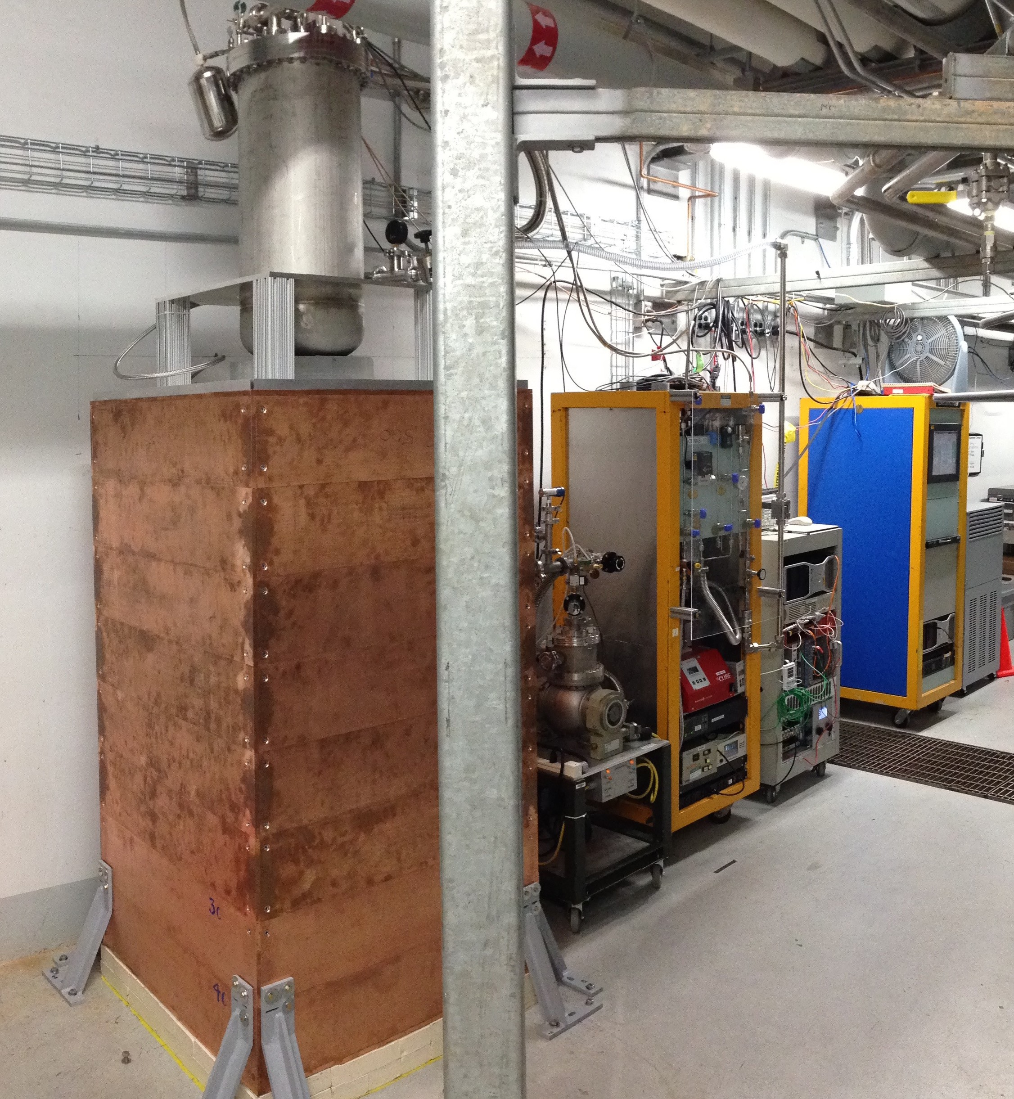
COHERENT experiment
Coherent elastic neutrino-nucleus scattering (CE𝜈NS)
Critical development directions
Breakthrough in detector miniaturization
Physics of the process:
- Coherent interaction with all nucleons
-𝜎 ∼ GF ² N²E𝜈² (N ‐ number of neutrons)
- For ¹³³Cs: enhancement by 6000 times
- Threshold: E_{𝜈} > 20 MeV
First observation (2017):
- Detector: CsI[Na] 14.6 kg 130
events in 308 days
- Significance: 6.7σ
- Expansion: Ar (2020), 24 kg
Practical significance: detectors of tens of kg
register reactor 𝜈¯_{e} at distances 20‐30 m.
Paradigm shift
Figure 18. COHERENT setup in Oak Ridge.
From kiloton detectors to setups of kilogram mass
Source: Akimov D., et al. COHERENT Collaboration. Observation of coherent elastic neutrino‐nucleus scattering // Science. – 2017. – Vol. 357, No 6356. – Pp. 1123–1126. – DOI: 10.1126/science.aao0990.
26 / 31

Slide 27
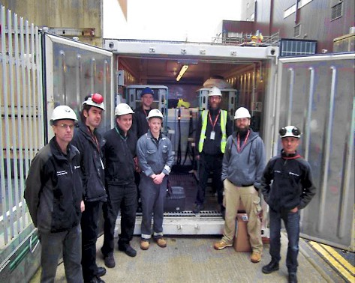
VIDARR project
Verification Instrument for Deep Analysis of Reactor Radionuclides
Critical development directions
Mobile monitoring systems: from concept to field trials
Technical parameters:
- 5 tons plastic scintillator
EJ‐254 + 0.5% Gd
- 144 detector cells
- Mobile platform
Results from Wylfa (2022):
- 2 Magnox reactors, each 490 MW
- Distance: 1.5 км
- 50‐70 events/day
- Thermal power error: 12%/week
Figure 19. Reactor monitoring group with some Wylfa employees during VIDARR installation in a 40-foot container.
Key achievement
Ready-to-deploy mobile system with source direction detection
Source: Bridges K., Carroll J., Coleman J. et al. VIDARR: monitoring reactor anti‐neutrinos using a plastic scintillator detector in a mobile laboratory // Journal of Instrumentation. – 2022. – Vol. 17. – P10009. – DOI: 10.1088/1748‐0221/17/10/P10009.
27 / 31

Slide 28
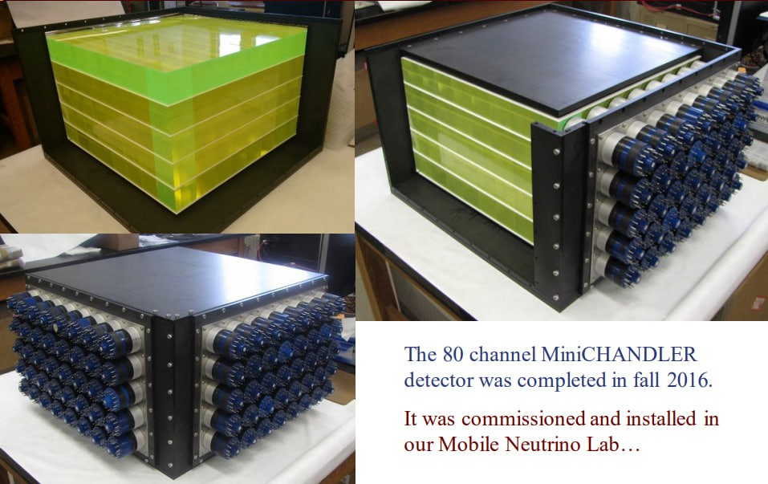
MiniCHANDLER detector
Mini Carbon Hydrogen AntiNeutrino Detector with a Lithium Enhanced Raghavan‐optical‐lattice
Critical development directions
Mobile monitoring systems: from concept to field trials
System parameters:
- Mass: 80 kg
-⁶Li‐doped plastic scintillator
- Raghavan optical lattice
- 3D‐segmented detector
North Anna trials (2017):
- Reactor: 2.9 GW, distance 25 m from active core
- Period: June‐November 2017
- 100 events/day
- Cosmic ray background exceeded signal by 400 times
- Signal-to-noise improvement by 4 times
- Significance: 5.5σ
Historical achievement
Fiigure 20. MiniCHANDLER detector
First reliable detection of reactor antineutrinos by an unprotected surface detector
Source: Haghighat A., Huber P., Li S., Link J. M., Mariani C., Park J., Subedi T. Observation of Reactor Antineutrinos with a Rapidly Deployable Surface‐Level Detector //
Physical Review Applied. – 2020. – Vol. 13. – P. 034028. – DOI: 10.1103/PhysRevApplied.13.034028.
28 / 31

Slide 29
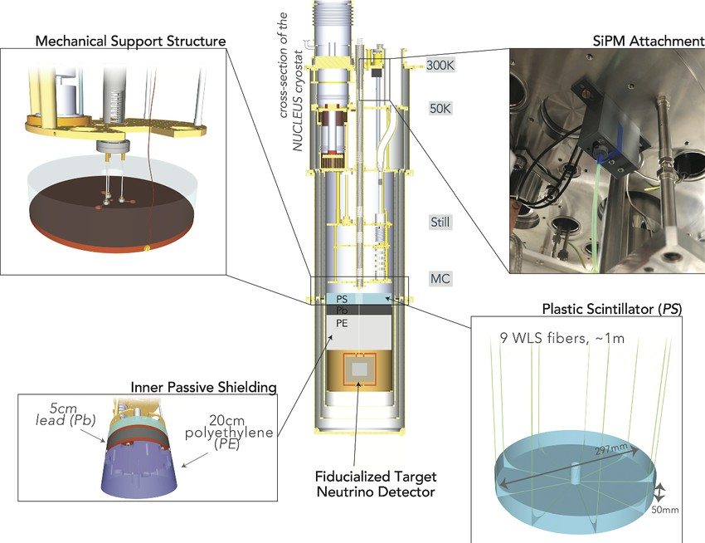
Limit of miniaturization: NUCLEUS experiment
Cryogenic bolometers for CE𝜈NS detection
Critical development directions
Mobile monitoring systems: from concept to field trials
Unique parameters:
- Detector system mass: 10 grams
- Energy threshold: 19.7 eV
- 5‐6 orders of magnitude lower than typical SQUID phonon readout
Placement (Chooz Nuclear Power Plant, France):
- 2 reactors, each 4.25 GW
- Flux density: 1.7×10¹² 𝜈¯_{e}/(s∙sm²)
- Expected: 100 events/year
- Launch at the nuclear power
plant: 2025
Results in the laboratory:
- Resolution: <20 eV
- Stable operation: >500 hours
Figure 21. Detector and passive shielding, including internal and external systems (plastic scintillator, SiPM, mounted shielding)
New paradigm
From tons to grams — detectors have shrunk by a million times
Source: Angloher G., Ardellier‐Desages F., Bento A. et al. Exploring CEνNS with NUCLEUS at the Chooz nuclear power plant // The European Physical Journal C. – 2019. – Vol. 79, № 12. – P. 1018. – DOI: 10.1140/epjc/s10052‐019‐7454‐4. 29 / 31

Slide 30
Conclusions
Summary
- In nuclear monitoring, there is a shift from research projects to operational systems. DANSS, PROSPECT, and VIDARR are already operational, determining reactor power with 1-8% accuracy and monitoring fuel composition. WATCHMAN will extend the range to 25 km for creating regional control networks..
- Naval applications are under active development. Although operational systems are still far off, the physical principles have been confirmed.
- Neutrino communication remains the most futuristic direction. The 2012 Fermilab experiment transmitted information through 240 meters of rock, but the speed of 0.1 bits/second and the need for an accelerator make the technology impractical. The POSITRINO project offers an alternative—navigation of underwater vehicles through neutrino detection using compact CEνNS detectors combined with inertial navigation.
- In geophysical research, KamLAND and Borexino detect geoneutrinos from the decay of uranium and thorium, determining Earth's radiogenic heat generation and the distribution of radioactive elements in the mantle. The development of compact detectors opens prospects for uranium deposit exploration. Meanwhile, IceCube uses the absorption of high-energy atmospheric neutrinos to create a density map of the planet, enabling tomography of Earth using elementary particle physics methods.
- Results from COHERENT pave the way for developing mobile nuclear verification monitoring systems. The NUCLEUS project, in turn, tests the limits of detector miniaturization, creating detector systems with a total mass of no more than 10 grams.
- Russia holds strong positions with the DANSS and iDREAM detectors, but to maintain competitiveness, research expansion is needed, particularly in compact CE𝜈NS and CE𝜈AS detectors and data processing systems.
- The SATURNE project, besides its primary task, detecting the CEνAS process and measuring the neutrino magnetic moment with unprecedented accuracy, will also address the miniaturization of neutrino detectors, which is highly significant for nuclear verification, nuclear power plant monitoring, and geological exploration. The next decade will be critical for shaping the technological landscape in this field.
30 / 31

Slide 31
Gratitude for Your Attention!

