Slide 1




21st Lomonosov Conference on Elementary Particle Physics
CDEX-300ν neutrinoless double beta decay experiment based on Ge-76
Wang Li（王力）, Liang Yifan（梁艺帆）
Beijing Normal University, Tsinghua University
On behalf of CDEX collaboration
2023-08-26, Moscow
Notes:
Because professor Wang cannot attend the conference, I will give the talk instead of him.

Slide 2

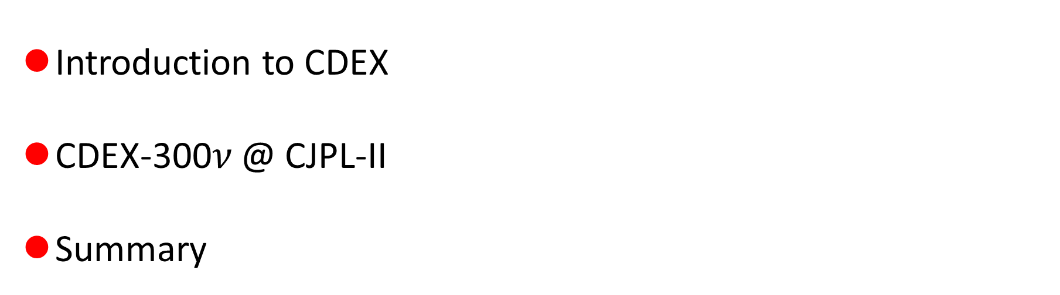
Outline
Introduction to CDEX
CDEX-300$ν$ @ CJPL-II
Summary

Slide 3
Introduction to CDEX

Slide 4

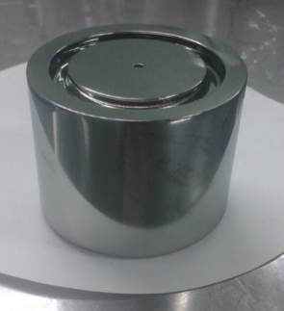
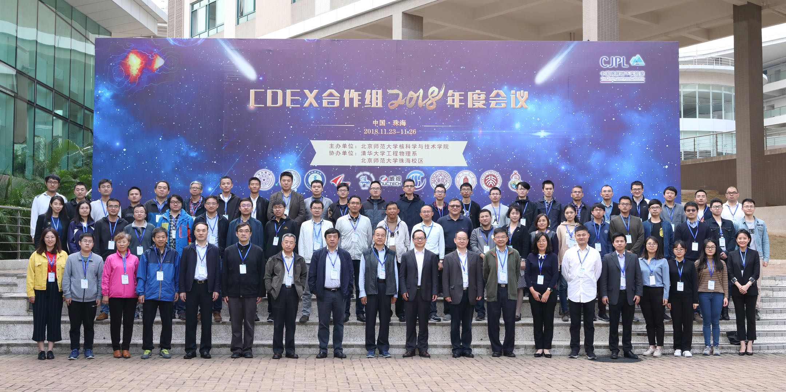
China Dark matter Experiment
Established in 2009, 11 institutes, >100 members.
DM and 0νββ experiment based on Ge detectors at CJPL.
Many world-level DM physics results published in last 10 years.
http://cdex.ep.tsinghua.edu.cn/
P-type Point-Contact(PPC)
Germanium detector
Best energy resolution (~200 eV @ 10.37 keV)
Low energy threshold (~100 eV)
Low background
Notes:
CDEX is China Dark Matter EXperiment. It has been established in 2009, now it has 11 institutes and more than 100 members. Based on the Ge technology, CDEX main target is DM direct detection and neutrino-less double beta decay EXperiment. After nearly 15 years of development, CDEX has become a world-level experiment.

Slide 5

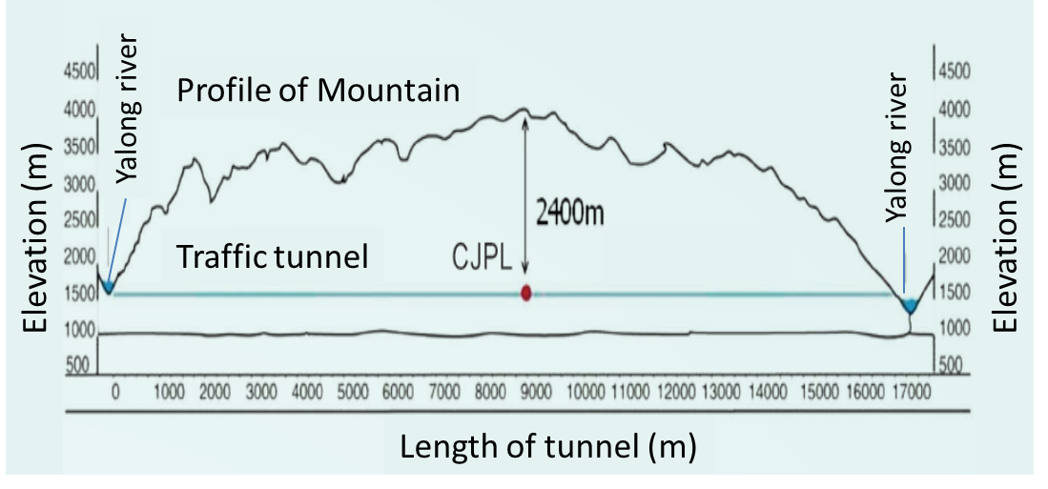
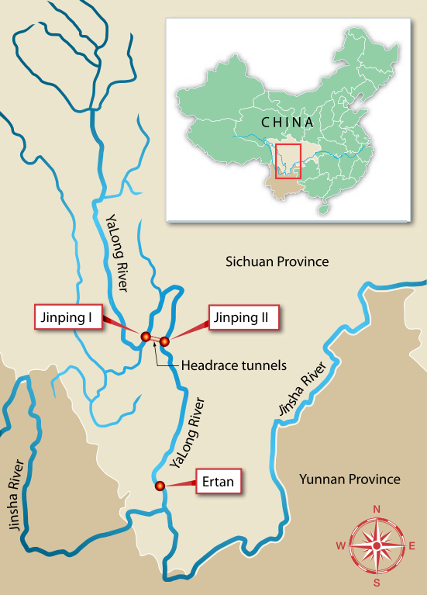
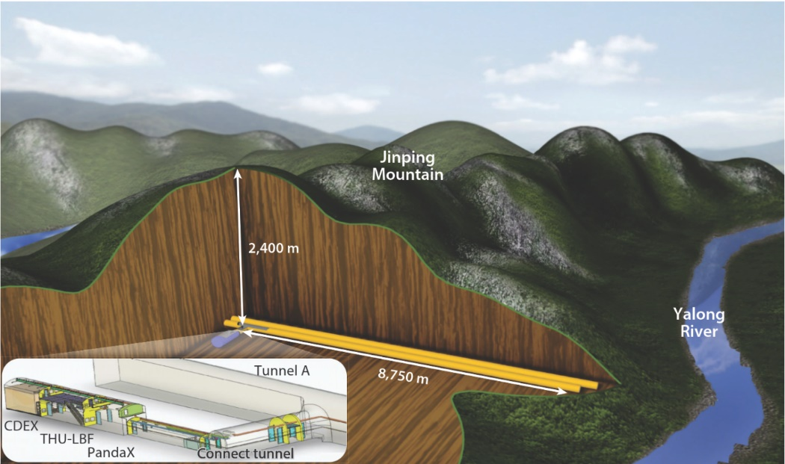
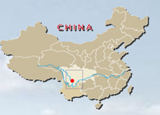
China JinPing underground Laboratory
CJPL-I
  Constructed by THU and Yalong Hydropower Company
  Completed in 2010
  Near Xichang city, Sichuan Province, Southwest China
  Rock overburden: 2400m (~6720 m. w. e.)
  Low Muon flux and environmental background
  CJPL-I Main Hall: 6.5m(W) x 6.5m(H) x 42m(L), Total space: ~4000 m³
China Jinping Underground Laboratory
(CJPL)
~60 muons/m²/year
CJPL-I
Cheng et al., Annu. Rev. Nucl. Part. Sci. 67:231 (2017)
Chinese Physics C 37:086001 (2013)
Notes:
CJPL was built by Tsinghua University and Yalong Hydropower Company, and CJPL-I was completed in 2010. CJPL is located in southwest China, near Xichang City in Sichuan Province. The laboratory is in the middle of a 17-kilometer-long tunnel with a rock overburnden of 2,400 metres thick. Currently it is the world's deepest underground laboratory and the cosmic ray flux is negligible . CJPL-1 has only one experimental hall, its total usable space is 4,000 cubic meters.

Slide 6
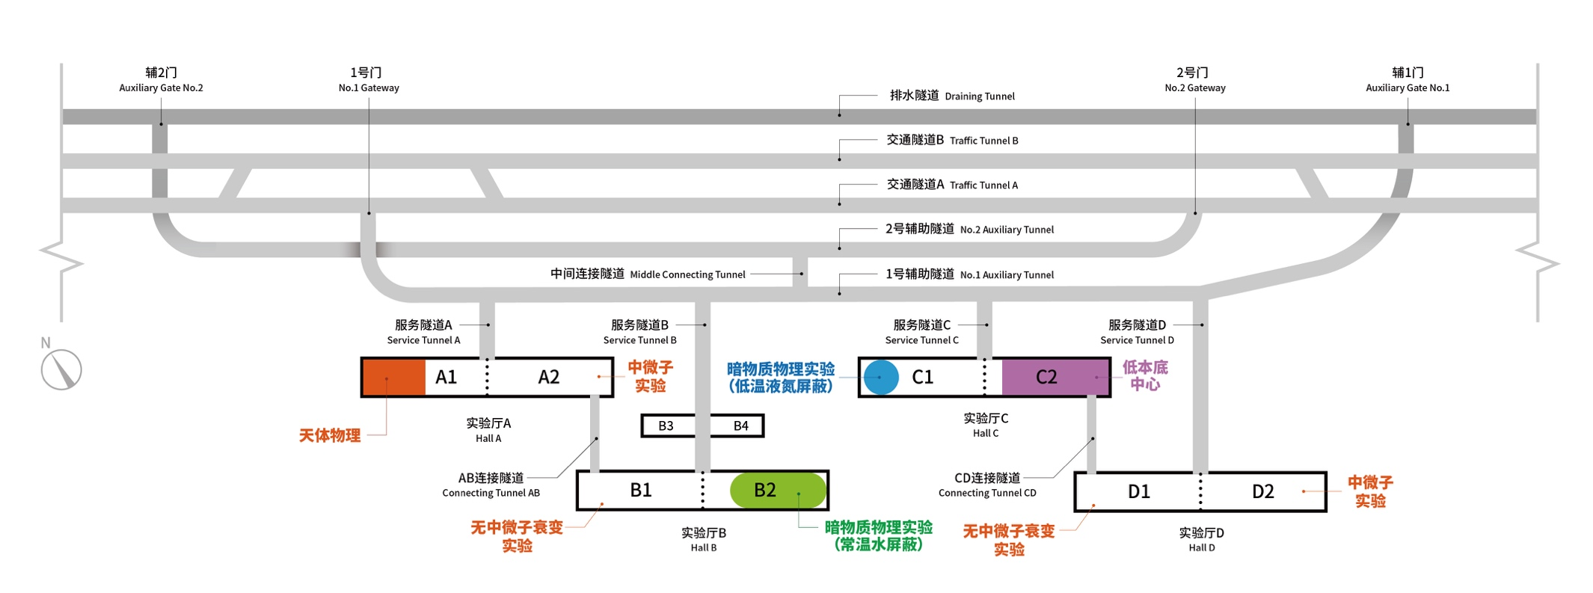
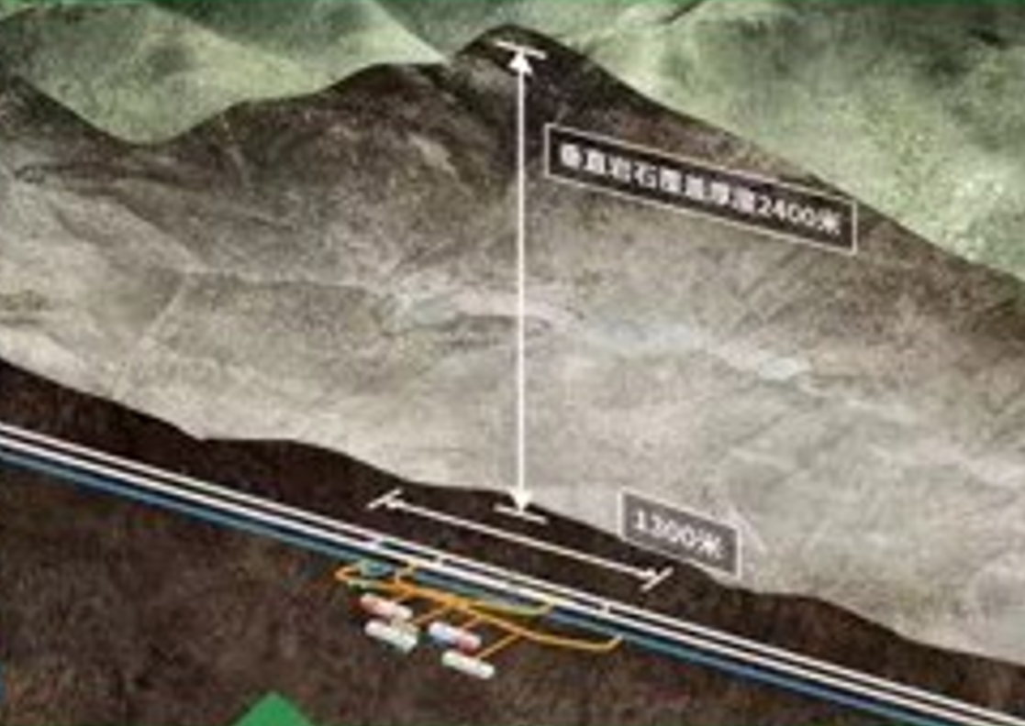
China JinPing underground Laboratory
CJPL-II
  Construction of started on Nov, 2014
  expected to be completed in 2024
  CJPL-I to CJPL-II，Volume: 4000 m³ to 300,000 m³; 1 main hall (6.5x6.5x42m) to 8 main halls (14x14x60m each);
2400m
CJPL-II with normal scale
Notes:
The space of CJPL-I is not enough to support the next generation of experiments, so we built CJPL-II. The construction of CJPL-II began in 2014 and is expected to be completed by the end of 2024. Compared with CJPL-I, CJPL-II has eight experimental halls, and the available space is increased to 300,000 cubic meters.

Slide 7
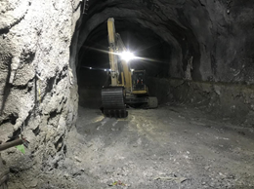
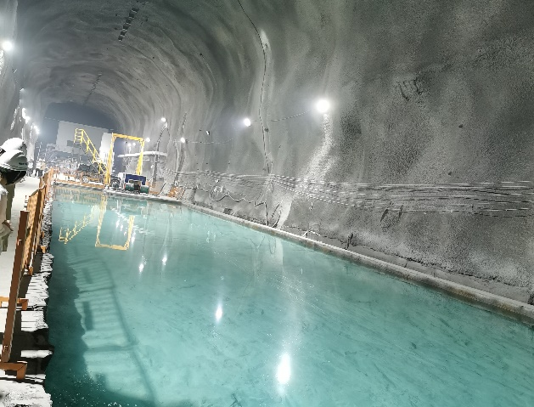
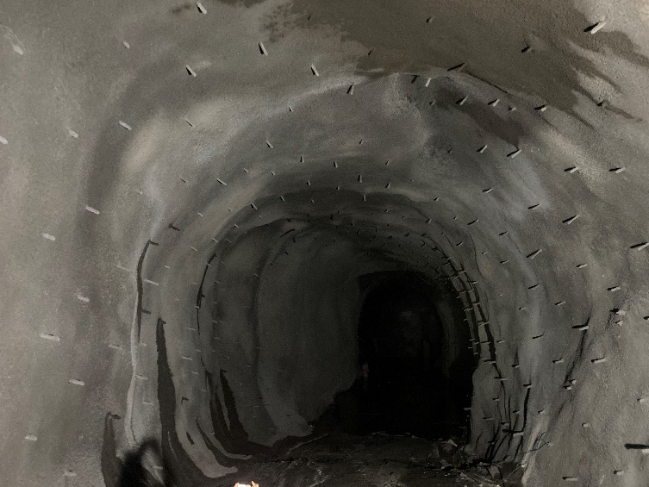
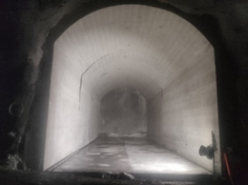
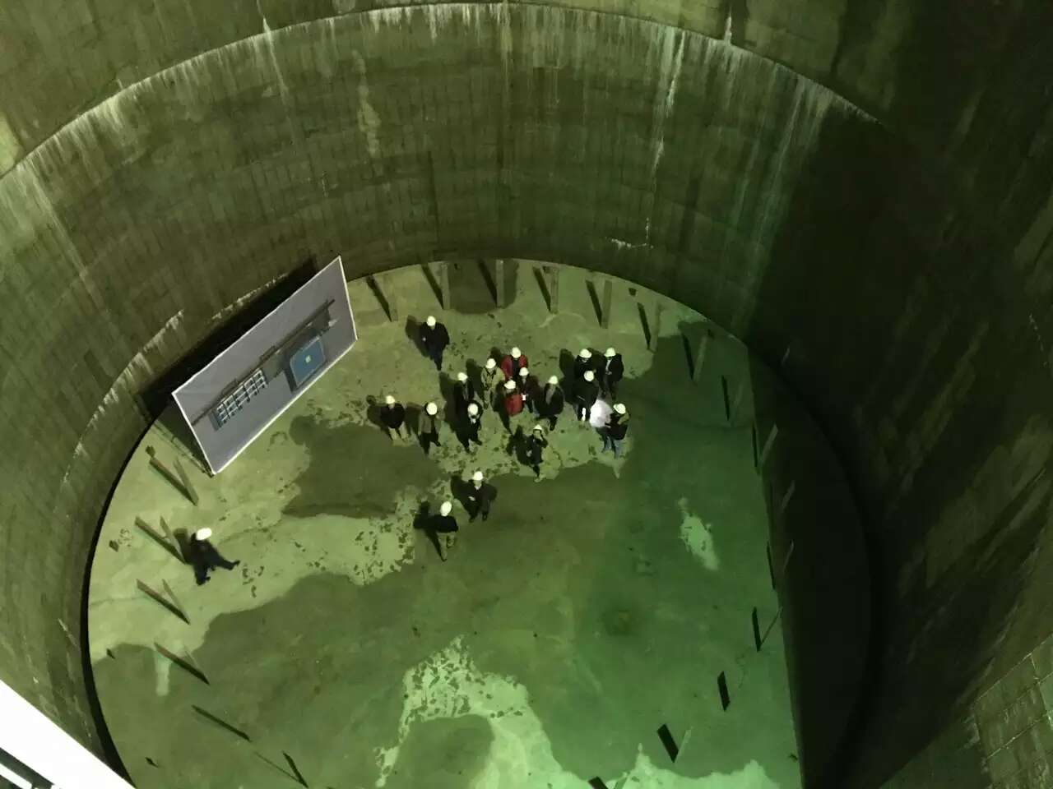
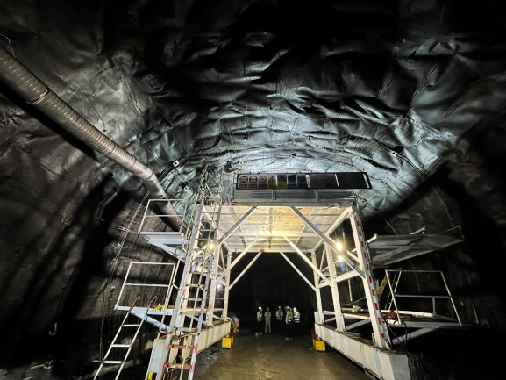
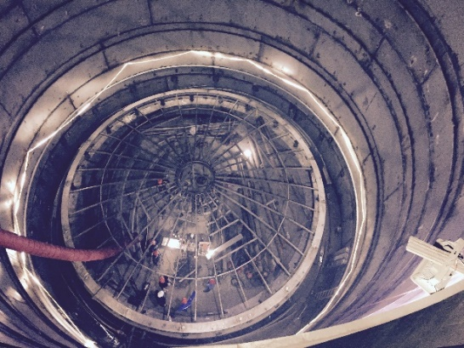
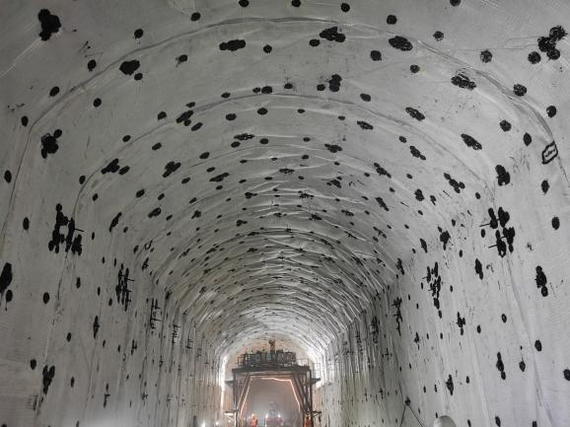
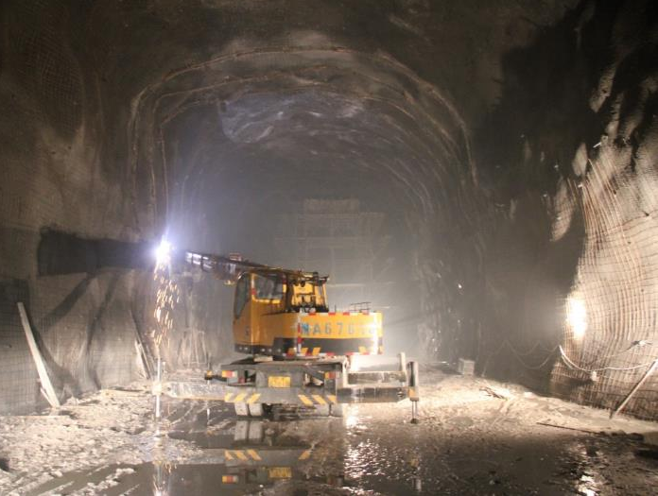
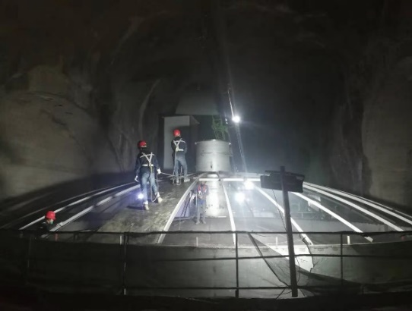
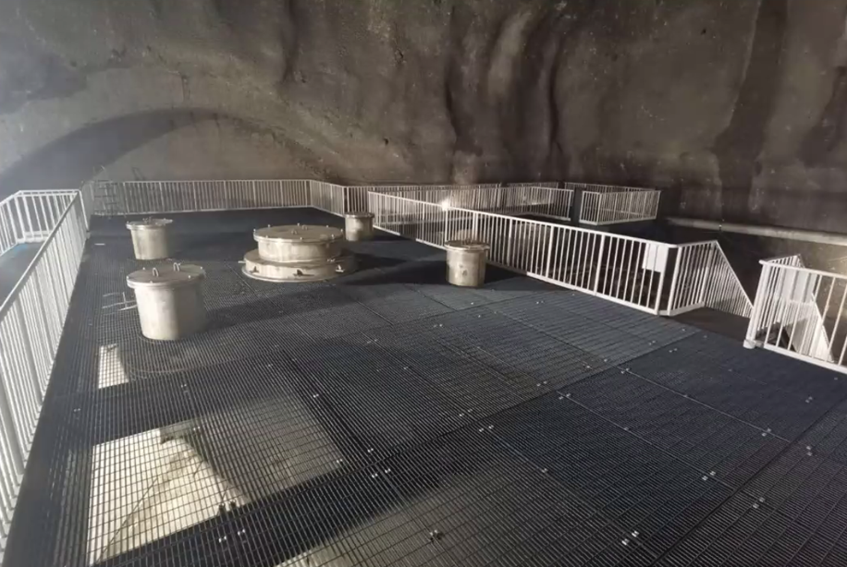
  Currently under construction
  major infrastructure construction will be completed by the end of 2023.
  Expected the construction of the laboratory will be completed by the end of 2024
Notes:
Here are some photos during the construction of CJPL-II, and when the construction complete, it will be like this.

Slide 8
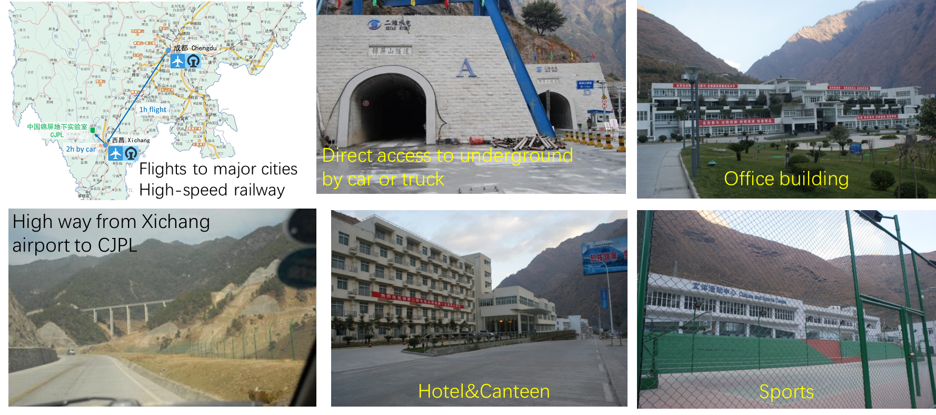
China JinPing underground Laboratory
Comprehensively supported by Jinping hydropower station.
Convenient & Comfortable for researchers.
Notes:
CJPL also has excellent ground facilities, providing a very convenient and comfortable environment for scientific researchers. There are office buildings, hotels, sports grounds, you can drive along the tunnel directly to the laboratory.

Slide 9
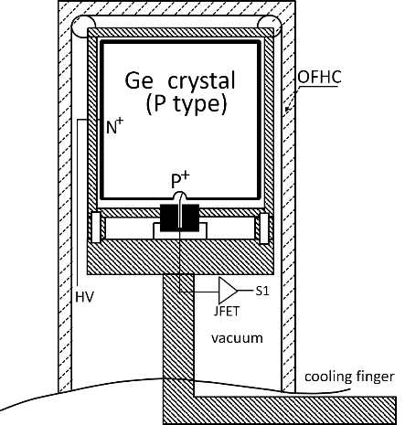
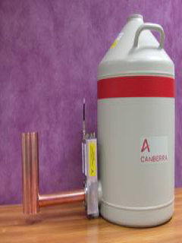
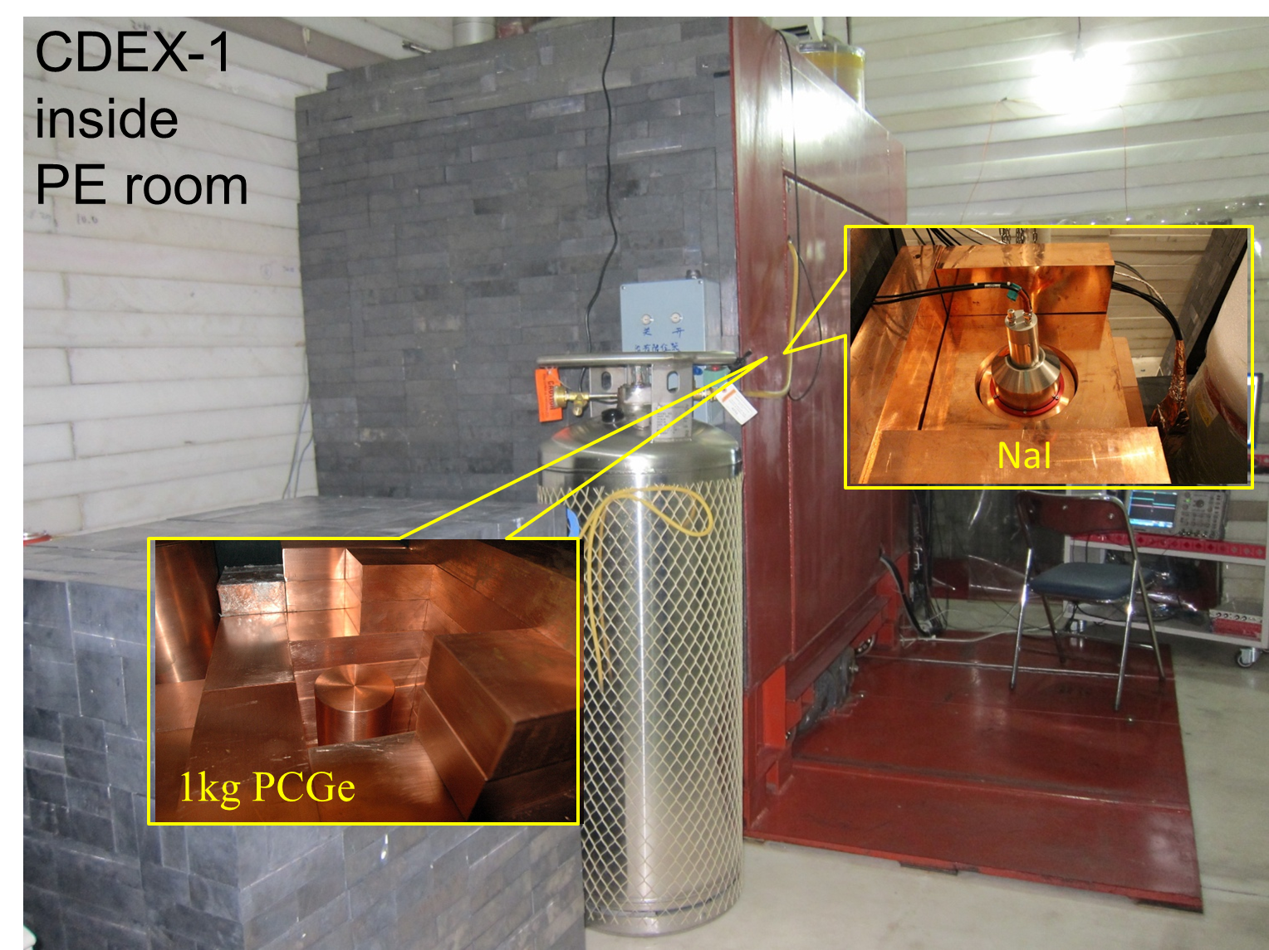
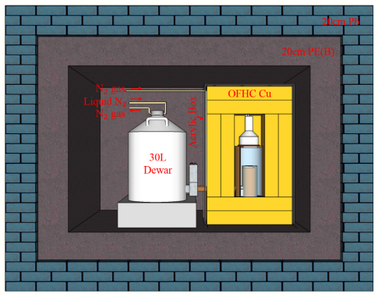
CDEX-1@CJPL-I
single-element 1kg pPCGe detectors;
Traditional cold finger refrigeration;
Passive shield: Low-bkg Pb, OFHC Cu, PE;
NaI(Tl) anti-Compton detector;
Located in PE room at CJPL-I;
Testing tank
CDEX-
10
CDEX-
1A
CDEX-
1B
CDEX-1 inside PE room
9
Layout of PE room, CJPL-I
CDEX-1A&B: 1kg PPC Ge×2
Notes:
We have two experiments at CJPL-I, The first is CDEX-1, the main target of this stage is to develop kg technology of PCGe detector. CDEX-1 detectors are commercial products. It has a cold finger cooling system, and the Ge crystal is sealed in a cppper cryostat. Around the crystal, there are variety of materials, such as electronics, cooling materials, even a piece of lead is used to hold the Ge crystal. The experience from CDEX-1 tell us that pPCGe really has low energy threshold around 160 eV, so it is suitable for DM search. And it also tell us the commercial detector is difficult to control background. Those background mainly from materials in copper cryostat and outer passive shielding.

Slide 10
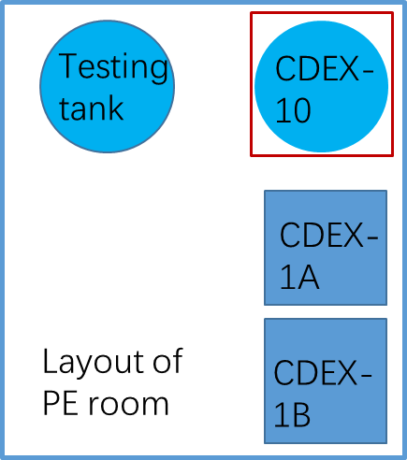
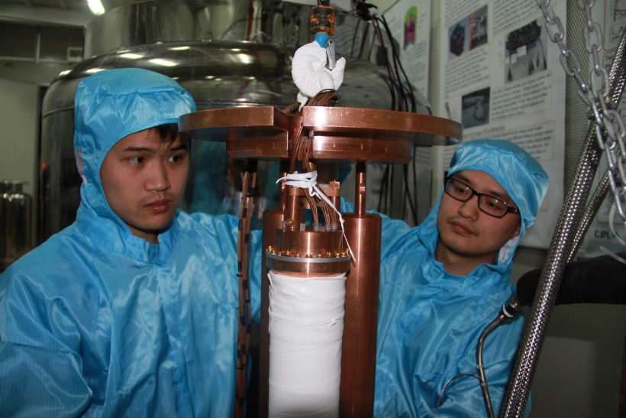
CDEX-10 @CJPL-I
Array detectors: 3 strings with 3 detectors each, ~10kg total;
Direct immersion in LN₂;
Prototype system for future hundred-kg to ton scale experiment
  Light/radio-purer LN₂ replacing heavy shield i.e. Pb/Cu;
  Arraying technology to scalable capability;
Science China-PMA 62, 031012 (2019)
CDEX-10: ~10kg PPC Ge array
10
Notes:
Another experiment at CJPL-I is CDEX-10 experiment. In this stage, we made two important changes. To increase the Ge target mass, we designed a string pPCGe detectors. The system has 3 strings, in each string there are 3 Ge crystals and they are sealed in the copper cryostat. To reduce the passive shielding background, the detector strings are directly immersed into LN2. LN2 has low radioactivity compared with traditional heavy shield, because there are almost no U/Th radioactivity isotopes in it. CDEX-10 successfully proves the feasibility of Ge array and the LN2 as the passive shielding instead of heavy traditional shielding Pb/Cu.
Using above theses two detectors, we published Many world-level DM physics results in last 10 years.

Slide 11
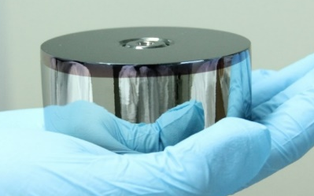
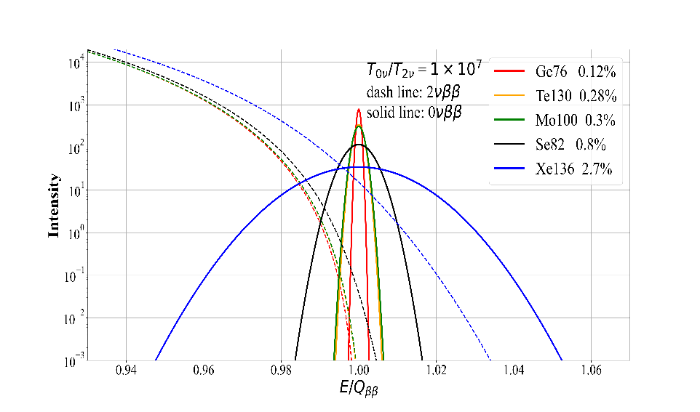
Go beyond DM -- 0νββ experiment
Advantages of ⁷⁶Ge 0νββ experiment
Excellent ER with high Qββ value: <0.12% FWHM @2039keV
✓Precisely measured Energy peak at known Qββ value： smoking-gun signature;
✓no irreducible 2νββ background contamination;
✓suppress ambient background within narrow ROI energy window;
High Efficiency: “Source”=“Target” with no self-shielding needed;
High purity Ge crystal >12N, and mature Isotopic enrichment technology: >86%;
Modular and easy scale-up technically; multi-site, multi-detector configurations possible without loss of fiducial mass
Notes:
In addition to dark matter detection, we also use the high-purity germanium detector to explore neutrino-less double beta decay. High purity germanium technology has the following advantages. First, it has the best energy resolution and high Q value, which can reach less than 0.12%; There is also a high detection efficiency, high purity, mature enrichment technology, can reach 86%. In addition, it can be modularized and array, to increase the detector mass.

Slide 12
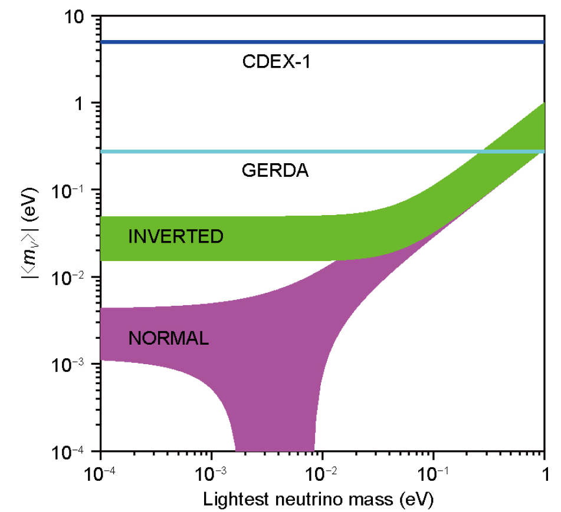
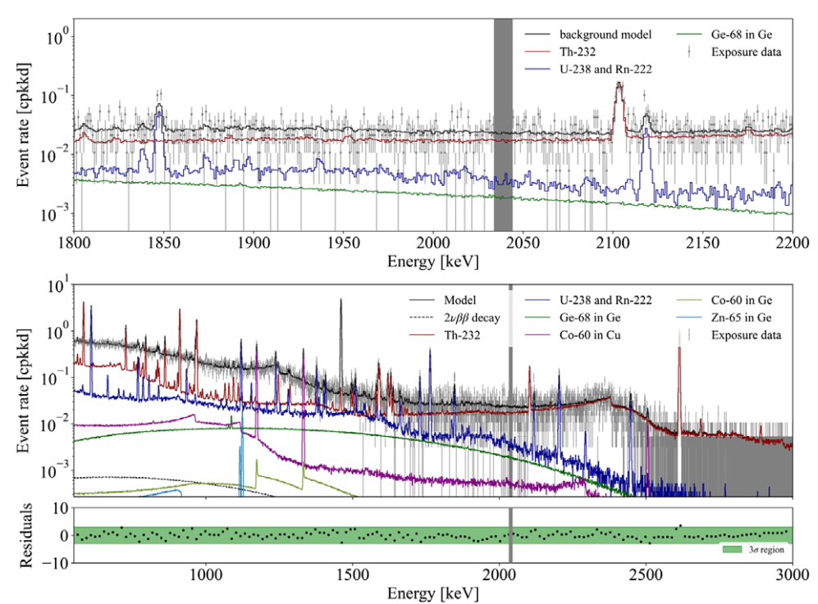
CDEX 0νββ results @CJPL-I
<m_{ββ}> sensitivity: one order less than GERDA-I with CDEX-1 PCGe @ 2017.
Natural broad energy germanium (BEGe) detector is operated @ 2022
Primary sources of background: U/Th adjacent material and Cosmogenic radioactive isotopes in Ge and adjacent material
BEGe Detector
First ⁷⁶Ge 0νββ result @ CDEX-1
Science China PMA (2017) 60: 071011
PRD 106, 032012, 2022
Notes:
In CJPL-I, We use two prototype detectors, CDEX-1 pPCGe and natural BEGe detector to study 0vbb experiment. And get the sensitivity one order less than Gerda-I. However, We successfully established the data analysis procedure and event selection method. These two detectors are both commercial product with traditional cold finger cooling system and copper cryostat. Through these two experiment, we get the experience that here, The high energy spectrum range clearly show that the primary background from this type of detector, one is U/Th from the materials near crystal like crystal holder, electronics, copper cup; the other is cosmogenic radioactive isotopes in Ge and copper.

Slide 13
How to improve the sensitivity
Increase the effective exposure
  Increase the mass of detector, ⁷⁶Ge enriched (>86% enrichment)
Background control
  Deep and large space of underground Laboratory --> CJPL-II
  Cosmogenic background control
    Optimize the exposure time of Ge on the ground in the production, transportation and storage processes
  Decrease the background from the material near crystal
    Change passive shielding: Cu/Pb/PE --> Liquid Nitrogen
    Immersed crystal directly into LN₂, no background from cold finger and cryostat system
    Upgrade to the low background, low temp., low noise electronics
    Material screening and selection
  Liquid argon veto system
Notes:
So how to improve the sensitivity? Based on the previous experience, The first is increase the effective exposure and more important is suppress the background. For the first we should increase the mass of detector, and for 0vbb Ge enriched should be done. For the background control, we need a deep and larger space in underground Laboratory. As to the dominate cosmogenic background, we should optimize the exposure time of Ge on the ground in the production, transportation and storage processes. The other method is to do the enrichment, which is effective way to suppress some cosmogenic isotopes like H-3 in dark matter search. Another important method is to decrease the background from the material surrounding the crystal. Change passive shielding to LN. Immersed crystal directly into LN, in order to remove the cold finger and cryostat system. Upgrade to the home made LB, LT, LN electronics. Another improvement is to use the LAr veto system to suppress the background

Slide 14
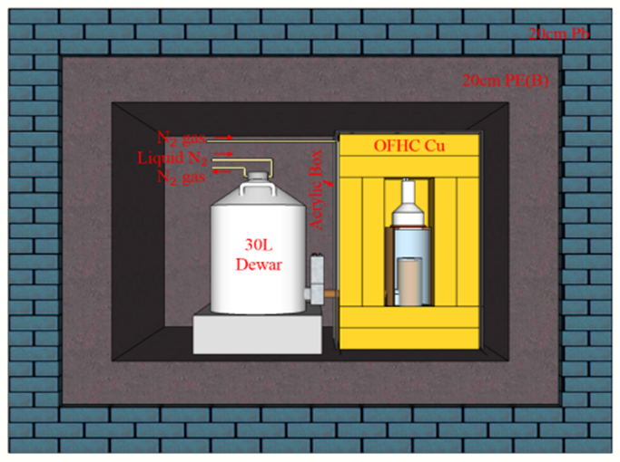
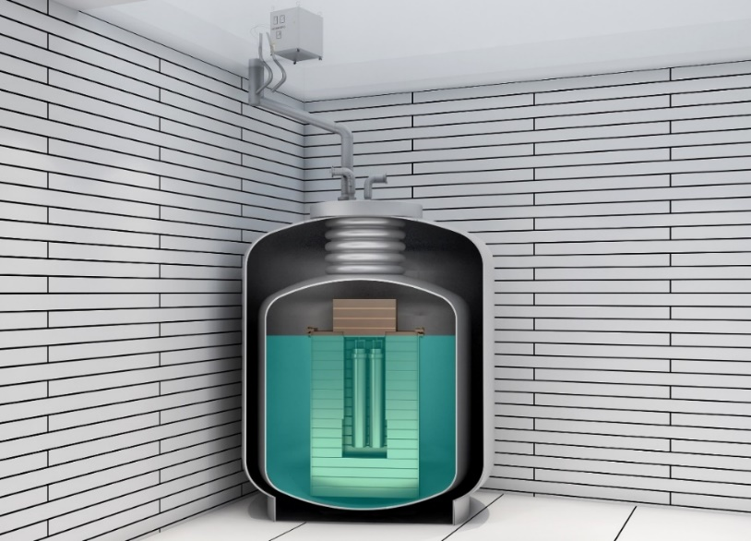
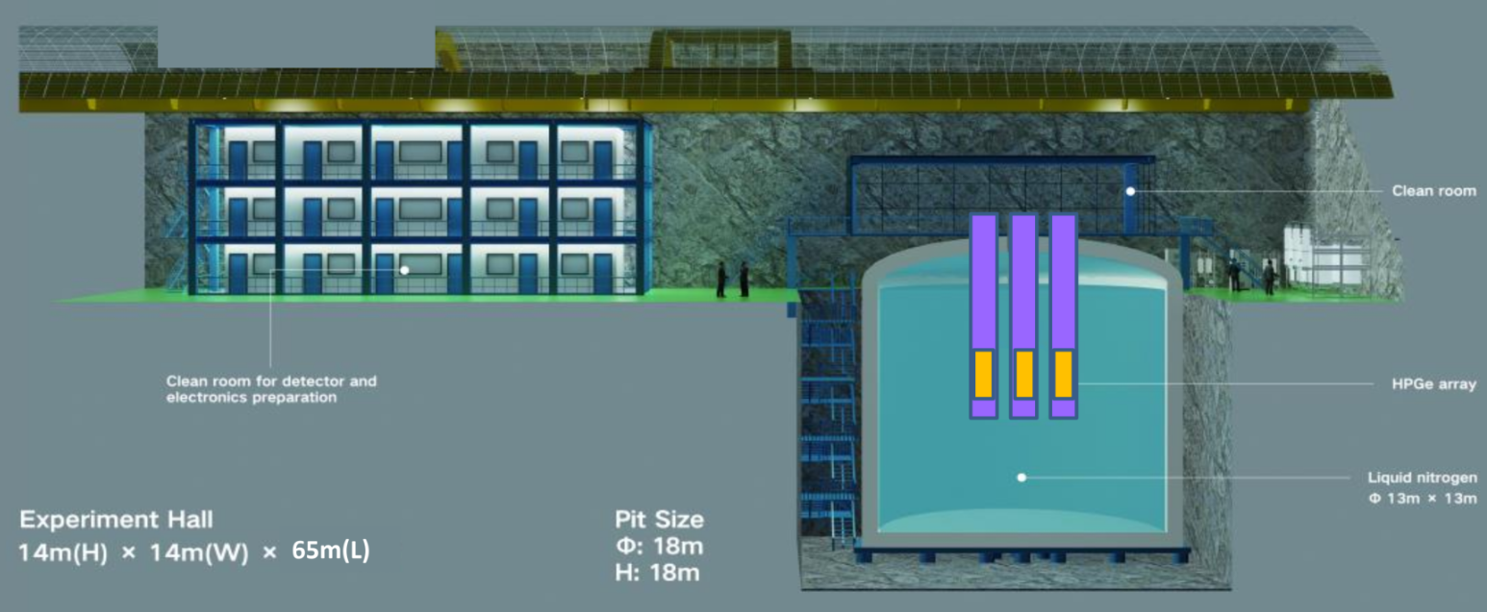
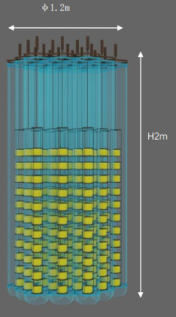
CDEX Roadmap
CDEX-1A/B (2011-2018)
2 PPC Ge detectors with a mass of up to ~1 kg
CDEX-50 (N, 2021-)
CDEX-300ν (E, 2021-)
50kg/300kg Ge array in large-volume LN₂/LAr
CDEX-10 (2016-)
10 kg PPC Ge detector array immersed into LN₂
CDEX-1T(E, 2028-)
1t Ge array in large-volume LN₂/LAr
CJPL-I
CJPL-II
Notes:
At CJPL-II, for the next generation of CDEX experiments, we are now building CDEX-50 and CDEX-300v program, whose targets are dark matter search and 0vbb, respectively.

Slide 15
CDEX-300𝜈 @ CJPL-II

Slide 16
CDEX-300𝜈 @ CJPL-II
Located in CJPL-II, Cosmic ray can be negligible
1725m³ LN₂ tank ready for cooling and shielding
Over 6 m thick LN₂ can provide an effective shield against ambient radioactivity.
Upgrade to the ASIC preamp
Notes:
CDEX-300v Experiment will be carried on in CJPL-II. The passive shielding changes to large LN cooling and shielding system and it provides over 6m thick LN2, which can support an effective shielding against ambient radioactivity.

Slide 17
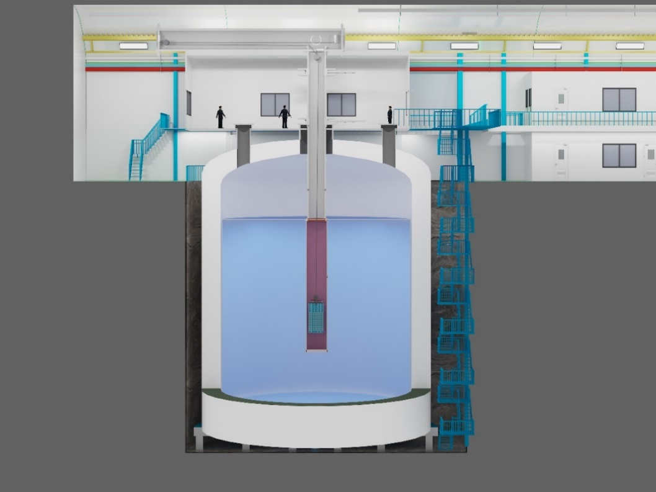
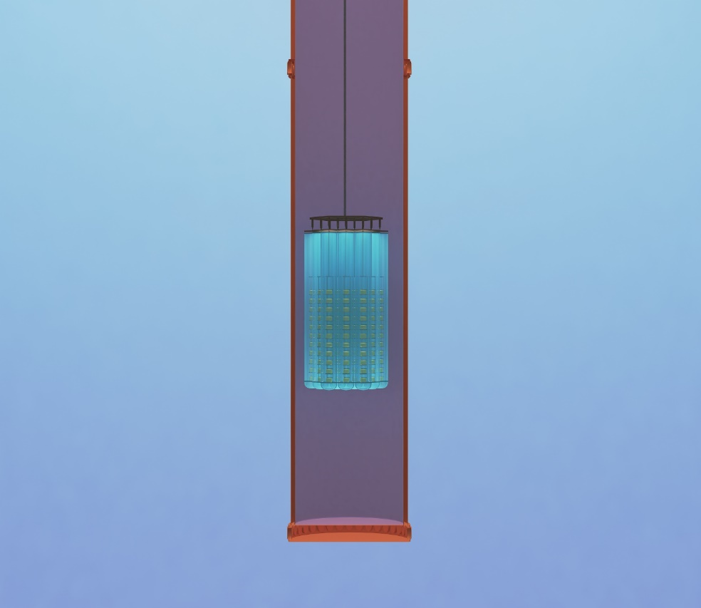
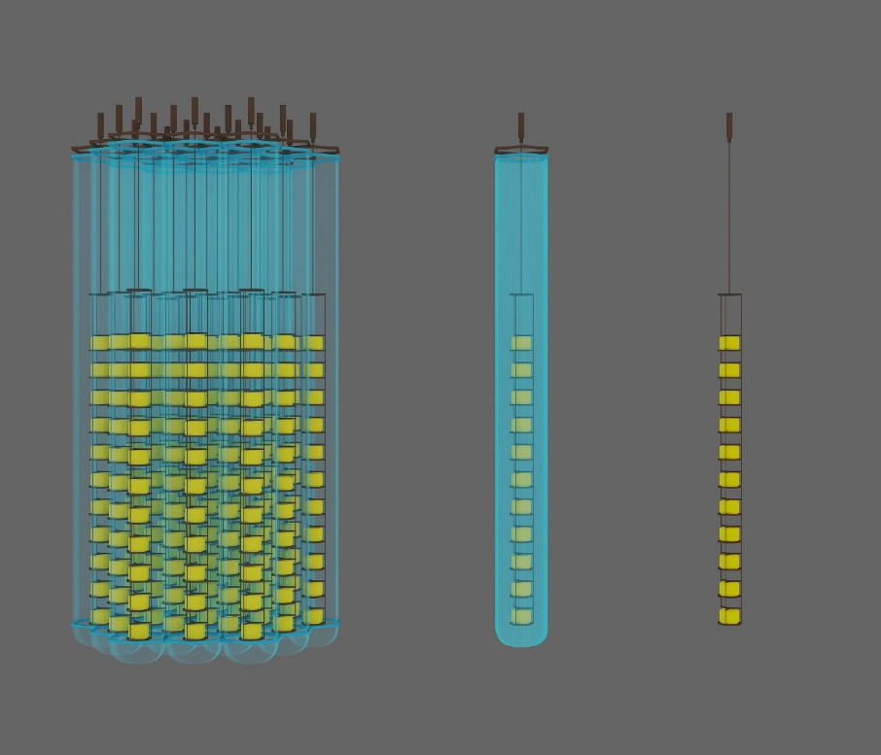
CDEX-300$ν$ experiment
~300kg enriched ⁷⁶Ge array
~20T LAr, AC veto and cooling
φ1.2m
φ0.24m
φ0.1m
H2m
×19
×19
1725 m³ Liquid Nitrogen
LAr tube
Enriched Ge array
Notes:
CDEX-300 program, there are 19 detector strings, each have 11 crystals, the total mass is about 300 kg. the enriched 76Ge array are placed into a LAr veto system and both of them are placed into the LN2 tank.

Slide 18
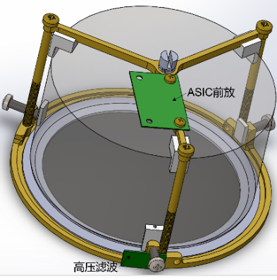
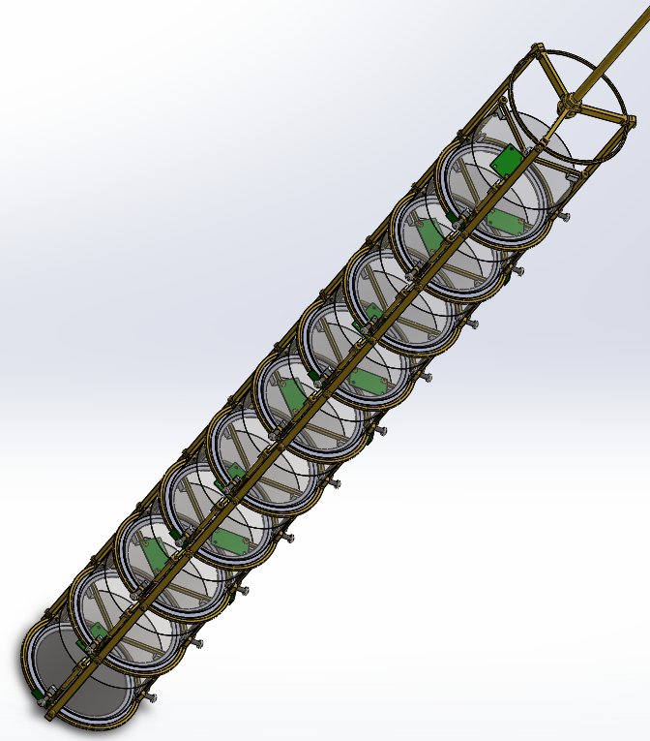
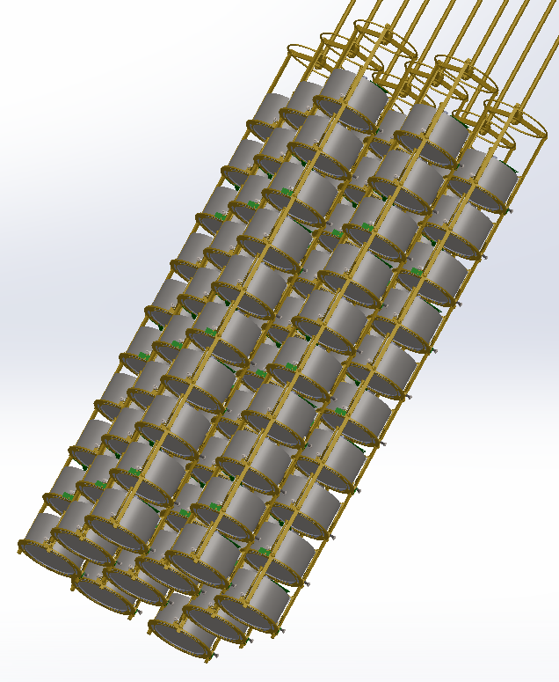
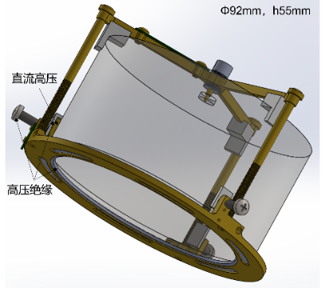
CDEX-300$ν$ detector
Ge-76 enriched BEGe detector units
Structural parts: low quality and low background design, high purity electrolytic copper and high purity polytetrafluoroethylene
Front-end electronics: ASIC +Silicon Substrate
Notes:
The enriched BEGe units have low quality and low background design. And we upgrade the electronics to ASIC based on the CMOS techniques with low background low Temp. design.

Slide 19
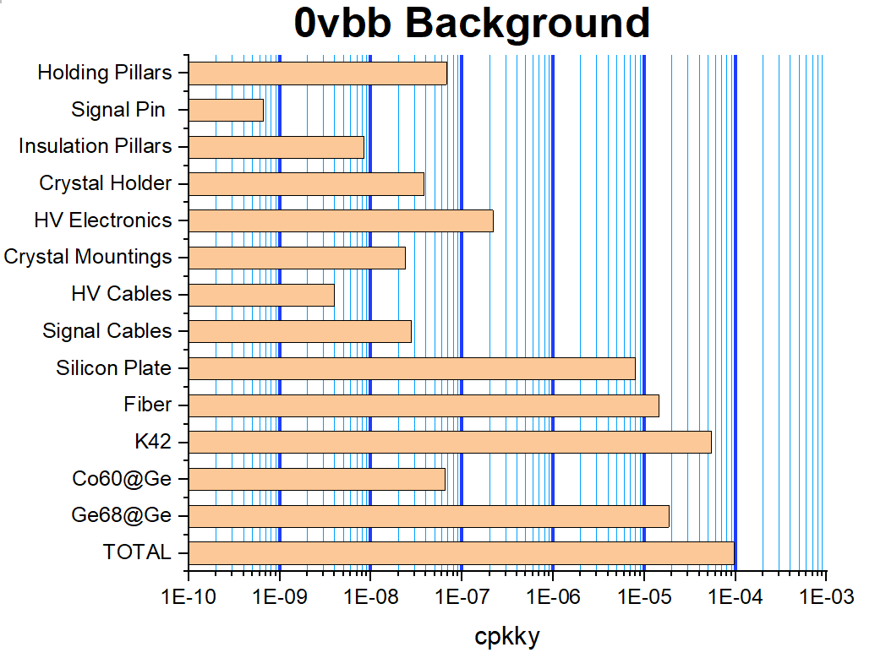
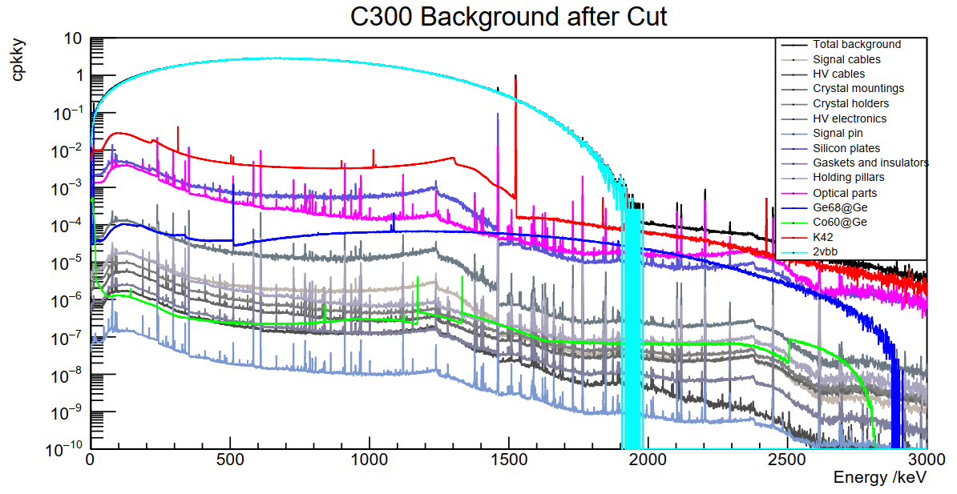
CDEX-300$ν$ Background Model and Simulation
Detector prototype: BEGe / ICPC
Energy resolution: 0.12% FWHM@2.039MeV.
Background Index：1×10⁻⁴ cts/(keV∙kg∙year)@ Q_{ββ}=2.039MeV.
CDEX-300 background
Notes:
Here is the simulation result for CDEX-300𝝂 Background Model. We can clearly see that the background mainly comes from crystal surrounding material, electronics and cosmogenic isotopes in Ge.

Slide 20
CDEX-300$ν$ projected results
Construction time: 2021-2026, Run time: 2027-2031 (5 years)
An exposure for ⁷⁶Ge 0νββ: >1t·y, T_{1/2} > 10²⁷y.
Parameter | CDEX-300
⁷⁶Ge mass | >225 kg
BI@2039keV | 10⁻⁴ cpkky
E_{R}@2039keV | 2.5 keV (FWHM)
Run time | 5 y (2027-2031)
Exposure | 1.125 t·y
T_{1/2} | >1×10²⁷y
m_{ββ} | 28.5~68.0 meV
Notes:
CDEX-300 is now under construction and plan to run in 2027. The projected BI @ ROI is ten to minus 4 cpkky, that is five times lower that the Gerda-II result which is the most sensitive experiment based on the Ge technology and projected half life is 5 times longer than gerda-II result and similar with the Legend-200 projection。

Slide 21
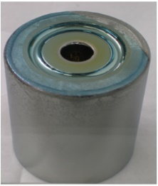
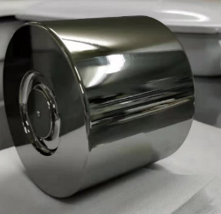
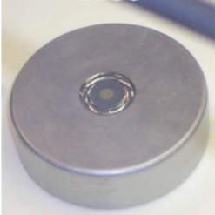
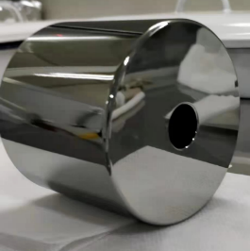
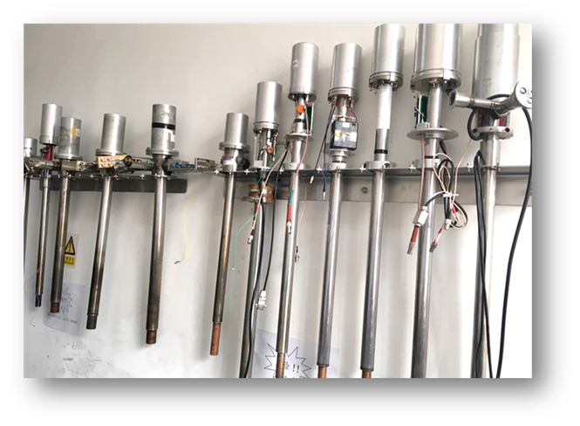
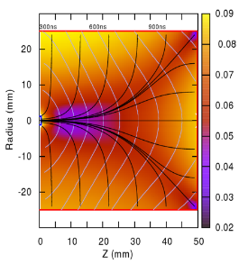




Ge Detector Fabrication
Home-made different Ge detectors by CDEX group;
Detector performances are the same with commercial products with long-term stability.
Commercial Ge crystal;
Structure machining;
Li-drift and B-implanted;
Home-made ASIC PreAmp;
Underground EF-Cu;
Underground assemble;
Underground testing…
Co-axial
PCGe
BEGe
ICPC
Notes:
To achieve the target, several key technologies are required. Home made Ge detector fabrication is one of them. It is too expensive to buy commercial detectors, we can not afford when the mass reach to order of 100 kg. The more important is that it is impossible to optimize the performance and background of the detector according to our requirements of the experiment. The optimization here includes germanium crystal design optimization, materials screening near the crystal, such as electronics, the structure of various materials. So CDEX has been working on the detector fabrication for many years, and successful made different types of Ge detectors, including coaxial/PCGe/ BEGe/ICPC and has the good long term stability. We can see from this pic., overing 1200 days the energy resolution of one detector has good stability.
PCGe with low energy threshold usually used in DM search, BEGe has excellent energy resolution and good pulse shape discrimination to suppress the background (by discriminating single event from muliti-event), usually used in 0vbb experiment. Inverted Coaxial Point Contact, ICPC, has been developed in resent years, it combines the features of coaxial PCGe and BEGe, which has high mass, a very small point contact electrode, it can achieve low noise, low energy threshold and good pulse shape discrimination, Legend plan to use this type of Ge in its future legend 1T experiment. One ICPC over 1kg mass (with dimension of phi75mm*h64mm) has been successfully made by Tsinghua University.

Slide 22








Ge Crystal Growth
On the ground
underground
Long-term work to grow Ge crystal at ground Lab by CDEX group;
Ge crystal growth and detector fabrication at CJPL funded.
Notes:
Ge crystal growth is an important key technology especially to the ton scale experiment when the cosmogenic isotopes is one of the dominated background. The underground crystal growth and fabrication can effectively decrease the cosmogenic background, so it is necessary for us to master this technology and achieve crystal growth in CJPL. For more than 10 years work, CDEX has made good progress in the growth of small size of high purity germanium crystal, which can be successfully fabricated to germanium detector.

Slide 23



Securing Enriched Ge Material Supply
200kg ⁷⁶Ge (>86%) stored at CJPL, half from Russia and half from China.
CDEX has the largest amount of ⁷⁶GeO₂ powder in hand now in the world.
The mass production power (Hundreds of kg each year) of enriched ⁷⁶Ge material has been setup in China and it is an important contribution to International ⁷⁶Ge 0νββ experiment community.
23
Notes:
As to the Ge-76 enrichment, in the international market, we can only buy Ge-76 from Russia and the other Europe’s Company, the production output is not high. It is said the production output is about ~100 kg/year. For security, we buy half from Russia company and half from China (China Atomic Energy Industry Corporation). Right now, we have the largest amount of enriched germanium powder in the world. More important is that the mass production power of enriched Ge material has been setup in China, and it is an important contribution to the international Ge-76 0vbb experiment community.

Slide 24





ASIC PreAMP + LN₂ Cryostat
The first Ge+ASIC+LN₂ detector in the world:
500g Ge + home-made CMOS ASIC preamp immersed into LN₂
Works with expected performance!
201712 T1 (3.15d)
201809 T1 (8.83d)
threshold ~300eV
Ge-68,71 KX
Fabricated and Tested in CJPL-I
ASIC PreAMP
Background spectrum @CJPL
Notes:
Another key technology is preamp. Traditional JFET Amplifier is not suitable for the next stage experiment because it can not work well in the LN2 Temp. ASIC preamp can work at the LN2 temp and the mass of ASIC chip is below 10 mg. It can help us to realize the low background. CDEX has successful built a system of 500g Ge with home made CMOS ASIC preamp immersed into LN2. And work with expected performance. The spectrum of this system are shown here.

Slide 25



LAr veto
Liquid argon volume (φ1.5 m×H 8 m) 14 m³, readout by optical fiber;
The liquid argon purification system
reduces the concentration of impurities(H₂O, O₂, N₂, CO₂) to less than 10ppb.
25
Notes:
LAr active veto technology is also an important technology for CDEX-300 experiment, which mainly includes the purification and circulation system of LAR and the readout system of LAR scintillation light. Like the other experimental groups, we plan to purify argon with a gas filter. Optical readout adopts the optical fiber and SiPM.

Slide 26
Summary
0νββ search: the top scientific questions in particle and astroparticle physics.
HPGe is one of the most competitive techniques
CDEX is establishing a Large-Science-Facility CDEX-300ν
CDEX has made great contribution to the international Ge community including:
  Large underground space at the deepest CJPL;
  Mass production of ⁷⁶Ge isotope material and Ge detectors;
  ASIC-PreAMP-Ge detectors;
  Underground Ge crystal growth and detector fabrication for cosmogenic background control.
Notes:
Summary: 0vbb is very important；HPGe is one of the most competitive techniques；The CDEX collaboration has already explored this area and is building the CDEX-300 experiment. CDEX has made great contribution to the international Ge community，including: Large underground space at the deepest CJPL; Mass production of 76Ge isotope material and Ge detectors; ASIC-PreAMP-Ge detectors; Underground Ge crystal growth and detector fabrication for cosmogenic background control.

Slide 27

Thanks for your attention!

