Slide 1
Probing Dark Matter–Electron Interactions via High Purity Germanium Detectors from CDEX
Zhenyu ZHANG (CDEX Group), Tsinghua Univ.

Slide 2
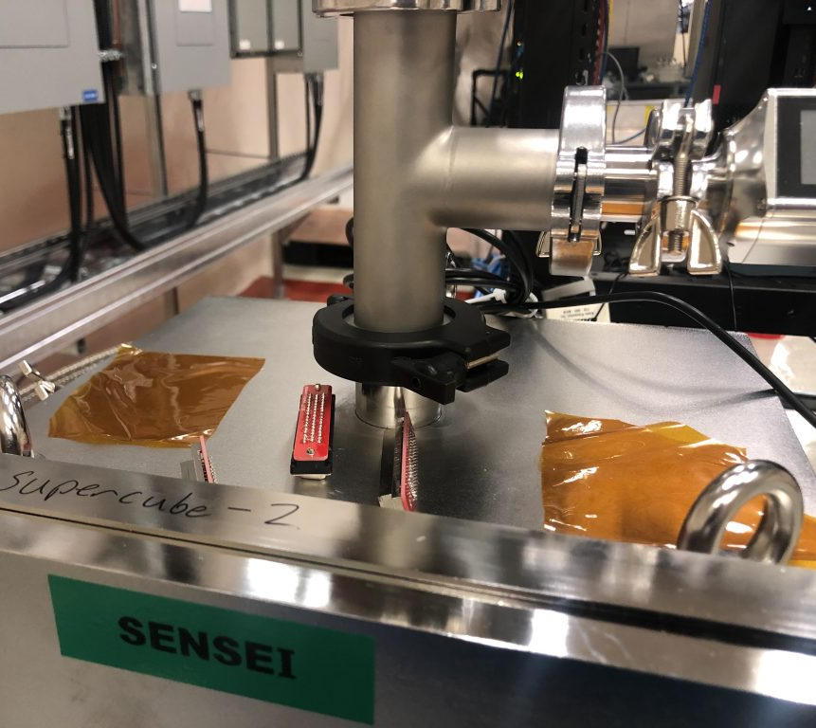
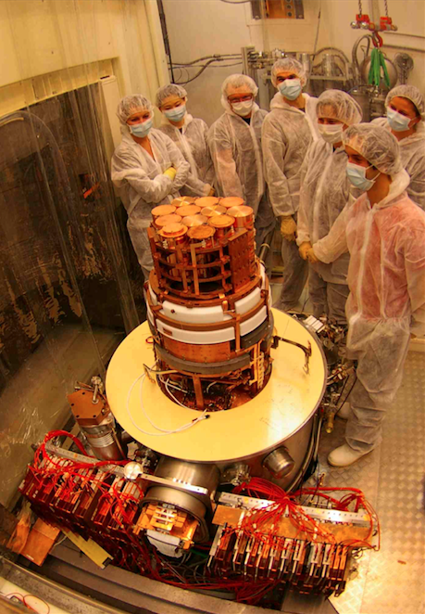
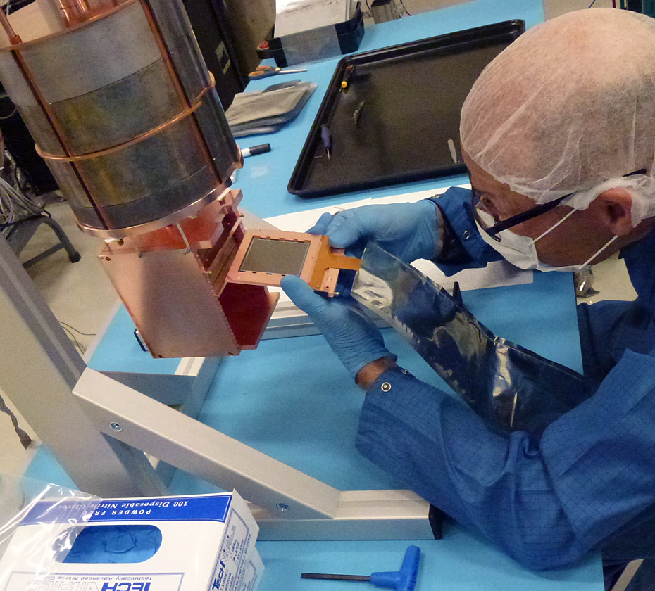
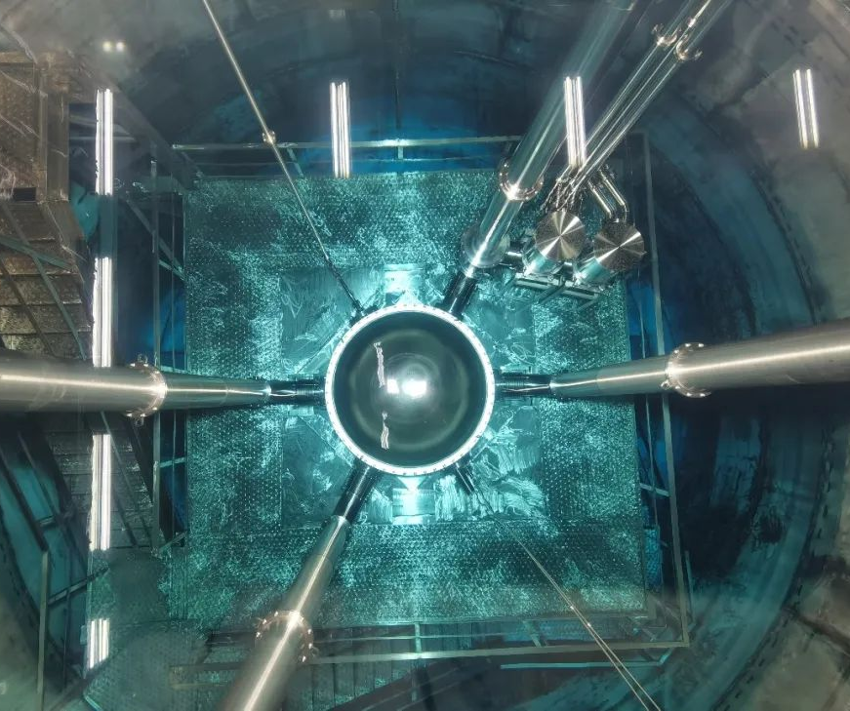
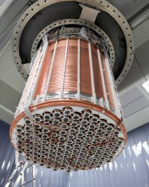
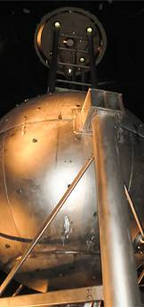
DM-e interaction paradigm
Previous DM detection experiments mostly focus on DM-nuclei(χ-N) interactions.
Recently a DM-electron (χ-e) scattering paradigm has drawn much attention. Further lowering the m_{χ} reach.
Solid state detectors
SENSEI, DAMIC, EDELWEISS
Liquid scintillators
XENON, PandaX and Darkside
The m_{χ} is now pushed down to ∼1 MeV.

Slide 3
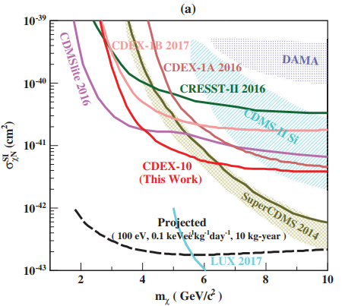
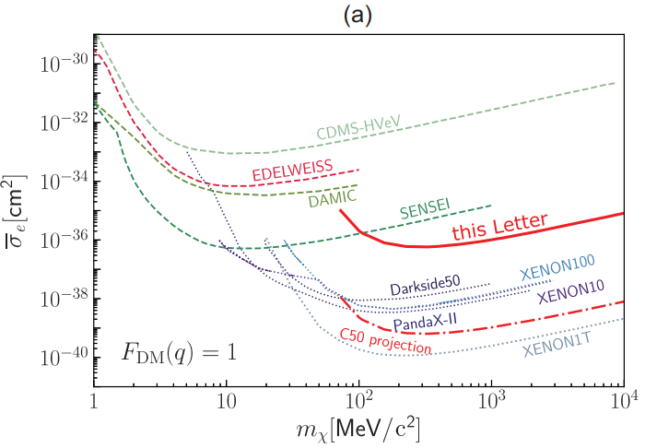
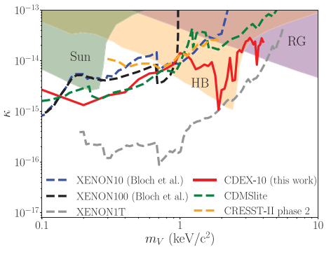
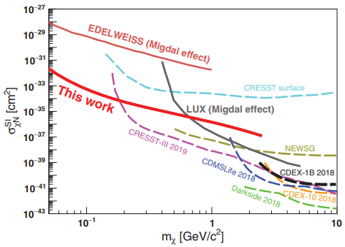
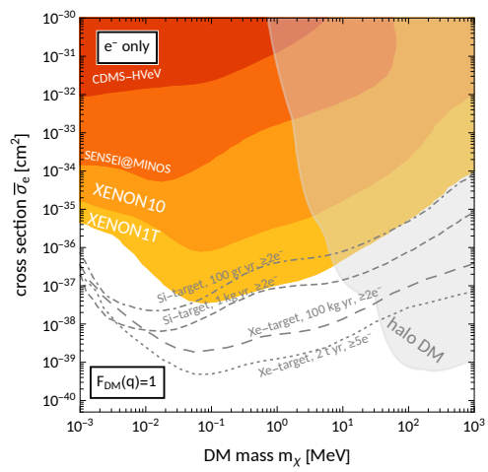
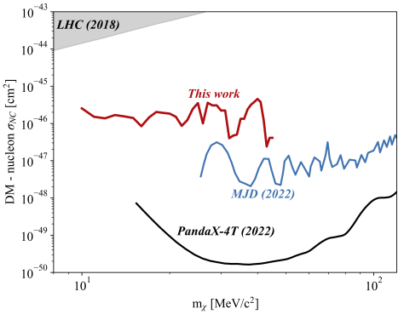
Dark Matter-Matter Interactions
Dark Matter-Nuclei
Dark Matter-Electron
Other Interactions
Mass Reach：~GeV
Mass Reach：~MeV
Mass Reach：~keV
DM-e interaction has great advantages in probing light Dark Matters.

Slide 4
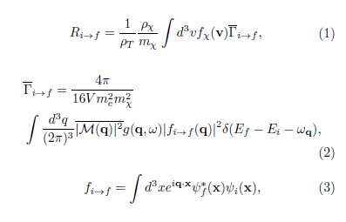
DM-e interaction rate calculation
To perform analysis, we need predicted rate in detectors
The total rate can be written as below, where f_{i→f} is the crystal form factor:
Heavy mediator
Light mediator
Screening factor
Noble gas target: atoms are considered isolated (simple)
Crystal targets(Ge/Si): many-body system (complicated)
Density function theory (QEdark package) realized valence and conduction transition rate calculation.
Still a problem for HPGe detectors (160 eV threshold)

Slide 5
Previous efforts
Semianalytic approximations for initial and final state wave functions. Density of states to incorporate band structures.
Energy loss function (ELF) method.
Density function theory (DFT) to calculate valence and conduction band structures and wave functions. QEdark package.
Predicted spectrum extend to ~50 eV.
Still a problem for HPGe detectors (160 eV threshold).

Slide 6
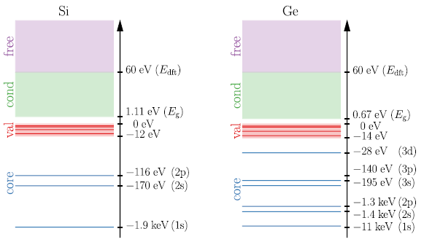
New technique: EXCEED-DM
EXCEED-DM：a new technique that incorporates both DFT with AE and semianalytic methods
Free: For states above 60 eV, electrons are considered free and are modeled as plane waves
Valence& conduction: DFT and AE reconstruction method
Core: Modeled as “core” electrons, semianalytic method is utilized.
QEdark package only take valence and conduction bands into account.
EXCEED-DM results are more complete and spectra can reach up to ~keV

Slide 7
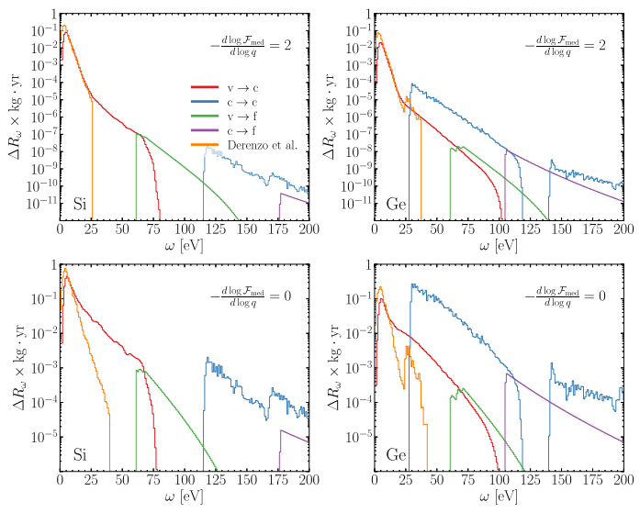
Predicted spectrum of EXCEED-DM
In low energy region: accords with QEDark, minor difference for low-threshold experiments.
In higher energy region: major improvement for HPGe detectors.

Slide 8
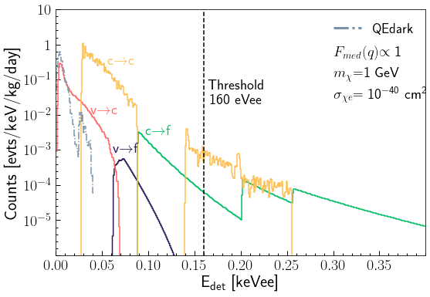
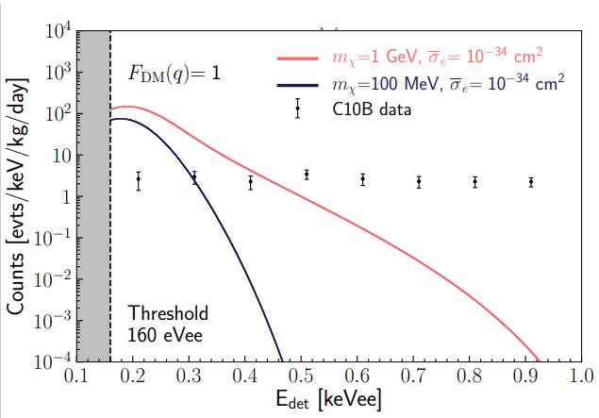
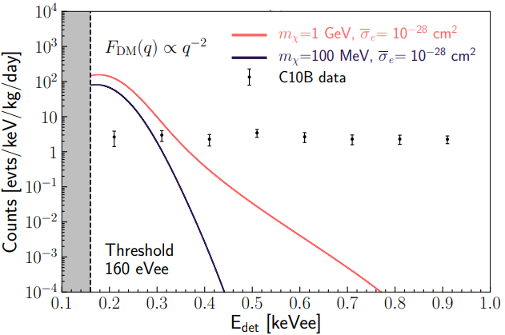
Expected rate in Ge detector
Actual spectrum we see via detectors is smeared with energy resolution.
Predicted spectrum from EXCEED-DM
Heavy mediator scenario with energy resolution
Light mediator scenario with energy resolution
Can we see events with energy lower than the threshold?
Maybe. But not for sure!
All removed before analysis.

Slide 9
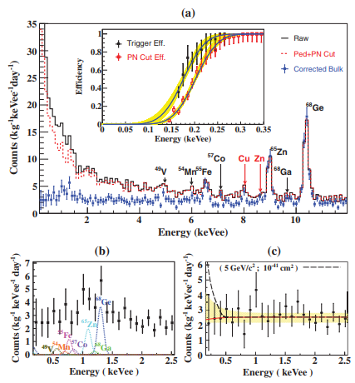
Data from CDEX-10
C10B-Ge1 dataset
Exposure: 205.4 kg·day
Treatment:
Pedestal noise cut
Physics event selection
B/S discrimination
Known radioactive peaks are subtracted according to K-X peaks
Threshold: 160 eVee (signal efficiency 4.5%)
Resolution:

Slide 10
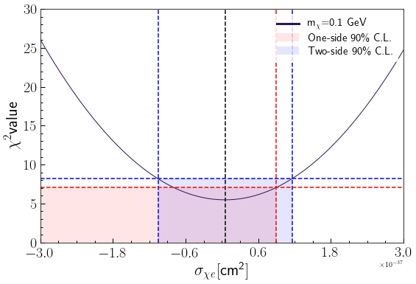
TI analysis
Energy range of the data is 0.16–2.16 keVee, and bin width is 100 eVee. Best fit using chi square method is performed:
Cross section has a physical limit of σ > 0, so an one-side upper limit is adopted.

Slide 11
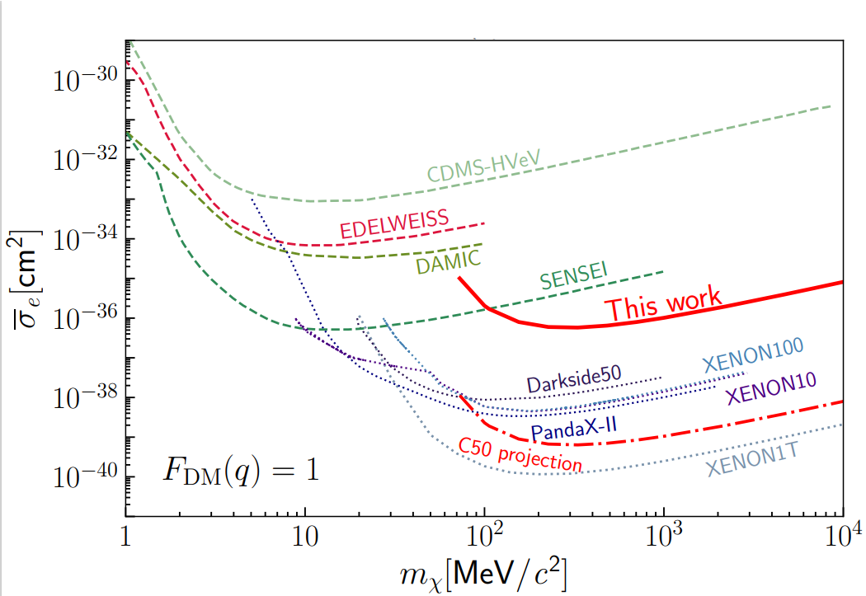
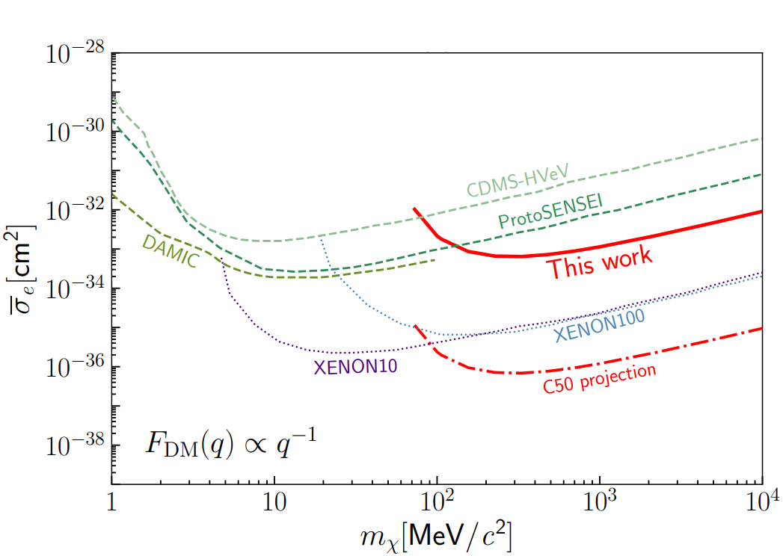
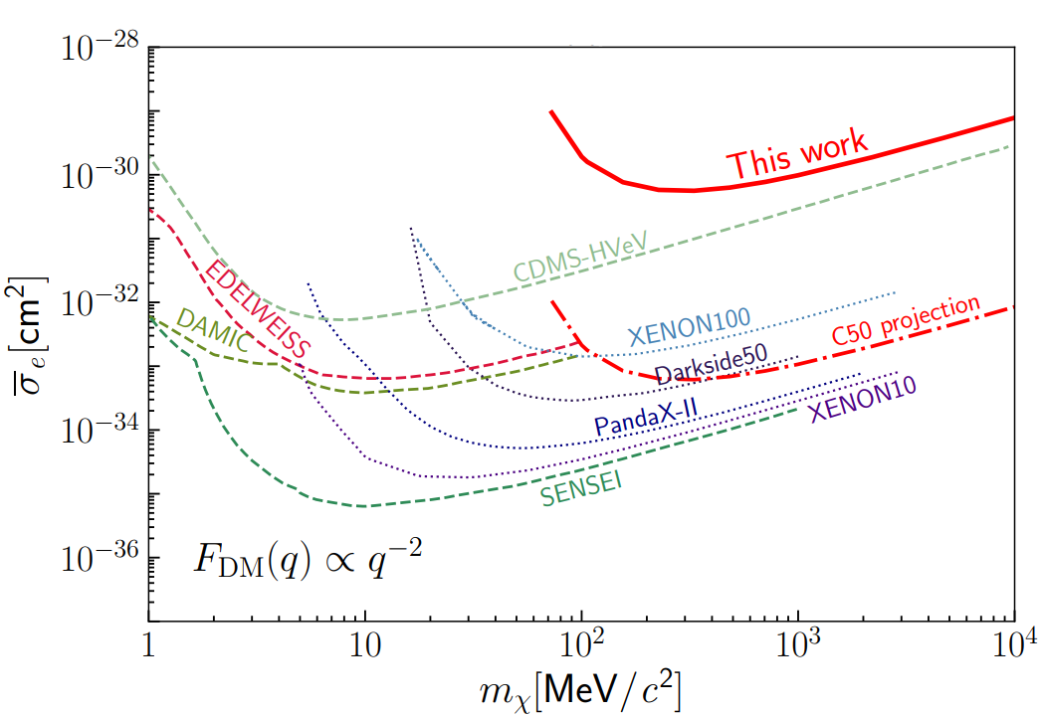
Exclusion line
The first χ-e result from HPGe detectors.
In the heavy mediator scenario, our result proves to be the most stringent amongst other solid state detector based experiments in mass region of m_{χ} > 100 MeV.
DOI: 10.1103/PhysRevLett.129.221301

Slide 12
Summary and next
This result reveals the vast potential of such technical route in probing the χ-e scattering.
Expected signal drops drastically as energy grows, yet HPGe detectors’ energy threshold is not that ideal. The superior ultra-low radiation environment of CDEX experiment greatly compensates the loss of sensitivity due to high threshold.
For CDEX-50 experiment with an array of 50 1-kg HPGe detectors, radioactive background will be further reduced to ~0.01 cpkkd in sub-keV region. An improvement up to three orders of magnitude is achievable.

