Slide 1


Overview of the PandaX Experiment
Wei Wang
Sun Yat-sen University (SYSU)
On behalf of the PandaX Collaboration

Slide 2

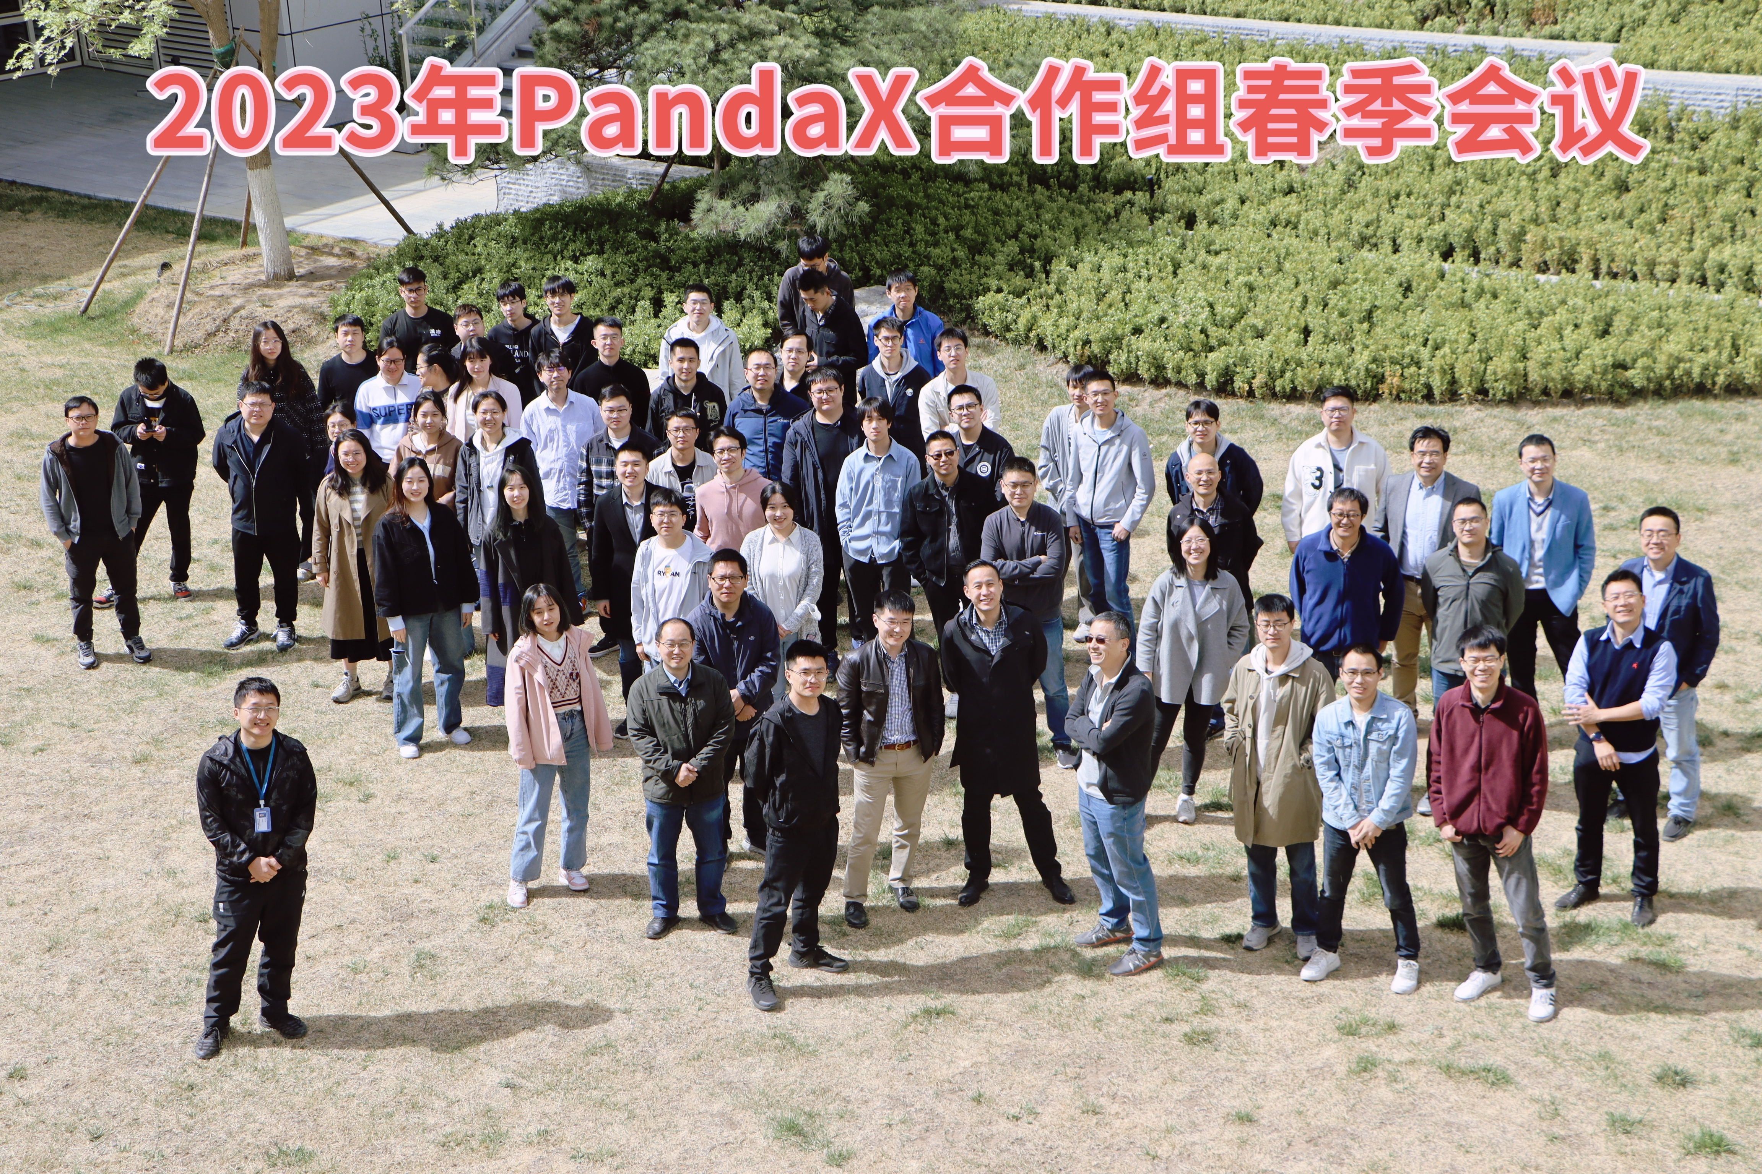
PandaX Collaboration
Notes:
PandaX collaboration, started in 2009, was built for searching the dark matter particles. Now there are more than ten cooperating organizations in the world and have dozens of researchers and students in our group. Here is a recent photo of our collaboration.

Slide 3
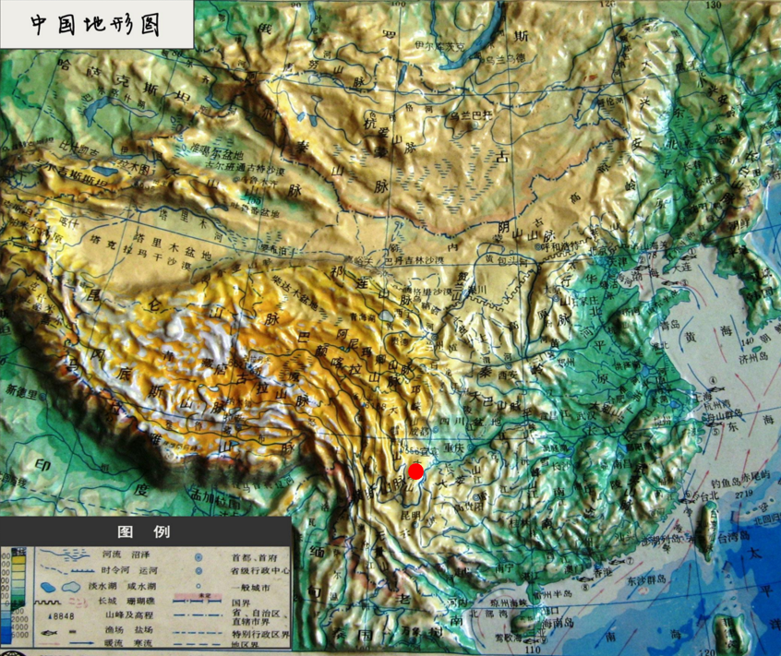
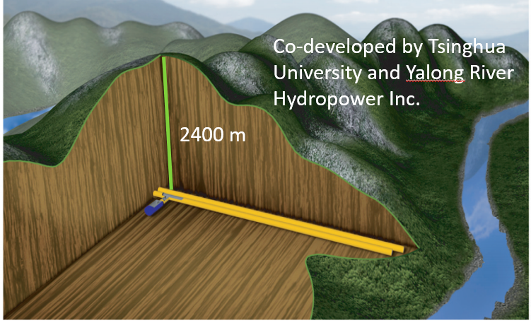
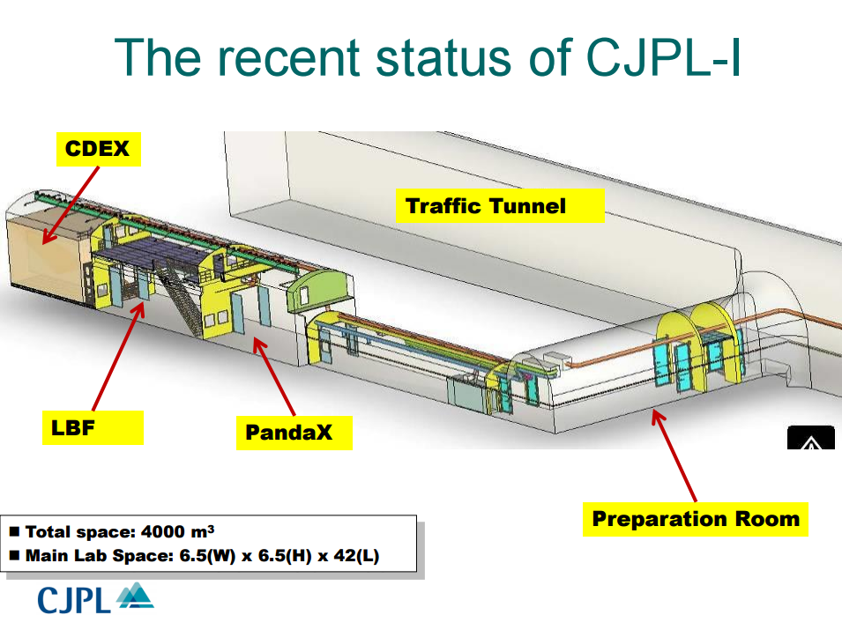
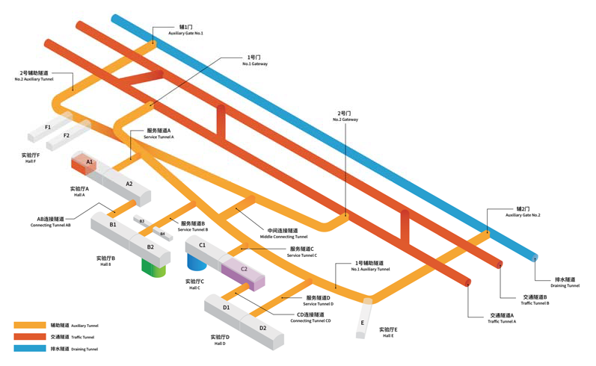
China JinPing Underground Laboratory – CJPL
  Deepest (6800 m.w.e )
  Horizontal access
  Muon rate: 1 count/week/m²
  From CJPL-I to CJPL-II
Notes:
The lab location for rare event search is essential to get rid of the cosmic ray background. PandaX experiment is located at the China Jinping underground laboratory, the deepest underground lab which has 2400 meter rock shielding, and the muon flux is only one count per week per square meter. In 2015, the second phase of CJPL, CJPL-II starts the construction, and in 2019, PandaX-4T detector move to the B2 hall of CJPL-II.

Slide 4
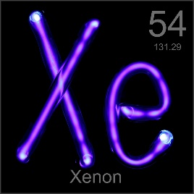
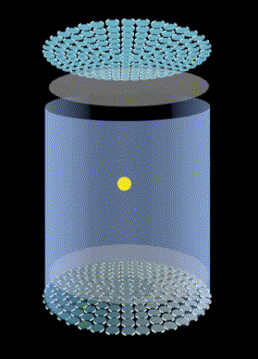
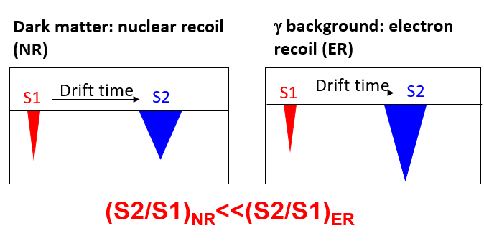
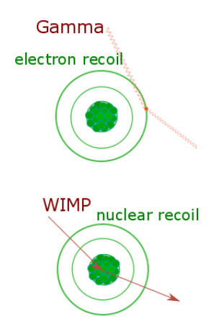
Dual Phase Liquid Xenon TPC
Purity liquid xenon target, high light & charge yield;
Good ER/NR discrimination by S2/S1 ratio;
3D reconstruction rejects external background;
Notes:
The key technology we used is the dual phase liquid xenon time projection chamber. It could collect the light as well as the ionization signals. Xenon is a heavy noble gas with the nucleon number about 130. It could significantly enhance the dark matter signals compare to other light elements. Besides, it’s liquefication temperature is about minus 100 centigrade degree that could be easily achieved. And xenon has a high light and charge yield. When a dark matter particle come into the detector, it will release the scintillation light and the ionization electrons. The light will be collected by the top and bottom PMT arrays, called S1. And the electrons will drift to the liquid-gas surface, and then extracted by the extraction field and release another light signal, called S2. The nuclear recoil event and the electron recoil events can be distinguished by the S2 over S1 ratio. For the conventional WIMP signals, it performs like a nuclear recoil. And according to the S2 distribution of the top PMT arrays, together with the time difference between S2 and S1, we could establish the 3D position of an event and reject external background.

Slide 5
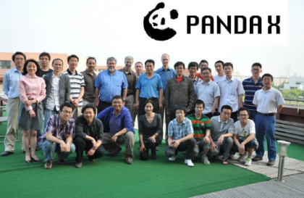
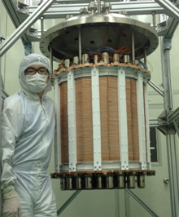

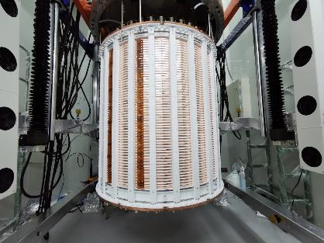
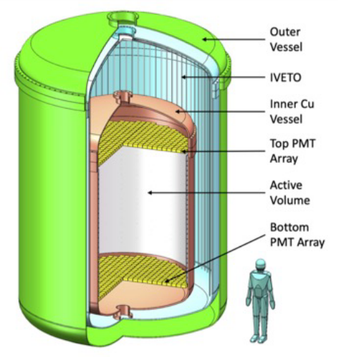
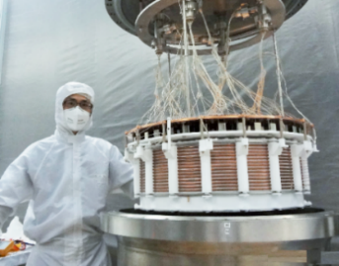
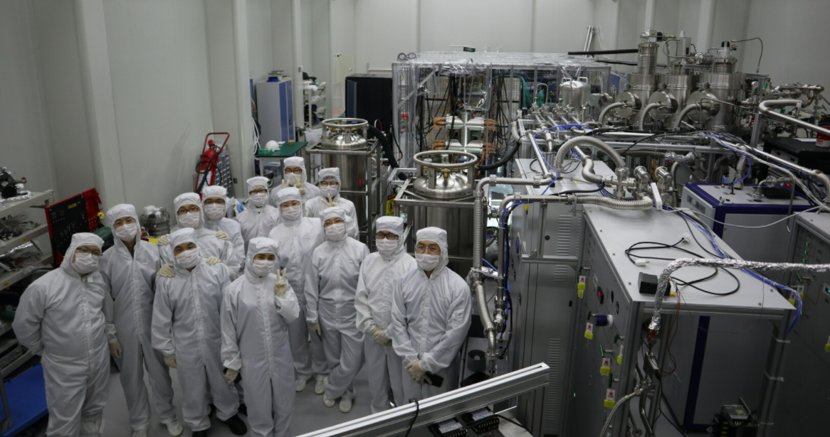
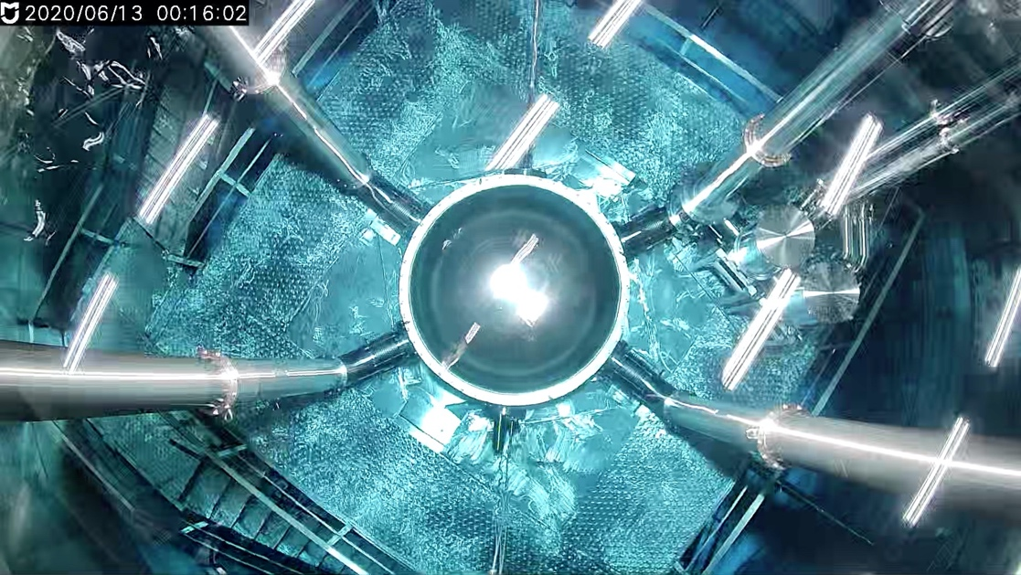
PandaX Roadmap
Particle and Astrophysical Xenon Experiments
PandaX-II, 580 kg operation
PandaX-4T
Commissioning
Collaboration formed
Ongoing
2014.5-10
2019.8
2021.11
2009.3
2016.7-2019.7
2020.11-2021.5
PandaX-xT
PandaX-I, 120 kg
operation
PandaX-4T moved to CJPL-II
PandaX-4T Run1
Notes:
PandaX dark matter experiment contains three phases and here is our operation procedure. We start from PandaX-I with 120kg liquid xenon in 2014. And PandaX-II, using 580kg liquid xenon started in 2016, and now the PandaX-4T with nearly 4-tonne liquid xenon in the sensitive volume. We just finished our commissioning run and science Run1, and the data analysis is ongoing. For the next-generation liquid xenon experiment, PandaX-xT which contains dozens of tonnes of liquid xenon is already on our schedule.

Slide 6
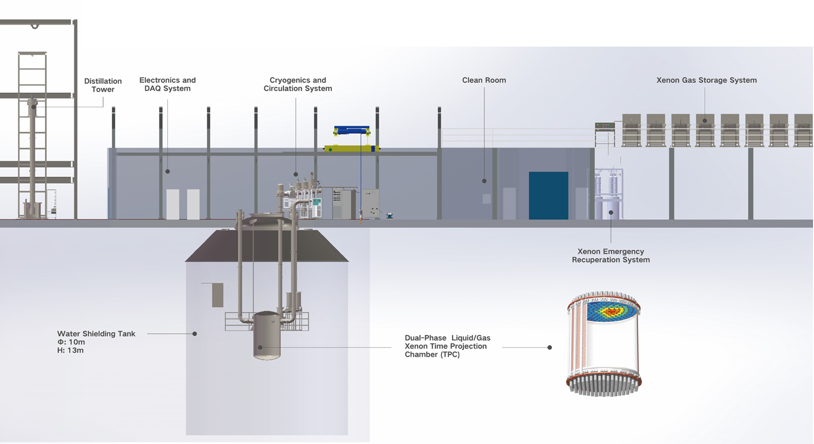
PandaX-4T Overview
System Layout
Notes:
Here is our PandaX-4T global layout at CJPL-II. The central part is a hyper-pure water tank for the background shielding and the 4T TPC locates inside it. On the top of the water tank is our clean room, with our electronics and DAQ system, the cryogenics and the circulation system inside. And out of the clean room, the left is the xenon distillation system and the right is the xenon gas storage system.

Slide 7
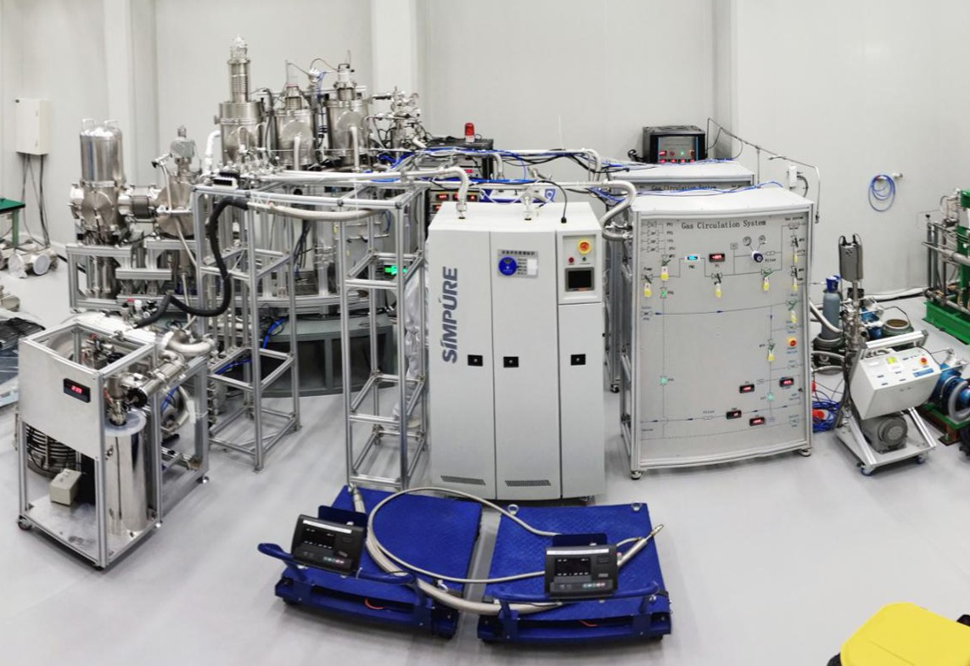
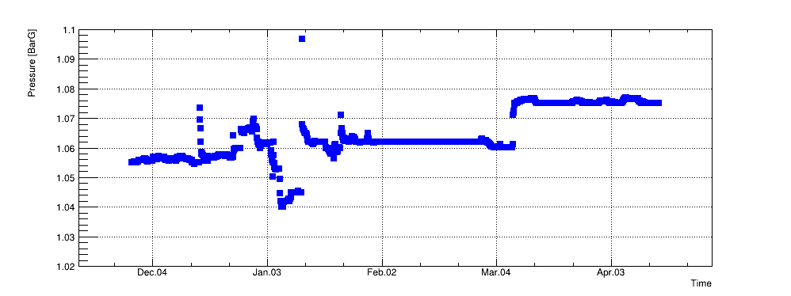
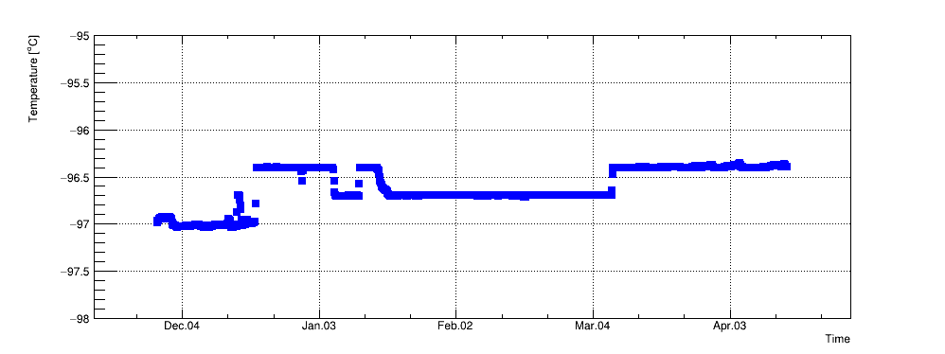
Cryogenics System
Pressure and temperature stability within 0.5% and 0.1K .
JINST 16 P07046 (2021)
Adjust Coldhead
temperature
Cryogenics
Loop2 In
Purification
Loop1 Maintenance
Parameters | Heating load (No purification) | Maximum Cooling Power | Filling/Recuperation flow rate | Outer Vacuum
Value | ~50 W | ~580 W | ~1 ton/day | <2E-4 Pa
Notes:
First, I’d like to start with the xenon handling system. In the left figure, you can see our cryogenics system and the purification system. As I mentioned, the liquid xenon needs a cryogenic environment and keep the liquid level and gas pressure stable. We use the commercial cryocoolers to apply the cooling power more than 500Walts. During the running, the pressure and the temperature are stable within 0.5% and 0.1Kelvin.

Slide 8
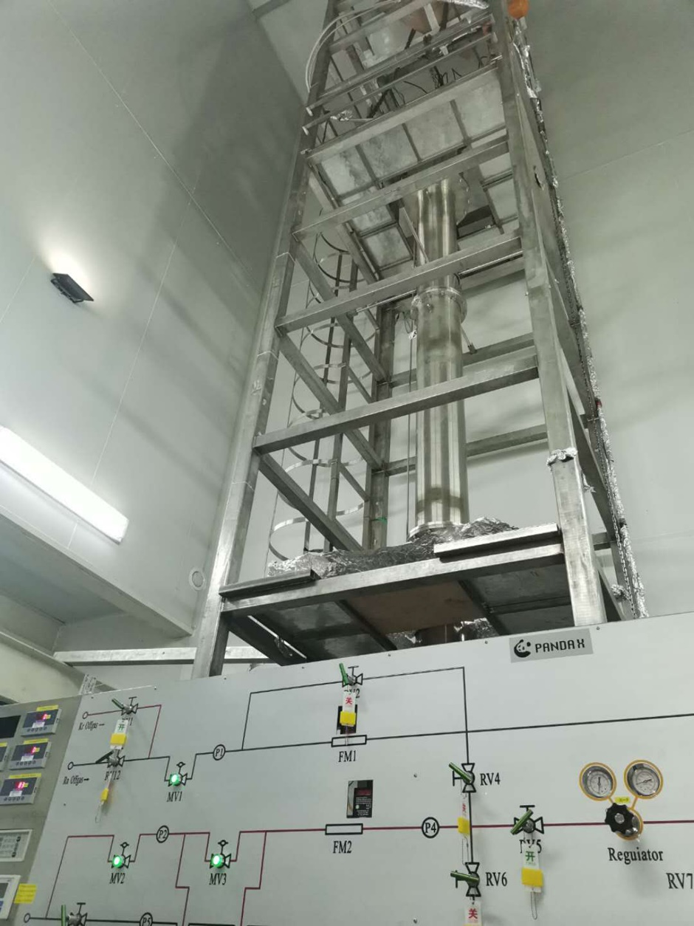
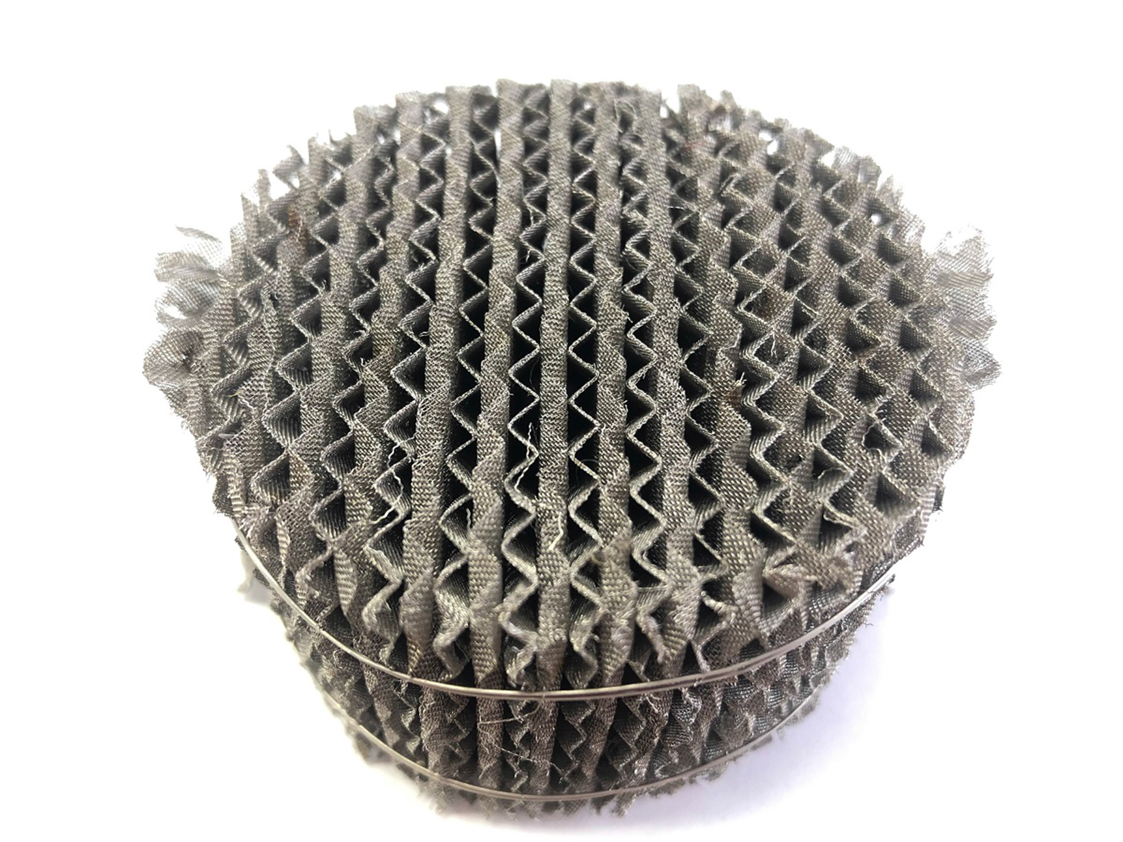
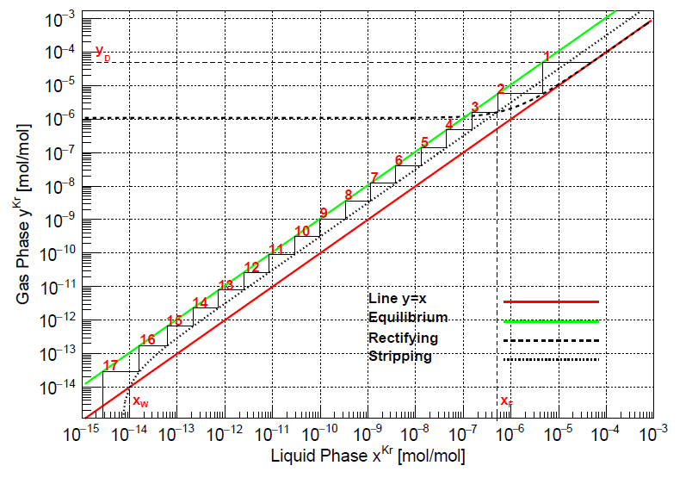
Distillation System
JINST 16 T06007 (2021)
Structured packing (inside)
M-T diagram for Kr removal
Distillation method for the LXe intrinsic background Kr & Rn removal;
~10⁶ reduction factor for Kr removal with 10 kg/h;
Reversed operation mode working for Rn removal;
Notes:
While for other noble gases contamination, like the main intrinsic background Krypton and radon, the distillation method is applied. Here is our distillation tower which is about 10-meter high. This is our structured packing inside the tower. By the M-T diagram, the krypton removal ability gives a reduction factor of 10^6 with 10kg/h. And this is the first tower for both the krypton and radon removal. Two different operation processes could be achieved by reverse the operation mode. Beside the krypton and radon, the distillation system might be helpful for the tritium removal, which plays an important background in the PandaX-4T commissioning.

Slide 9
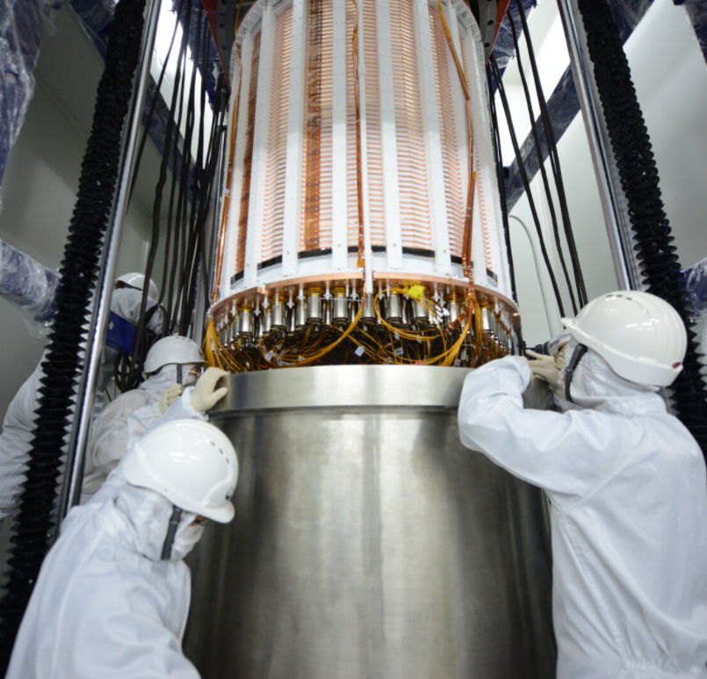
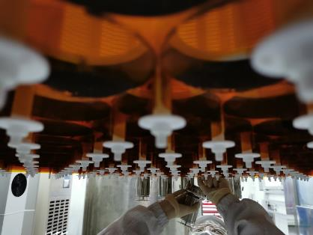
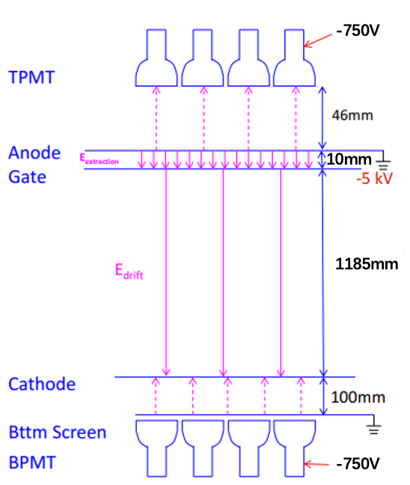
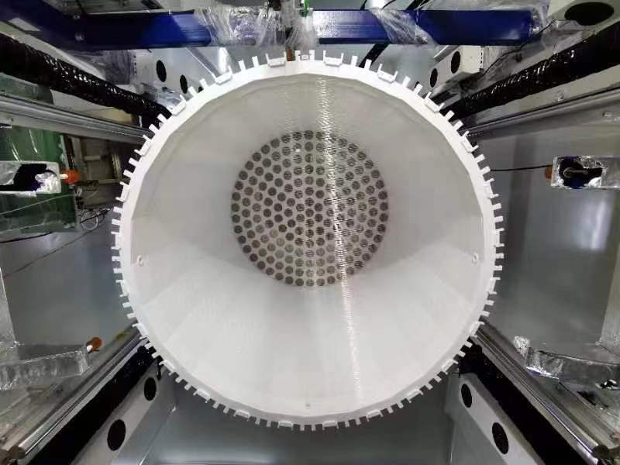
TPC Conditions
 | Set1 | Set2 | Set3 | Set4 | Set5
Gate(kV) | -4.9 |  | -5 | -5
Cathode (kV) | -20 | -18.6 | -18 | -16
Notes:
Well, Back to the detector itself. Left are some pictures of our TPC, and the right figure shows the electric field we used. Including the drift field in the liquid xenon and the extraction field. The liquid-gas surface is between the Gate and Anode. During the commissioning run, the Gate and Cathode voltages are stable.

Slide 10
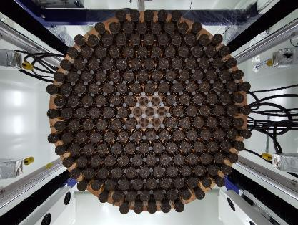
PMT Arrays
Bottom PMT arrays
169 top + 199 bottom R11410-23 3-inch PMTs, with the average gain of 5.5×10⁶;
LED calibration every week, monitor gain stability;
Notes:
The S1 and S2 are collected by the PMT arrays, they are the eyes of the detector. In PandaX-4T, 3-inch PMTs are used with an average gain of 5.5 times 10^6. We did LED calibrations every week to calibrate the PMT gain and monitor the stability.

Slide 11
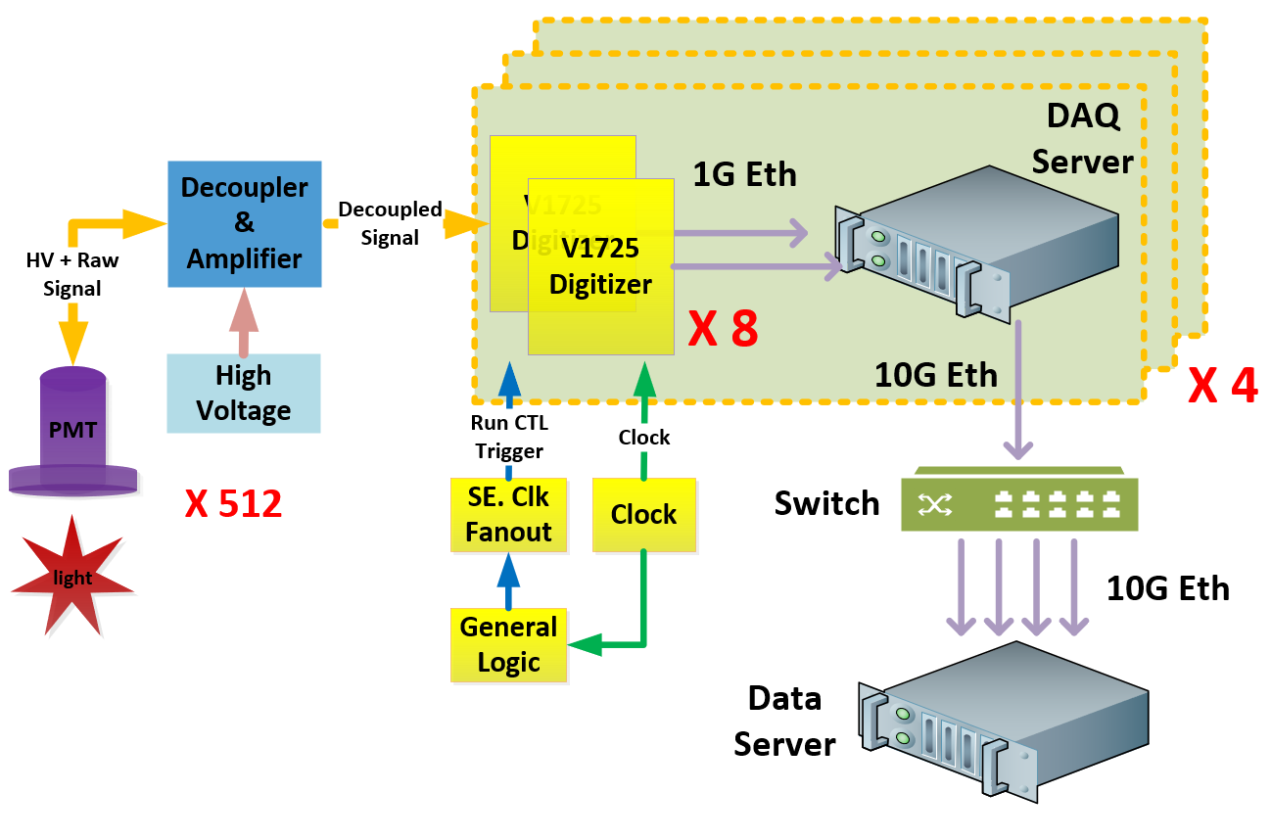
Electronics
From PMT to DAQ server;
CERN V1725 Digitizer, 250 MS/s;
Self-trigger mode: read out pulses above 20 ADC (~ 1/3 PE);
Notes:
After the lights collected by the photo sensors, those data will be digitized by the V1725 from CERN and stored in our server. The self-trigger mode is applied during PandaX-4T running. The waveforms will be stored and we require the read-out pulses above 20 ADC.

Slide 12
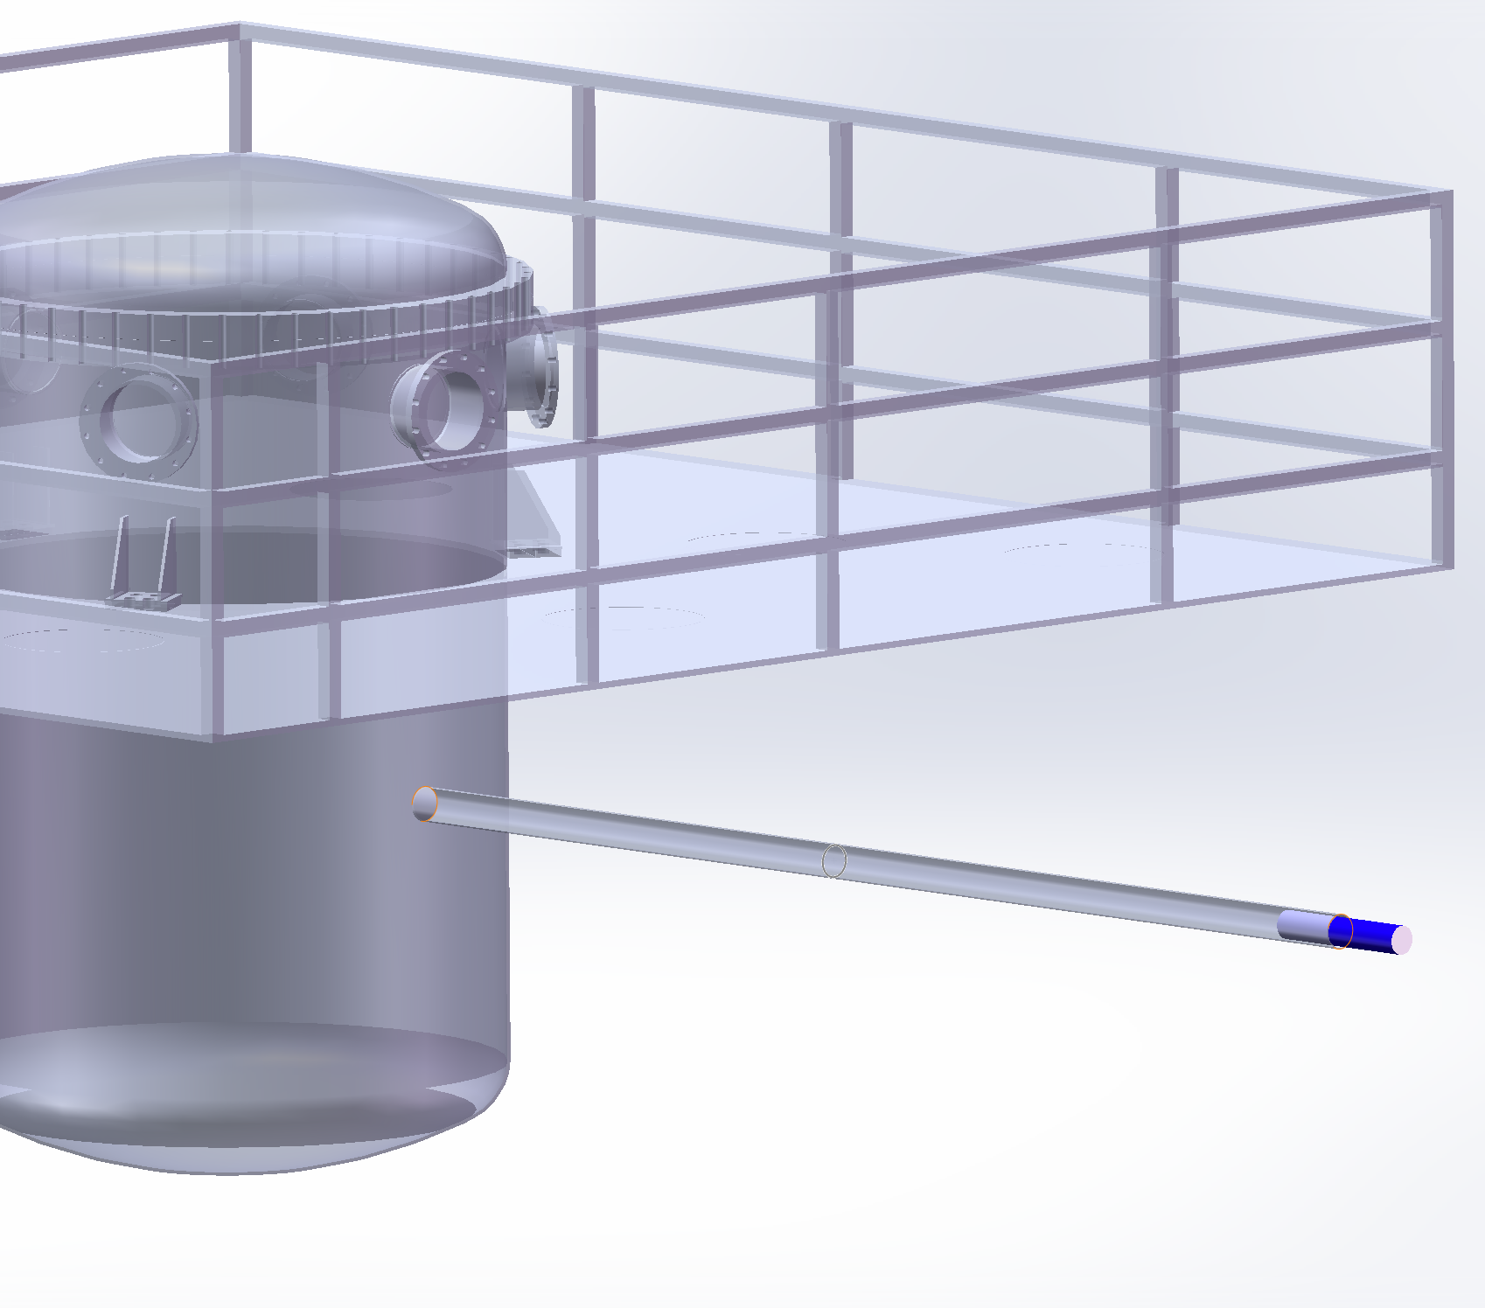
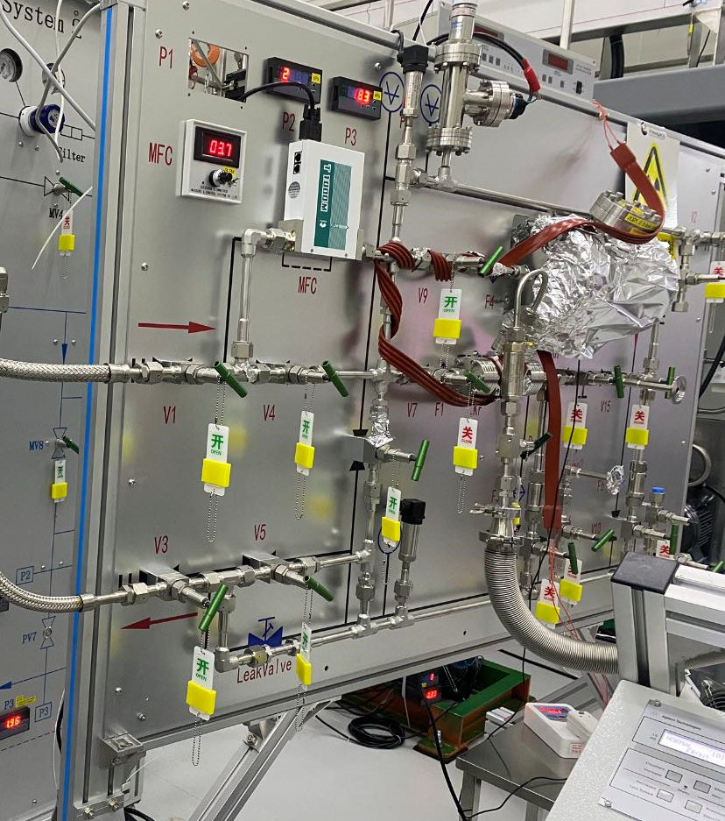
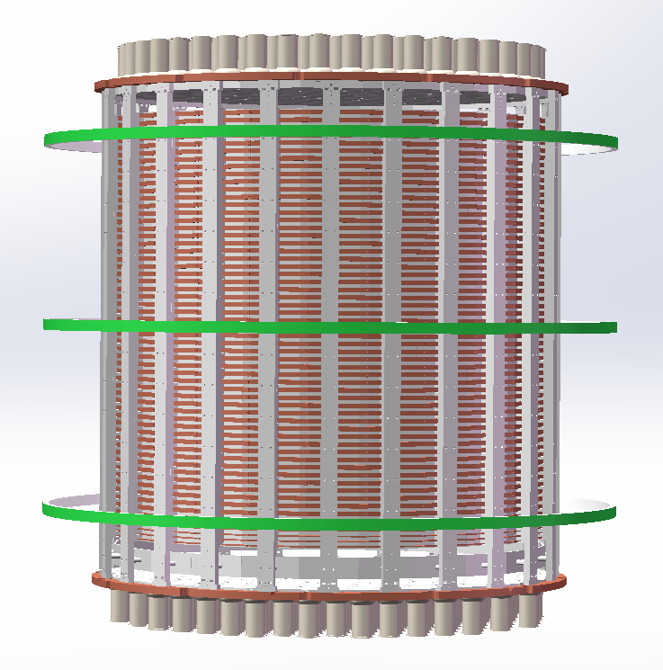
Calibration System
Gaseous source injection panel
Calibration tubes
D-D generator
Calibration source | Position
^{83m}Kr/²²⁰Rn | Injected from gas panel
²⁴¹Am-Be | Calibration tubes
D-D neutron | Beam pipe
Notes:
Next, about the calibration system. To know about the signal response in the PandaX-4T detector, both electron recoil and nuclear recoil events need to be calibrated. For the electron recoil calibration, the injected Kr-83-meta and Rn-220 are applied by the gaseous source injection panel just coupled to the purification system. As for the nuclear recoil calibration, the Am-Be source and the Deuteron-Deuteron neutron are used. There are three parallel calibration tubes just outside the inner vessel, and you can see the DD generator tube pointing to the center of the TPC.

Slide 13
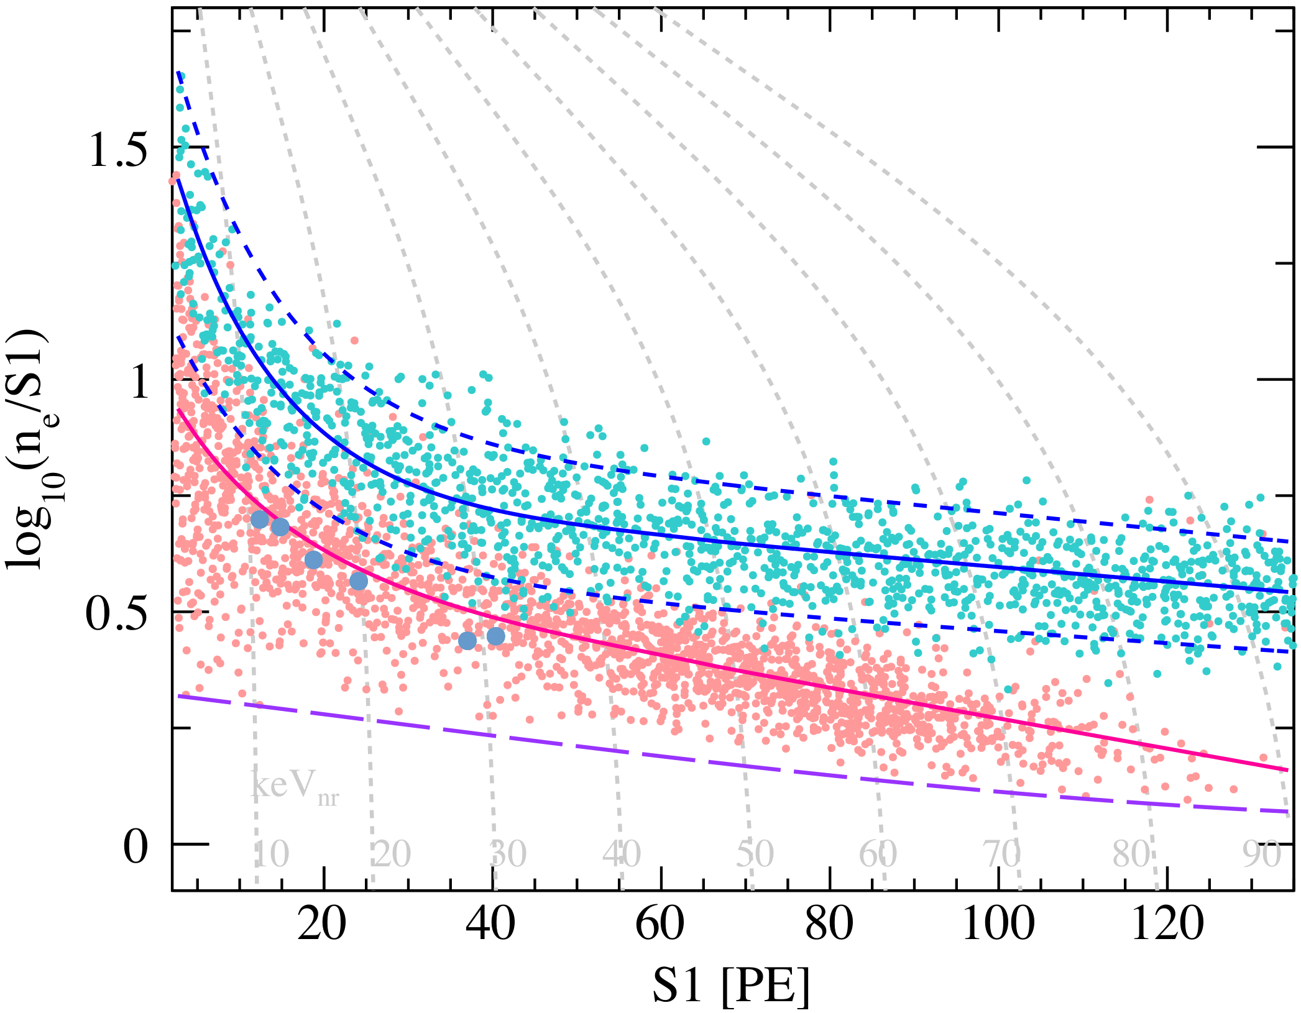
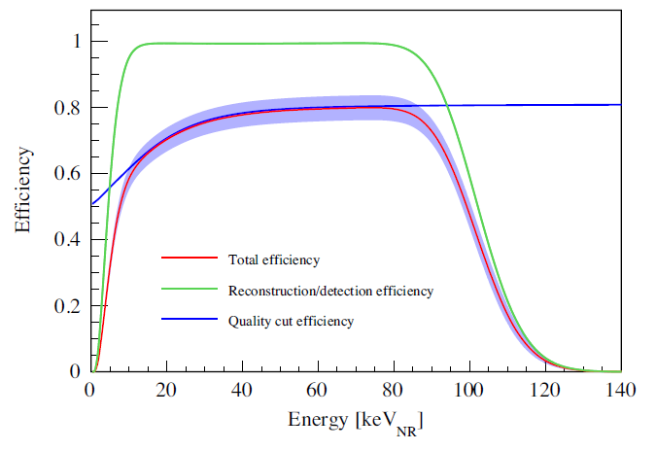
Detector Response
²²⁰Rn
D-D
ER leak ratio (below NR median curve) is 0.43%±0.18%;
Efficiencies separately determined from ER or NR calibration data are all consistent;
Notes:
This is our events distribution in the calibration data. The ER and NR band are separated with only 0.4% ER events leak below the NR median curve. On the right is our efficiency curve for WIMP search, which is about 78% at 40 keV.

Slide 14
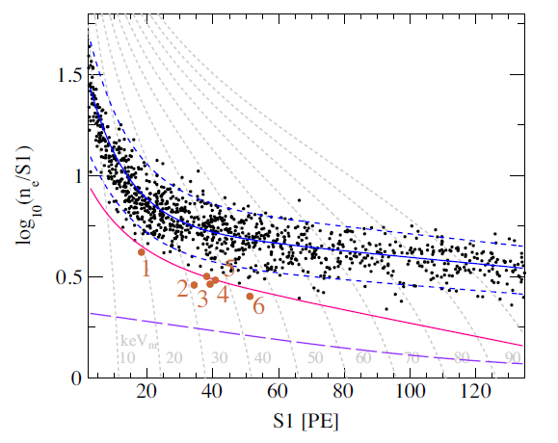
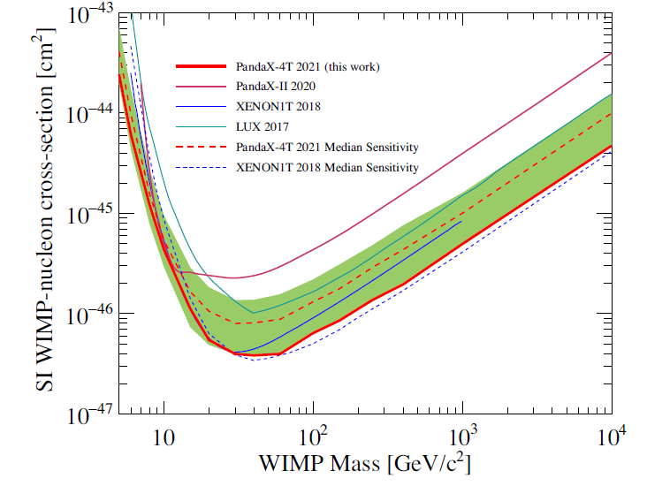
PandaX-4T first commissioning Result - WIMPs
0.63 tonne·year
Y. Meng et al. PRL 127, 261802 (2021)
1058 candidates (expected 1054±39), 6 below NR median curve (expected 9.8±0.6);
Sensitivity improved from PandaX-II final analysis by 2.9 times (30 GeV/c²);
Notes:
Finally, with 0.63 tonne year exposure, over 1000 candidates are identified in our region of interest and 6 of them is observed below the NR median curve compare to the expected background is 9.8. Therefore, no event excess above our background level. Here is our final exclusion parameter space for the spin independent WIMP-nucleon scattering. The sensitivity is improved from PandaX-II by about 3 times.

Slide 15
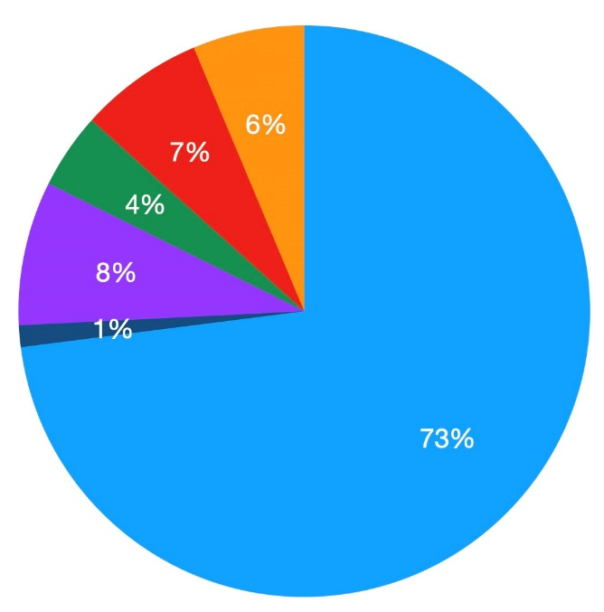
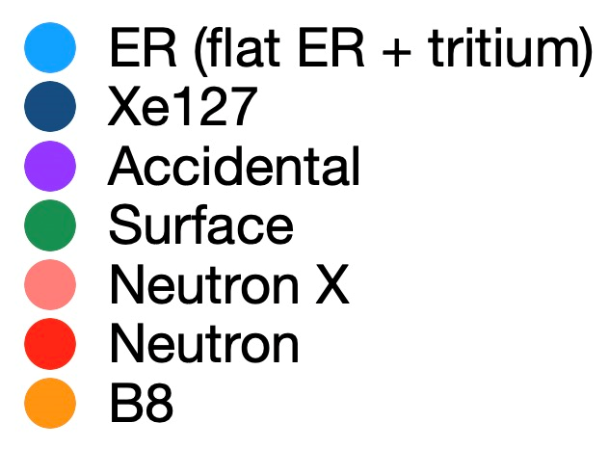
Backgrounds
Expected below-NR-median events: 9.8 (0.6) evts
ER (Rn+Kr+Material+Tritium) background dominated in the selection region;
Background per unit target is improved from PandaX-II by 4 times (<10 keV);
Notes:
We all know that background is another key issue for the dark matter search. We did a very careful background analysis and I will quickly show the result in our commissioning run. The left figure shows the background budget. You can see the ER background, including the material, Kr, Rn and tritium, is dominated in our selection region. And the background per unit target is improved from the PandaX-II by 4 times.

Slide 16
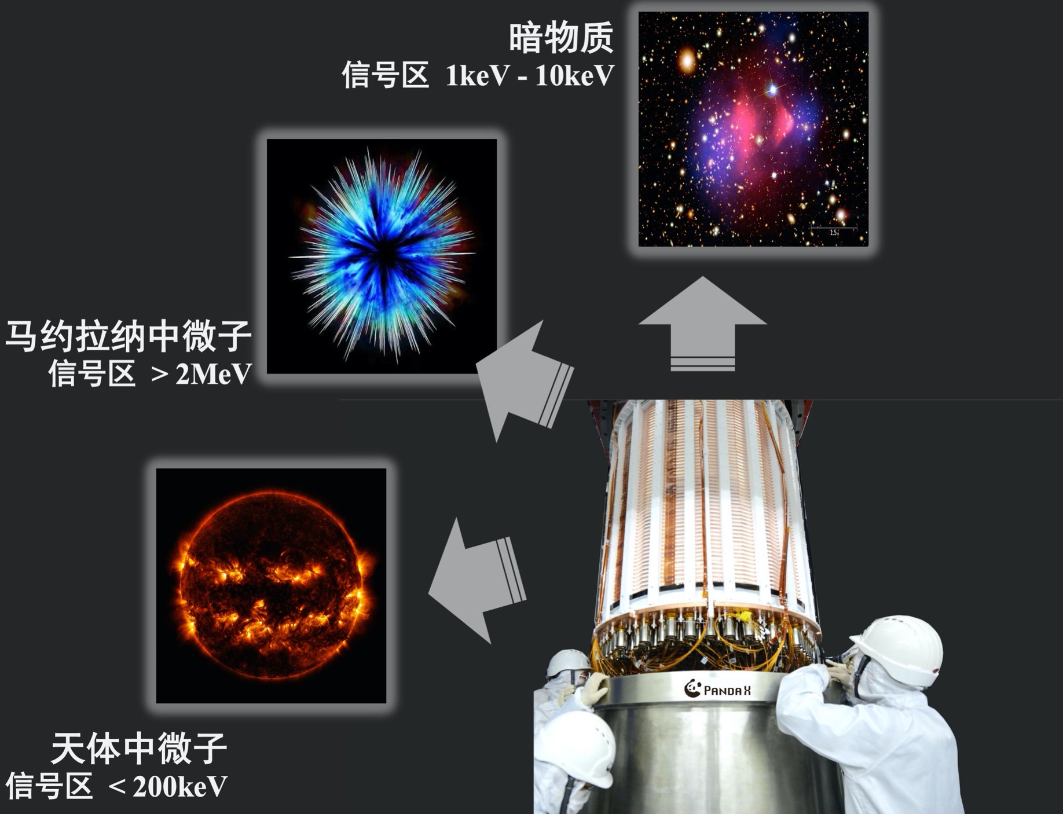
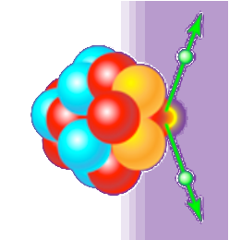
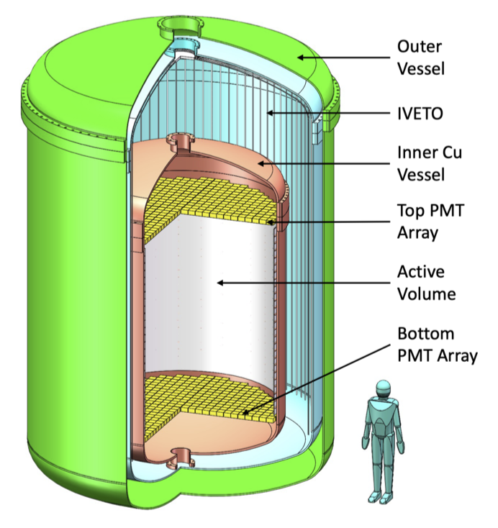
PandaX: Multi-physics Goals
Dark Matter
1 keV – 10 keV
Majorana neutrino
> 2 MeV
Astrophysics neutrino < 300 keV
Notes:
As an experiment which has multi-physics goals, The science channels of a PandaX-4T contains the particle physics, nuclear physics, astrophysics, solar physics, and cosmology.

Slide 17

¹³⁶Xe 2$υ$DBD Half-life Measurement
Research Vol 2022, 9798721 (2022)
Notes:
Beside the dark matter search, since natural xenon contains 8.86% Xe-136 (around 650kg Xe in the FV and 59.6+/-1.3kg of Xe-136), we could carry out neutrinoless and 2-neutrino double beta decay studies with the same detector and data. However, beta decay energy scales are much higher than the DM signals thus place challenges to the detector responses as shown above. We have carried out the first analysis of the two-neutrino double beta decay half-life measurement of Xenon-136 is finished with the natural xenon, that the energy region is up to 2.8 MeV.

Slide 18
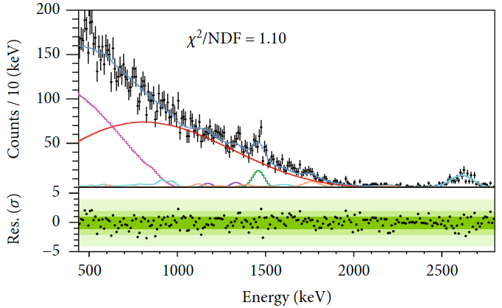
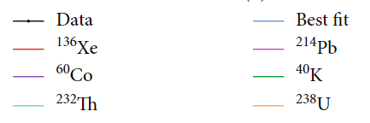
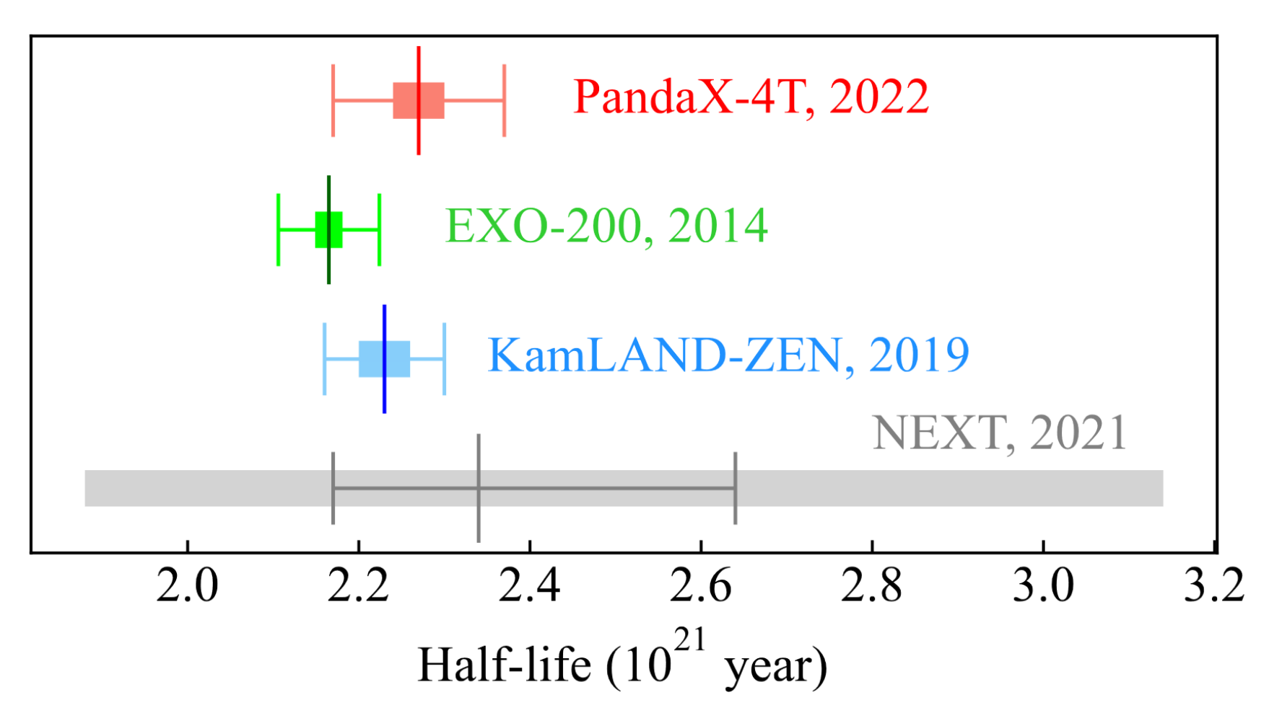
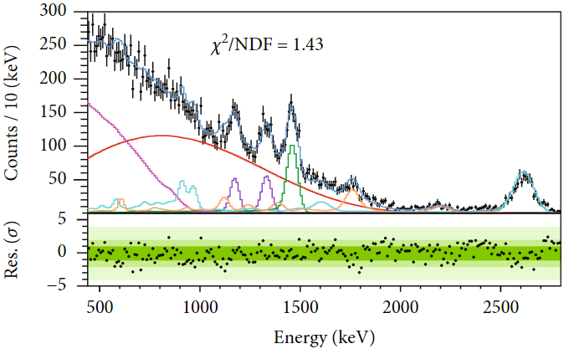
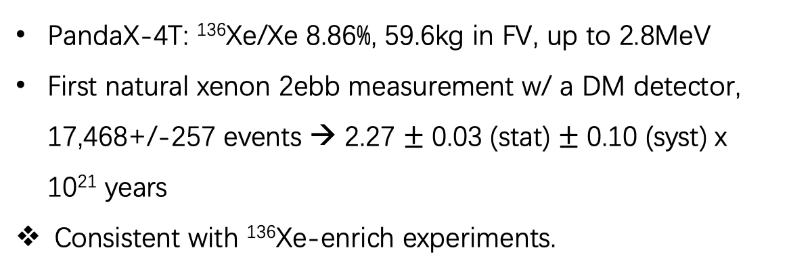
¹³⁶Xe 2$υ$DBD Half-life Measurement
Research Vol 2022, 9798721 (2022)
PandaX-4T: ¹³⁶Xe/Xe 8.86%, 59.6kg in FV, up to 2.8MeV
First natural xenon 2ebb measurement w/ a DM detector, 17,468+/-257 events → 2.27 $±$ 0.03 (stat) $±$ 0.10 (syst) x 10²¹ years
Consistent with ¹³⁶Xe-enrich experiments.
Region1
Region2+3+4
Notes:
The spectra of different detector regions are shown on the left and a likelihood fit is carried out. We found 17,468 events, which corresponds to a half-lifetime of 2.27x10²¹ years. Our result is consistent with Xe136-enriched experiments, such as EXO and KAMLAND-ZEN. And it’s a major step forward for the NLDBD search with the liquid xenon TPC, which could answer the question whether the neutrino is its own anti-particle or not.

Slide 19
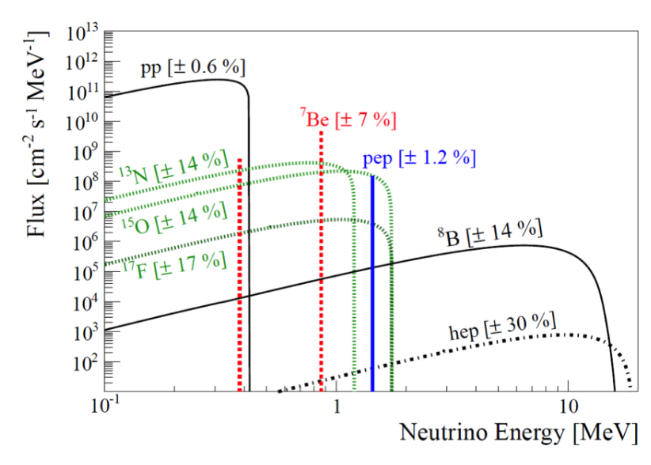
PandaX-4T Search for ⁸B CEvNS
To enhance sensitivity on ⁸B (like a 6 GeV WIMP), need to lower selection threshold (S1↓, S2 ↓)
Major challenge: Accidental background (AC, non-physical S1 and S2 randomly paired)
Blind analysis: 0.48 ton-year data, excluding data with increase of noises rate (micro-discharge)
Similar as
6 GeV WIMP
19
Notes:
As the sensitivity improves, we are approaching the solar neutrino floor, that the boron-8 analysis is first applied. To enhance the sensitivity on B8, we need to lower the selection threshold, both for S1 and S2. While the major challenge is the accidental background, often called AC, meaning the non-physical S1 and S2 which are randomly paired. We perform blind analysis with 0.48 tonne-year data, excluding those with a higher noise rate due to micro-discharge.

Slide 20
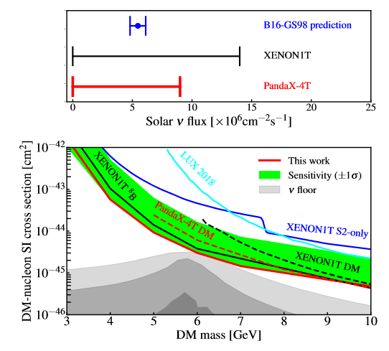
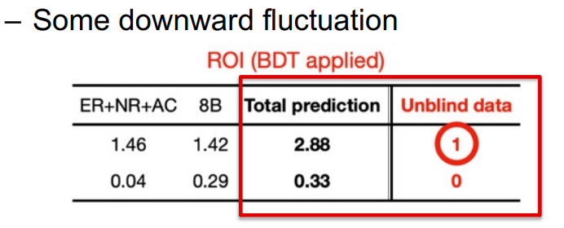
Constraints on ⁸B neutrino
W. Ma et al. PRL 130, 021802 (2023)
A multi-variate (BDT) algorithm trained to suppress AC background
Leading constraint on ⁸B neutrino flux through CEvNS
Assuming nominal ⁸B background, set strongest constraints on light WIMP of 3 -10 GeV
Notes:
To suppress the AC background, we use a multi-variate machine learning algorithm. And finally the leading constraint on boron-8 neutrino flux is achieved through the coherent elastic neutrino-nucleus scattering analysis. And if assuming nominal ⁸B background, we also set the strongest constraints on light WIMP of 3 -10 GeV mass.

Slide 21
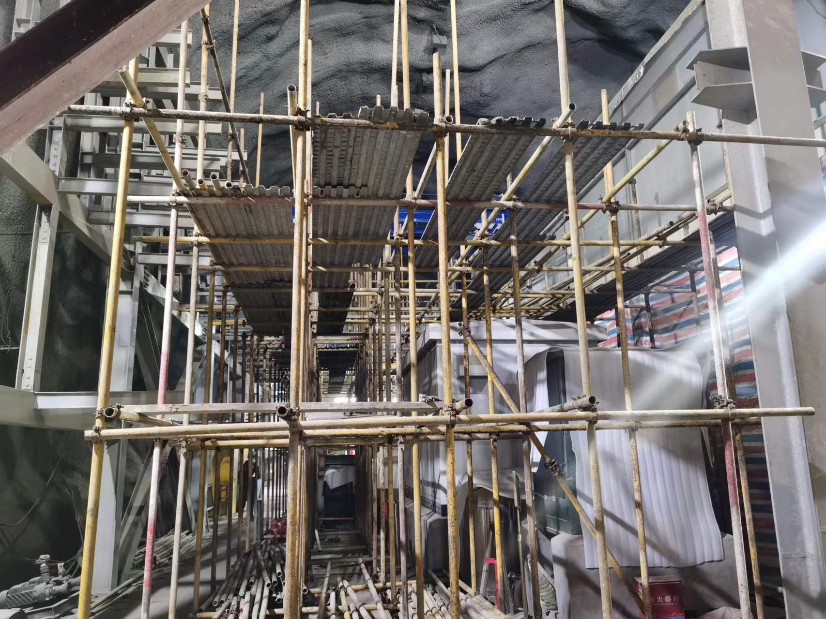

After Commissioning
Tritium identified in commissioning data
Offline xenon distillation
1st physics run (Run1)
– Data still under blind analysis
CJPL-II B2 hall construction
Detector upgrade
CJPL-II B2 Hall
Notes:
And some information after our commissioning run: as mentioned above, tritium background is identified in the commissioning data, So we perform an dedicate offline xenon distillation. After refilling the xenon back to the detector, we collected our first science run data (called Run1), and the data is still under blind analysis. we expect to release new result in the fall of this year. Now, the CJPL-II is under construction and we use this time window to upgrade our detector.

Slide 22


Tritium Removal
Preliminary estimation of tritium level (keep S2 blinded)
Extensive tritium measures planned for the next run (Run 2)
Period | Run0 Set 4 | Run0 Set 5 | Run1
Tritium Counts/day/tonne | 3.0 ± 0.3 | 1.6 ± 0.2 | 0.4 ± 0.1
Run0
Set4
Run0
Set5
Run1
Preliminary
Preliminary
Notes:
We use the Run1 S1-only data to get a preliminary estimation of tritium level, with a reduction factor of 4 compared to the end of commissioning run. Besides, extensive tritium measures are planned for the up-coming data taking.
Getter long run some effects on tritium removal (Set5 smaller): Getter (Distillation,Flashing between run0-1) combined effect

Slide 23

Future Plan: PandaX-xT
Dark Matter
1 keV – 10 keV
Majorana neutrino
> 2 MeV
  Multi-physics goals;
  With > 30 tonne liquid xenon in the sensitive volume;
  Decisive test on WIMP and key test on Dirac/Majorana neutrino;
  Stay tuned!
Astrophysics neutrino < 300 keV
Notes:
PandaX-4T is one of the new generation multi-tonne xenon experiments. We are doing intense searches for various types of physics, including DMs and neutrinos. For the future, PandaX plans to build a larger TPC which can contain at least 30 tonne liquid xenon. Please Expecting more interesting results from PandaX and we highly welcome new collaborators!

Slide 24

Future plan: PandaX-xT
“Ultimate”liquid xenon experiment
  With >30 tonne sensitive volume
  Letter-of-interest sent to Chinese funding agency
  Decisive test on WIMP and key test on Dirac/Majorana neutrino
Notes:
For the future plan of PandaX, we are aiming to build up the “Ultimate”liquid xenon experiment, refer to as the PandaX-xT. It’s an idea for using at least 30 tonne liquid xenon in the sensitive volume in a future TPC, and to perform decisive tests on WIMP and the nature of neutrino.

Slide 25


PandaX-xT R&D: Electrode and Xenon Storage
TPC: Large size high light transmission electrode
Large xenon storage system
自研高速波形采集卡（500MB/s）
Notes:
So we are making progress towards this future experiment. For example. We are testing the large size electrode with high light transmission for larger TPC. And we design a storage system for large amount of xenon gas.

Slide 26


PandaX-xT R&D: 2-inch PMTs and New Electronics
PMT:
R12699 2-inch PMTs with 4 independent anode readout;
Better time response for better waveform building;
Lower radioactivity;
Electronics:
Higher sampling rate;
Accept out-trigger mode;
Custom-developed: 14-bit, 500MS/s
 |  | R11410 | R12699 (4ch/piece)
Time Response [ns] | Rise Time | 5.5 | 1.2
 | Transit Time | 46 | 5.9
Radioactivity [mBq/pc] | Co-60 | < 2.34 | < 0.07
 | Th-232 | < 7.82 | < 0.40
 | U-238 | < 56.48 | 0.47 ± 0.11
Notes:
In addition, we will use the 2-inch square PMTs, type R12699 with 4 independent anode readouts, and could give a better position reconstruction. Its fast time response is beneficial for recoding the waveform information. The radioactivity is tested by the high-purity Ge detector and as you can see from the table here, it is much better than our 3-inch PMTs used right now. More information of this new low background PMT can be found in Dr. Yan Binbin’s talk the day after tomorrow.
In our calibration run, the much higher event rate gives us some trouble. So, in the next generation of our electronics, the custom-developed digitizer with 500 million samples per second will be used. And the out-trigger mode is also accepted as more suitable for the calibration run with a much higher rate.

Slide 27



PandaX-xT R&D: Distillation and Purification
 |  | PandaX-4T | Upgraded
Flow rate [kg/h] | Kr | 10 | 30
 | Rn | 56.5 | 856
Reduction factor | Kr | 10⁶ | 10⁸
 | Rn | 2.2 | 4.4
Magnetic driven pump
Oxygen-free copper
Low Outgassing
High flow rate
Notes:
Last but not the least about the xenon distillation and purification. Higher distillation speed is a key parameter for the large-scale liquid xenon experiment, especially for radon removal. In the next generation, two independent towers will be used and both the flow rate and reduction factor are improved. As for the next generation purification, the way is strict forward. Use the low outgassing instruments, especially for the circulation pump. Here is the picture of our magnetic-driven pump for gas circulation. Another thing is to increase the circulation speed, like using liquid xenon purification. Here I also show some ultra purity Copper that could be used for the oxygen removal.

Slide 28
Summary
PandaX-4T is one of the new generation multi-tonne xenon experiments
Intense searches for various types of physics, including DMs and neutrinos
Expecting more interesting results from PandaX
Welcome New Collaborators!
Thank You！
Notes:
Here are some take-home messages. So PandaX-4T is one of the new generation multi-tonne xenon experiments. And we have been doing intense searches for various types of physics, not only DMs, but also neutrinos. More interesting results are expecting from PandaX group, and as usual, we highly welcome new collaborators! That’s all for my talk today and thank you for listening!

Slide 29
Backups

Slide 30


Purification System
NEXT
Magnetic driven pump
Oxygen-free copper
Ref. the maximum drift time ~ 840 µs
Low Outgassing
High flow rate
Notes:
The contamination of non-noble gases, especially the electronegative gases, like the oxygen, it will absorb the electron then affect the ionization signals. The electron lifetime indicates the purity level in the liquid xenon. The best achieved electron lifetime is over 1400 us compare the maximum drift time is about 800 us.

Slide 31
Distillation System
NEXT
Preliminary
Run0
Set4
Run0
Set5
Run1
 |  | PandaX-4T | Upgraded
Flow rate [kg/h] | Kr | 10 | 30
 | Rn | 56.5 | 856
Reduction factor | Kr | 10⁶ | 10⁸
 | Rn | 2.2 | 4.4
Preliminary

Slide 32


Control of Accidental Background in ⁸B Search
Use “scrambled” real data to model accidental background
A multi-variate (BDT) algorithm trained to suppress AC background
Training/selection is blinded
postBDT: N_{obs}=1, N_{bkg}=1.6, N_{sig}=1.7
S2:300-800PE
S2:65-230PE

Slide 33

How dark is dark matter?
How dark is dark matter?
Image Credit: Public Domain

Slide 34

Luminance of Dark Matter
Residual weak EM properties
Coupling with photons
$$ℒ=Qe\overline{χ}γ^{μ}χA_{μ}+\frac{μ_{χ}}{2}\overline{χ}σ^{μν}χF_{μν}+i\frac{d_{χ}}{2}\overline{χ}σ^{μν}γ^{5}χF_{μν}+b_{χ}\overline{χ}γ^{μ}χ∂^{ν}F_{μν}+a_{χ}\overline{χ}γ^{μ}γ^{5}χ∂^{ν}F_{μν}$$
magnetic dipole electric dipole charge radius anapole
millicharge
tree-level
higher-order loop-level
Notes:
Next, I’d like to tell you our efforts on constraining the luminance of dark matter, or more intuitively, how dark is dark matter. By saying the luminance, I am talking about the possible residual weak electromagnetic properties or the possibly coupling with photons. We studied those EM properties systematically, including the millicharge, the electric and magnetic dipole, the charge radius and the anapole, each correspond to a term in the full Lagrangian.

Slide 35



Photon-mediated Interaction
Nuclear recoil signature
  Charge radius: similar to SI
  Millicharge: $1/E_{R}^{2}$
  MD and ED: $1/E_{R}$
30 and 100 GeV/c² DM
recoil energy
Notes:
Those properties can match to non-relativistic effective field theory and further link to the nuclear recoil signatures. The typical shape of the charge radius recoil spectrum is similar to the standard SI. While the millicharge related spectrum is much sharper. The right plot shows how these signals distribute in the two-dimensional parameter space.

Slide 36


Results from Xenon Recoil Data
First experimental constraints on DM charge radius
  4 orders of magnitude smaller than neutrino
Other EM properties
  up to 3 – 10 times improvement
X. Ning et al. Nature (2023)
Notes:
Finally, using the xenon recoil data, we obtain the first experimental constraints on DM charge radius, which is 4 orders of magnitude smaller than the neutrino. And we also get an up to 3-10 times improvements for other EM properties, compare with previous measurements. These results have been published in Nature this year.

Slide 37




DM-$υ$ Conversion
$$E_{R}=\frac{m_{χ}^{2}}{2(m_{T}+m_{χ})}$$
Characteristic mono-energetic signal:
Xe-nucleus targets, m_{x} = 40 MeV, E_{R} ~ 6.5 keV
Electrons targets, m_{x} = 40 keV, E_{R} ~ 1.5 keV
40 MeV/c² DM-nucleus
ν
J. Dror et al, PRL 124, 181301 (2020)
Notes:
Besides the search of standard WIMP, we also studied many kinds of exotic [igzotik] dark matter models. In this talk, I will mention the dark matter-neutrino conversion as one example. In this exotic process, Dark matter particle is absorbed entirely, with an out-going neutrino. Similar to WIMP scattering process, it will induce detectable nuclear recoil (NR) and electronic recoil (ER) signals, respectively. It will generate characteristic mono-energetic signal, which is quite different from our known backgrounds.

Slide 38





Mono-energetic Signal Search
$χ+$Xe $→υ+\text{Xe}$
$χ+e$ $→υ+\text{e}$
e$ν→χ$e, ee$→χν$
L. Gu et al. PRL 129, 161803 (2022) , Editors’ Suggestion
D. Zhang et al. PRL 129, 161804 (2022) , Editors’ Suggestion
Notes:
We didn’t observe an excess either for the nuclear recoil events or the electronic recoils. And Our result is much more sensitive than the collider search and consistent with the astrophysical observations. Both results have been published on PRL.
(level of fine-tuning of UV model to satisfy CMB); Existing constraints from relic density (overproduction e$ν→χ$e, ee$→χν$) ，cosmological observation of Universe expansion ($χ→3ν)$ and X-ray satellites ($χ→γγν）$

Slide 39



Photon-mediated Interaction
Matched to non-relativistic EFT
  Nuclear response function N. Anand, A. Fitzpatrick, W. Haxton PRC 89, 065501 (2014)
Nuclear response function:
full-basis shell-model calculations (GCN5082 interaction).
No truncation (9 billion Slater determinants)!
Eugenio Del Nobile Phys. Rev. D, 98(12), Dec 2018
A.Liam Fitzpatric et al. JCAP, 2013(02):004004, Feb 2013
Bradley J. et al. JHEP 2019(4), Apr 2019
Chiara Arina et al. Eur. Phys. J. C, 81(3):223, 2021
A.Liam Fitzpatric et al. arXiv: 1211.2818
Fady Bishara et al. JHEP 11:059, 2017

Slide 40


Exclusion Limits of Neutral current FDM Absorption (NR)
No significant excess above 1σ. 90% C.L. upper limit within the ±1σ sensitivity band (slight downward fluctuation in the DM mass range [40,55] MeV/c², power-constrained to −1σ)
The strongest limit achieved is 1.4×10⁻⁵⁰ cm² at a fermionic dark matter mass of 35 MeV/c²
Constraints on the coupling $g_{χ}$ to the order of ${10}^{−10}{\left(TⅇV⋅cm\right)}^{0.5}$
Notes:
灰色区域标示出了对撞机实验对于Z’的排除限制，红蓝的彩色曲线给出了PandaX-4T实验对于吸收散射截面和耦合常数的限制，我们也同时给出了±1σ的灵敏度区间，在40~55 MeV的暗物质质量范围有轻微的downward fluctuation, 并且已经被power-constrained到−1σ

Slide 41


Exclusion Limits of FDM Absorption on Electron
$σ_{eχν}^{A}≈3σ_{eχν}^{V}$ w.r.t. the same $Λ$
A general fermionic (sterile neutrino-like) dark matter absorption on electron.
In soft tension with XENON1T’s ER excess, consistent with XENONnT latest result.
A strong sensitivity to vector and axial-vector mediators, complementary to astrophysical constraints, but much less theoretical uncertainties.
Competitive constraint in 20-55 keV/c² .

Slide 42


Ionization-only Search
Abandon the scintillation signal cut
  ROI: S2 [60, 200] PE
  Threshold down to ~100 eV (from ~1 keV)
  Tight quality cuts on the ionization signal
Background components
  Micro-discharging (MD)
    Small charge, strong run-condition dependence
  Cathode activity
    Large charge, large pulse-shape width
  Data-driven estimation
    Validated in control region
control region
Notes:
I would also like to show our efforts on light dark matter searching, with the ionization-only signal. To achieve this, we focus on a very low signal range of 60 to 200 PE for ionization charge, which corresponding to an energy threshold down to 100 electro-voltz. For the first time, we study the background component in detail and identify the micro-discharging and cathode activity from the control region.

Slide 43



Constraints on light dark matter
Blind analysis of 0.55 tonne-year exposure
Most stringent constraints are derived
  DM-electron interaction, $2×{10}^{−41}$cm²
S. Li et al. arXiv:2212.10067 Accepted by PRL, Editors’ Suggestion
Notes:
By taken all the background components into account, we derive the most stringent constraints for the DM-electron interaction down to the 10^-41 centimeter square level. This result have been accepted by PRL recently and will get published soon.

